Slide 2
Building the First Colonies
Chapter 4

Slide 3
Lesson 1: The Spanish Colonies
Spain had sent many explorers to the Americas and claimed large amount of land
Spain created colonies to protect its land from other Europeans and the Native Americans
New Spain and Mexico city were two Spanish colonies
What is a colony?
“A land ruled by another”

Slide 4
Spanish Colonies continued
The wealth of the New World motivated more settlers to come
Some began plantations and they used Native Americans and African Americans as slaves
Do you remember Bartolome de Las Casas and his defense of the Native Americans?
Spanish soldiers built forts
Missionaries built missions
Some settlers built large homes

Slide 6
Lesson 2:The Virginia Colony
The English wanted their own colonies. Why?
They wanted to compete with other European countries in the New World
They wanted wealth, land, and raw materials.

Slide 7
Roanoke The Lost Colony What a Mystery!
In 1584 Queen Elizabeth wanted Walter Raleigh to North America to form a colony
He sent John White to form a colony at Roanoke in 1587
When White returned three years later all of the settlers were gone! No one knows why!
Why is Roanoke important? Historical Significance!
HS: The first attempts by the English to colonize North America AND The first English child born in North America -Virginia Dare
What did it mean for the future?

Slide 9
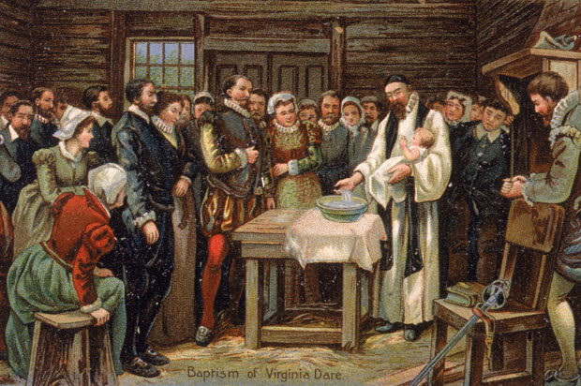

Slide 10
What do you think happened to the Roanoke colonists?

Slide 11
http://www.youtube.com/watch?v=4p-bWA1FOqs
http://www.youtube.com/watch?v=Ne2tzfxQ6T4

Slide 12
Jamestown (1607)
Jamestown was settled in 1607 by the English
The Virginia Company helped pay for the trip in hopes of making money and finding gold
John Smith was the leader –”Anyone who would not work did not eat” HS: led Jamestown and wrote A Description of New England which inspired others to go to the New World
Gold was never found
John Rolfe brought tobacco to Virginia which was a cash crop and a very important export to England
Indentured servants did much of the work
Eventually African slaves were brought to Virginia to work
HS: England’s first permanent colony

Slide 13
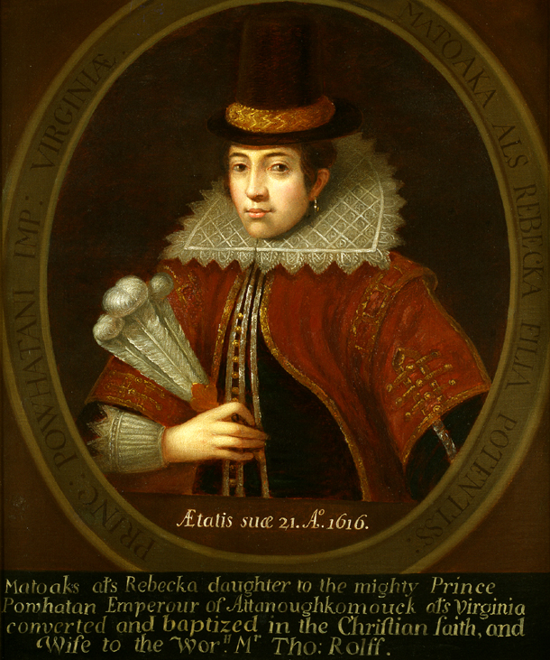
Pocahontas
Pocahontas was a member of the Powhatan tribe and the daughter of Chief Powhatan
She is credited with saving the life of John Smith
She married an Englishman John Rolfe –HS??
HS: During her lifetime she helped to create peace between the English and the Powhatan and she showed how there could unity between the English and the Native Americans.
Can we think of anyone else who was/is a peacemaker like Pocahontas?

Slide 14
A legislature (lawmaking group), The House of Burgesses was created to govern Jamestown
Only men who owned property could vote –women, indentured servants, and slaves could not
The Powhatan Wars broke out between the colonists and the Powhatan tribe (the Native Americans in the area) as the colonists took more land
Jamestown became a royal colony meaning it was owned by the King of England, King James

Slide 15
