Slide 1
The Plains

Slide 2
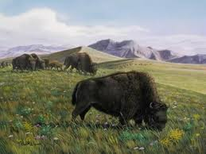
Natural Resource – Buffalo

Slide 3
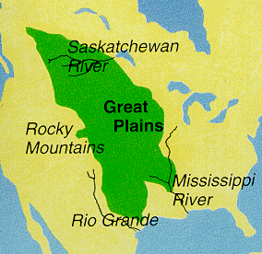
Life on the Plains
Interior Plains between Mississippi River and the Rocky Mountains.

Slide 4
Buffalo – most important natural resource
Gave the Plains groups what they needed to make clothing, tools, utensils, and shelters.
Made clothing and moccasins.
Used every part of the buffalo for their daily life

Slide 5
Nomadic Society
Wood is scarce on the Plains, and other sources of fuel must be used.
People of the Plains built shelters that were easy to move because they were always moving to follow buffalo herds.
Tepees were built from wooden poles set in a circle and tied together. They were topped with buffalo skins (natural resources) .

Slide 6
Culture on the Plains
Ceremonies were held to celebrate and give thanks for the corn harvest.
A ceremony is a celebration to honor a cultural or religious event.

