Slide 1
The Eastern Woodlands

Slide 2
Life in the Eastern Woodlands
People built their villages along the banks of rivers and streams.
All groups of Native Americans of the Eastern Woodlands shared the common natural resource of trees. They were used to make canoes and shelters, weapons, and food.
Division of labor in the Eastern Woodlands – women prepared the food, and men hunted animals for food. This was to produce more goods.

Slide 3
The Iroquois
Eastern Woodland groups were grouped by the languages they spoke:
Algonquian language people lived on the Coastal Plain.
Iroquoian-speaking lived farther inland.
Iroquoian groups (Five Nations) – Great Lakes
The Mohawk –largest cultural group
The Oneida
The Onondaga
The Cayuga
The Seneca

Slide 4
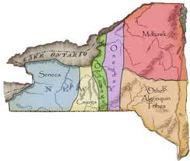
The Iroquois Five Nations

Slide 5
Iroquois Villages
They lived in shelters called longhouses – poles were cut from trees, are bent and covered with bark.
Three Sisters crops – corn, beans, and squash.
Used wampum to make beaded designs and was traded for goods.
The Iroquois League
Five Nations united as a group in A.D. 1570
Its purpose was to settle disputes among the people peacefully.

Slide 6
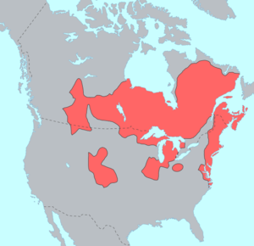
Algonquian – Coastal Plain and Great Lakes

Slide 7
The Algonquian
Algonquian Groups – all live on the Coastal Plain
The Delaware
The Wampanoag
The Powhatan
Some built longhouses, and others built bark covered shelters called wigwams. Trunks of trees were bent, tied together to make a dome shape, and covered with bark.
Fish was an important resource, not crops. They built canoes to fish the rivers.
They used animal bones and wood to make hooks and fishing traps.

