Slide 1
Farms and Seaports of the Middle Colonies
Ms. Boucher

Slide 2
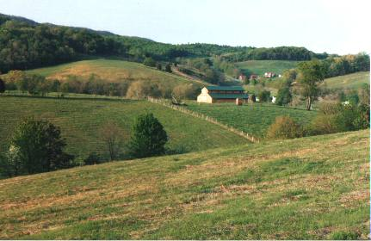
Farmlands

Slide 3
Farmlands
Fertile soil.
Wheat fields were common.
Wheat, corn, and rye were the common crops.
Dairy cows ate the grass.
Pigs ate acorns and berries.

Slide 4
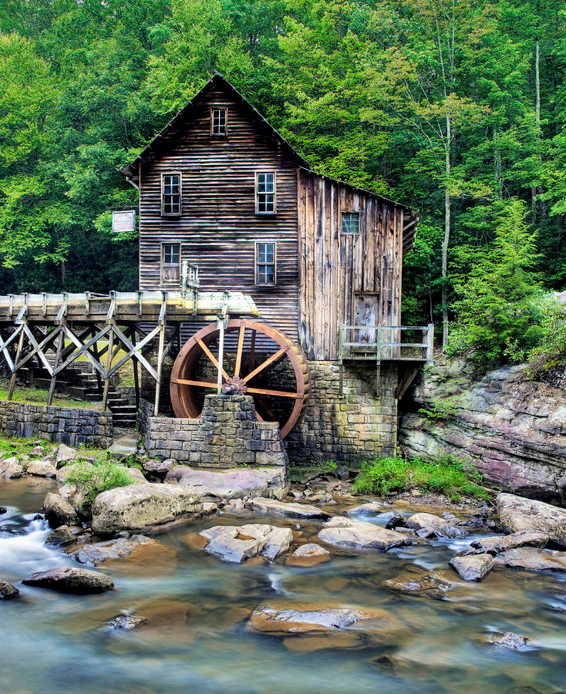
Gristmill
Ground grain into flour.

Slide 5
Port Cities
Major trade centers for the Middle Colonies.
The prosperity of the Middle Colonies depended on the ports.

Slide 6
New York City
Hudson River made trade easy.
Port harbors along the East River was a good place for ships to dock.
Farmers, fur traders, and lumber workers traded their goods in New York City.

Slide 7
Philadelphia
City built along the Delaware River.
Crops went to merchants to sell.
Ships would sail into the Delaware Bay and then across the Atlantic.

Slide 8
Exports and Import
What is an export?
What is an import?
Exported: furs, salted meat, wheat, grains and lumber.
Imported: furniture, tea, gunpowder, medicines, and metals.

Slide 9
Colonial Jobs
Variety of different jobs.
What is an artisan?
Jobs include farming, shipping, and ironworking.

Slide 10
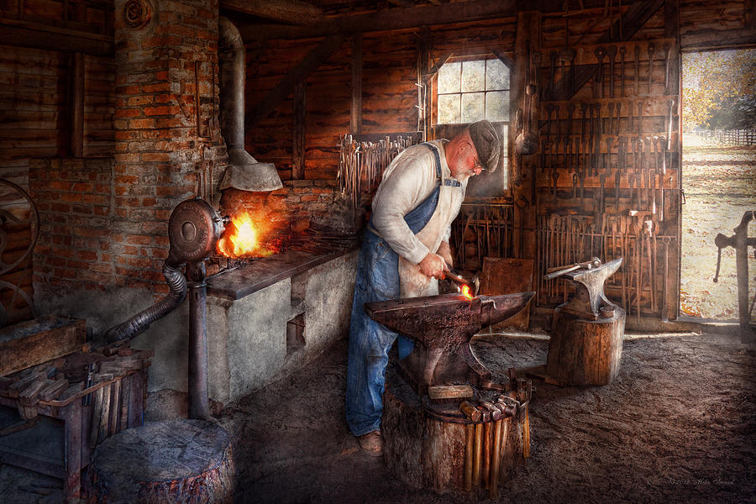
Blacksmith
Used iron to form horseshoes and tools.

Slide 11
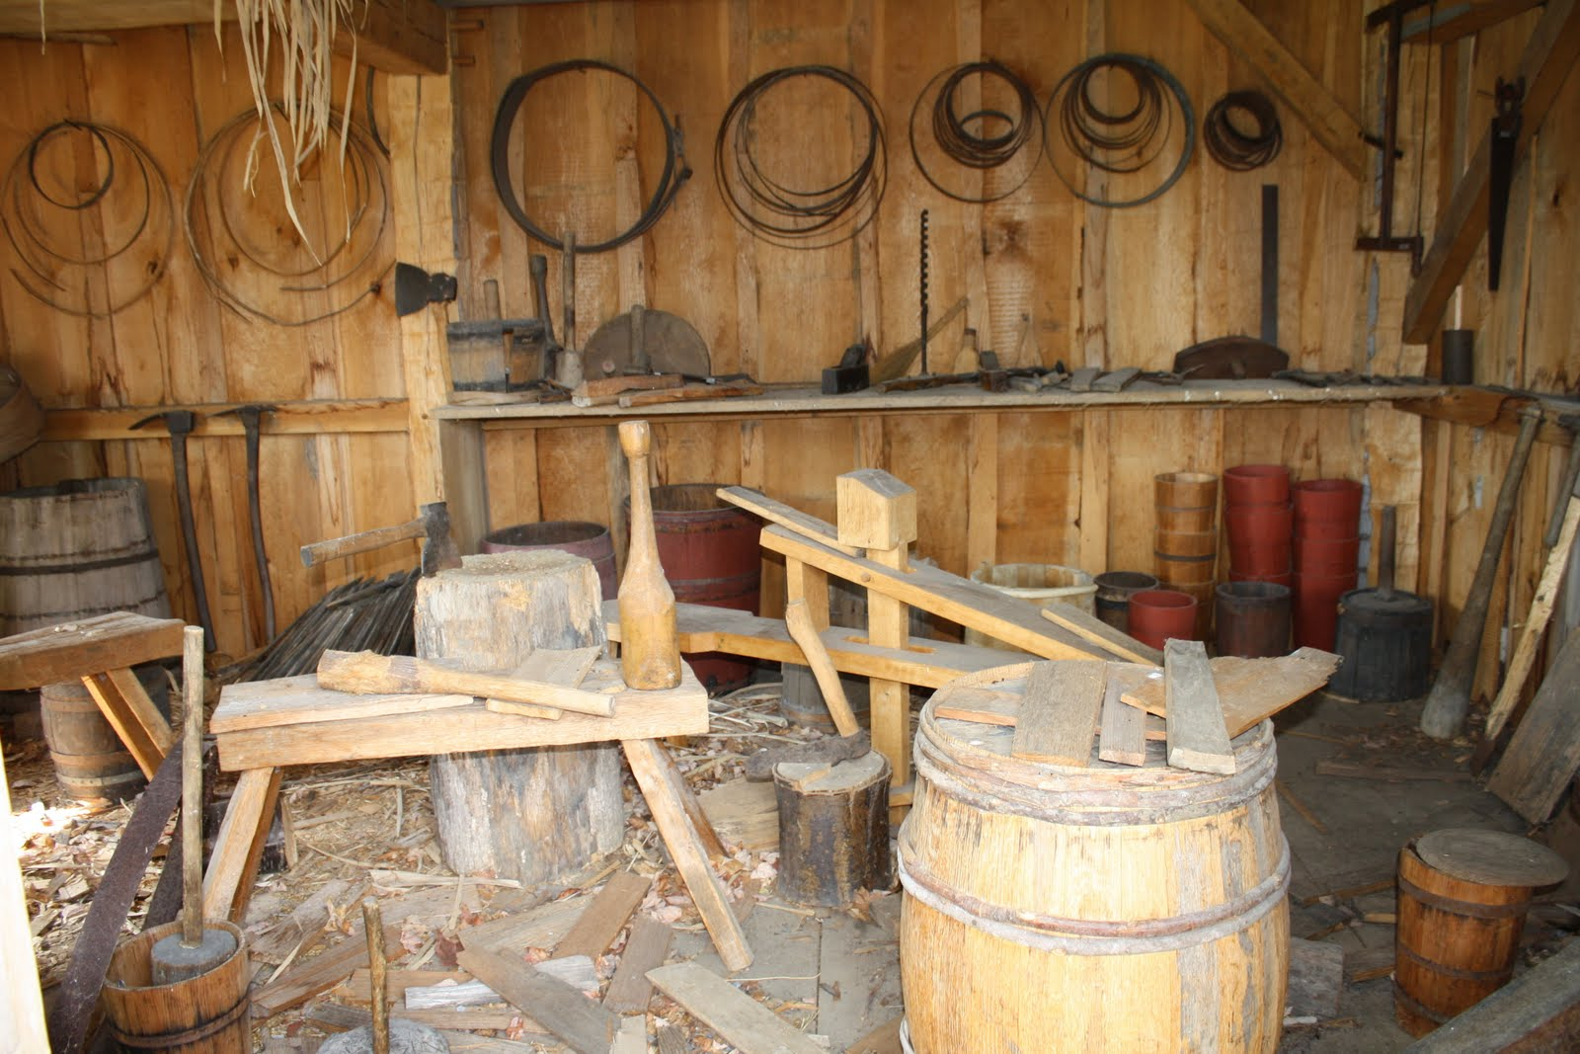
Cooper
Made barrels out of wood.

Slide 12
More Colonial jobs
Carpenters- Used wood to build houses and ships.
Bricklayers- Used stone and clay to pave streets and raise buildings.
Dress makers- Used wool, linen, and cotton to make clothing.
Tanners- Turned animal skins into leather.
Cobblers- Used leather to make shoes.
Chandlers- Used tallow (animal fat) to make candles.

Slide 13
Learning the trade
Some people went to school to become a lawyer, banker, or minister.
Other people became apprentices to learn their trade.
What is an apprentice?

Slide 14
Activity
Students will get into groups of two.
Each group will get a colonial job.
Students will write a story of what the life of a person with that job would look like.
What materials would they need to make their product?
How do they make their product?

