Slide 1
Lesson 3: The Middle and New Kingdoms

Slide 2
The Middle Kingdom 2050 BC -1750 BC
Pharaohs lost power at the end of the Old Kingdom
The Old Kingdom fell around 2200 BC
The Middle Kingdom began when Pharaoh Mentuhotep II united Egypt under one ruler again
The Middle Kingdom ended when internal disputes kept the pharaohs from maintaining control
The Hyksos invaded in the mid 1700s and ruled Egypt for 200 years

Slide 3
The New Kingdom: 1550 BC-1050 BC
The New Kingdom began when Pharaoh Ahmose united Egypt
The New Kingdom was when Egypt reached “the height of its power and glory” p.97
During this era the Egyptians created an empire in order to protect themselves from future attacks
The Egyptians took over the Hyksos lands and the eastern shore of the Mediterranean
Conquest made Egypt wealthy for example the Kushites sent gold, leopards skins, and precious stones to the pharaoh each year
Conquest expanded Egyptian trade routes

Slide 4
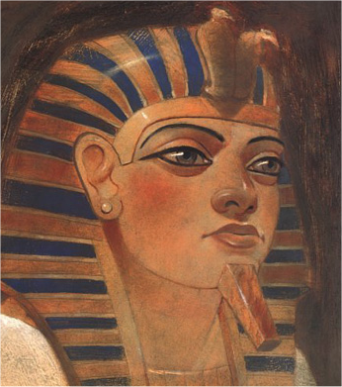
Queen hatshepsut: ruled 1472-1458 BC
She was the Queen of Egypt and a very powerful female pharaoh
She dressed as a man and took over the throne until her stepson became old enough to rule
She expanded Egyptian trade
She used her wealth to build monuments and temples, most important the temple built near Thebes

Slide 5
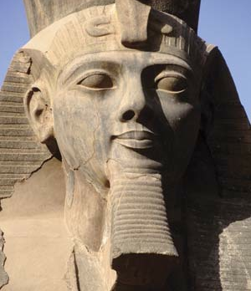
Invasions
In the 1200s BC Ramses the Great was a great military leader
He made treaties and built forts to strengthen his empire
After Ramses’ death Egypt was invaded and in about 50 years the Egyptian Empire had fallen

Slide 6
Work and Daily Life

Slide 7
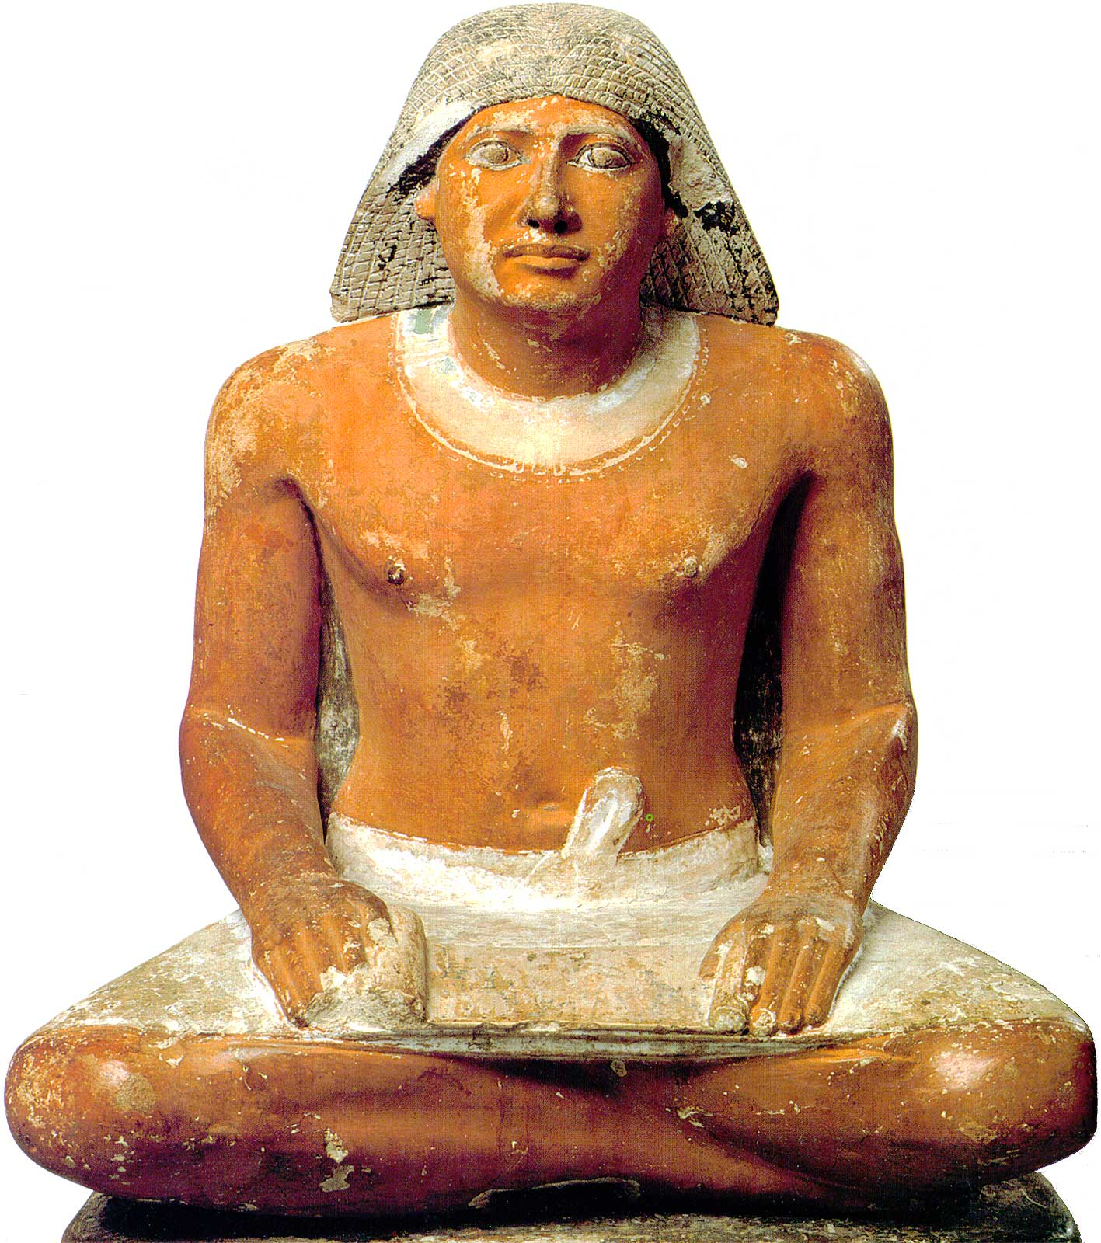
Scribes
Scribes were very honored in Egyptian culture
They kept records and accounts, also they copied religious and literary texts
What would we know about Egyptian culture today if there had not been scribes?

Slide 8
Artisans, Artists and Architects
These workers were very skilled
They included “sculptors, builders, carpenters, jewelers, metal workers, and leather workers” p.99
They created items such as “statues, furniture, jewelry, pottery, and footwear
They designed temples and tombs and palaces
Artisans were very highly respected in Egyptian culture

Slide 9
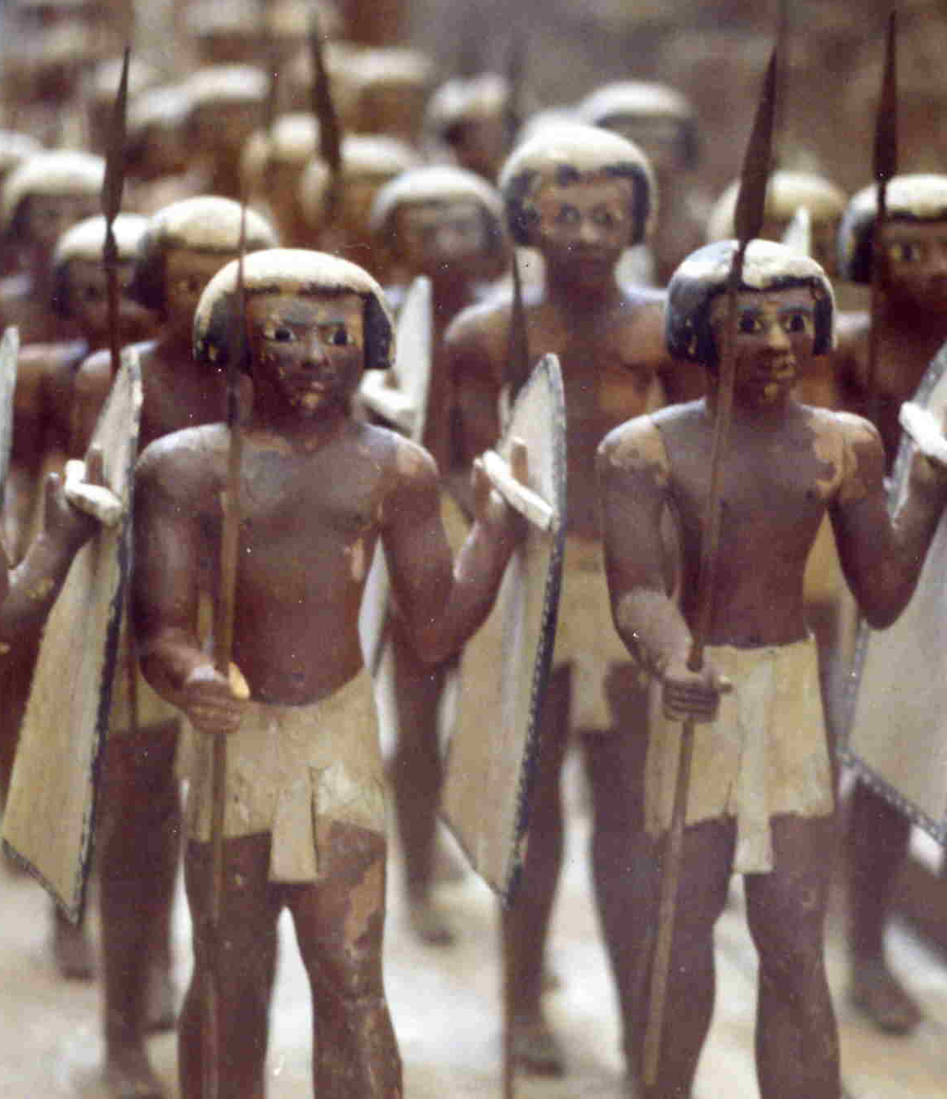
Soldiers
The Egyptians created a professional army after the Middle Kingdom
Soldiers received land and treasure they captured as payment

Slide 10
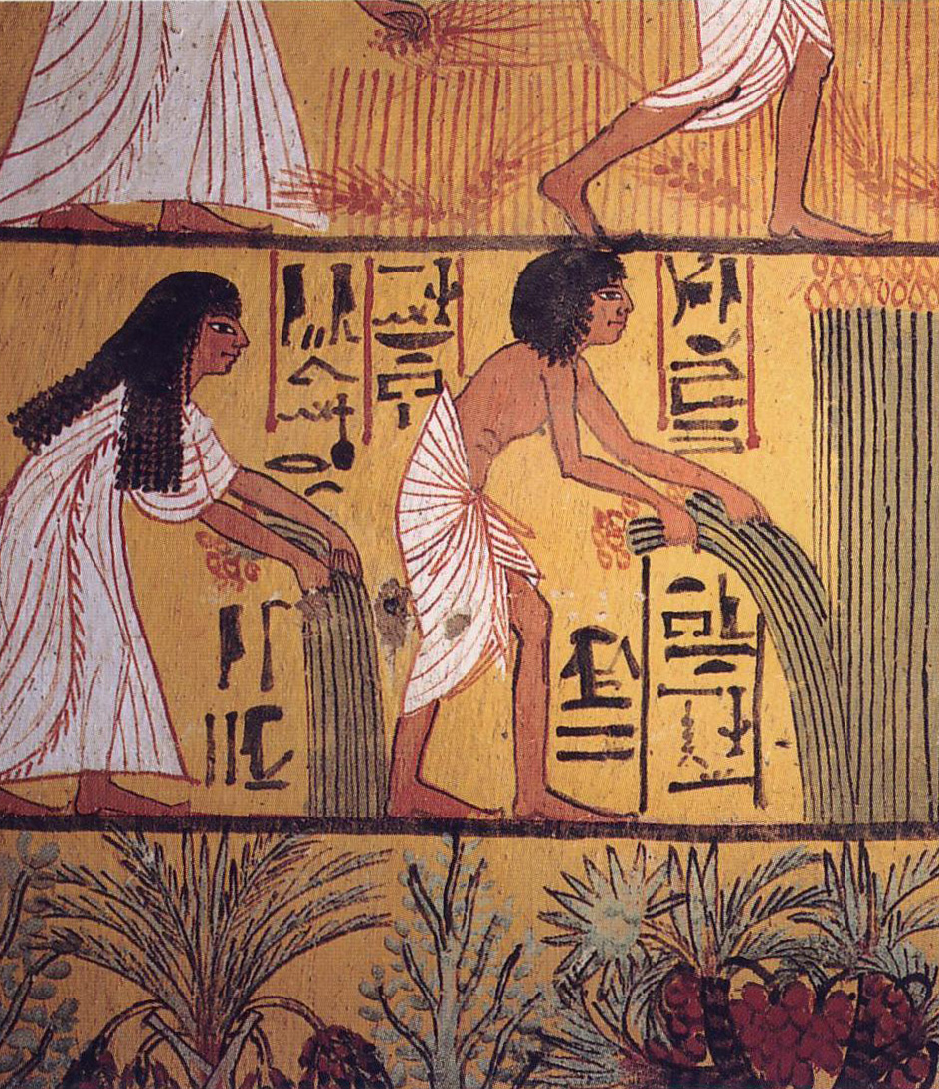
Farmers and Other peasants and slaves
Farmers and peasants made up most of the Egyptian population
Farmers had to pay crops as taxes to the pharaoh and also had to serve working on building projects or in the army
Slaves also farmed, worked on projects, and worked in households
Occasionally they could earn their freedom and they have some rights

Slide 11
Consider…
How did the Egyptian social structure influence Egyptian society?
How did each role influence the others?

