Slide 1
Roberto Clemente Althea Gibson Sports and Athletes Impact on Culture Slide 1
PowerPoint created by Lisa Looney
Scio Central School
Scio, New York

Slide 2
Roberto Clemente
Slide 2

Slide 3
What I Infer: What I Notice: What I Wonder
Summary: physical description, characteristics, era, sport played
Slide 3

Slide 4
Roberto Clemente
“Any time you have the opportunity to make a difference in this world, and you don’t do it, ou are wasting your time on this earth.”
Slide 4

Slide 5
Roberto Clemente
http://www.biography.com/people/roberto-clemente-9250805
http://www.robertoclemente.si.edu/
http://www.sites.si.edu/images/exhibits/Roberto%20Clemente/slideshow/index.htm
Slide 5

Slide 6
Slide 6

Slide 7
Slide 7

Slide 8
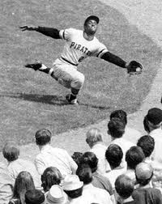
Slide 8

Slide 9
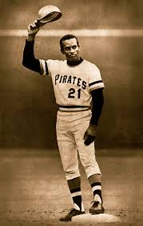
Slide 9

Slide 10
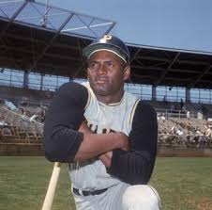
Slide 10

Slide 11
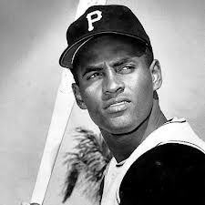
Slide 11

Slide 12
Althea Gibson
Slide 12

Slide 13
What I Infer: What I Notice: What I Wonder
Summary: physical description, characteristics, era, sport played
Slide 13

Slide 14
“I hope that I have accomplished just one thing: that I have been a credit to tennis and my country.” —Althea Gibson
“I always wanted to be somebody. If I made it, it’s half because I was game enough to take a lot of punishment along the way and half because there were a lot of people who cared enough to help me.” —Althea Gibson
Slide 14

Slide 15
“I don’t want to be put on a pedestal. I just want to be reasonably successful and live a normal life with all the conveniences to make it so. I think I’ve already got the main thing I’ve always wanted, which is to be somebody, to have identity. I’m Althea Gibson, the tennis champion. I hope it makes me happy.”
—Althea Gibson
Slide 15

Slide 16
“No matter what accomplishments you make, somebody helped you.”
—Althea Gibson
“In the field of sports you are more or less accepted for what you do rather than what you are.”
—Althea Gibson
Slide 16

Slide 17
“In sports, you simply aren’t considered a real champion until you have defended your title successfully. Winning it once can be a fluke; winning it twice proves you are the best.”
—Althea Gibson (from http://womenshistory.about.com/od/gibsonalthea/a/Althea-Gibson-Quotes.htm)
Slide 17

Slide 18
“Shaking hands with the Queen of England was a long way from being forced to sit in the colored section of the bus going into downtown Wilmington, North Carolina.”
—Althea Gibson, from her autobiography I Always Wanted to Be Somebody, 1958
Slide 18

Slide 19
Althea Gibson
http://www.biography.com/people/althea-gibson-9310580
http://www.history.com/this-day-in-history/althea-gibson-is-first-african-american-to-win-wimbledon
Slide 19

Slide 20
Slide 20

Slide 21
Slide 21

Slide 22
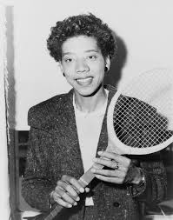
Slide 22

Slide 23
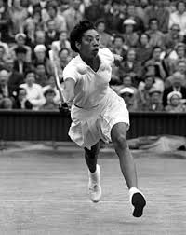
Slide 23

Slide 24
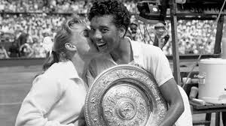
Slide 24

Slide 25
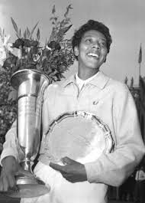
Slide 25

Slide 26
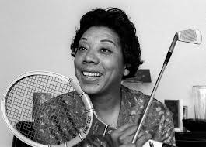
Slide 26

Slide 27
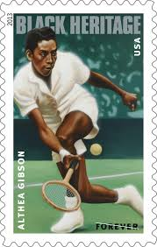
Slide 27

