Slide 1
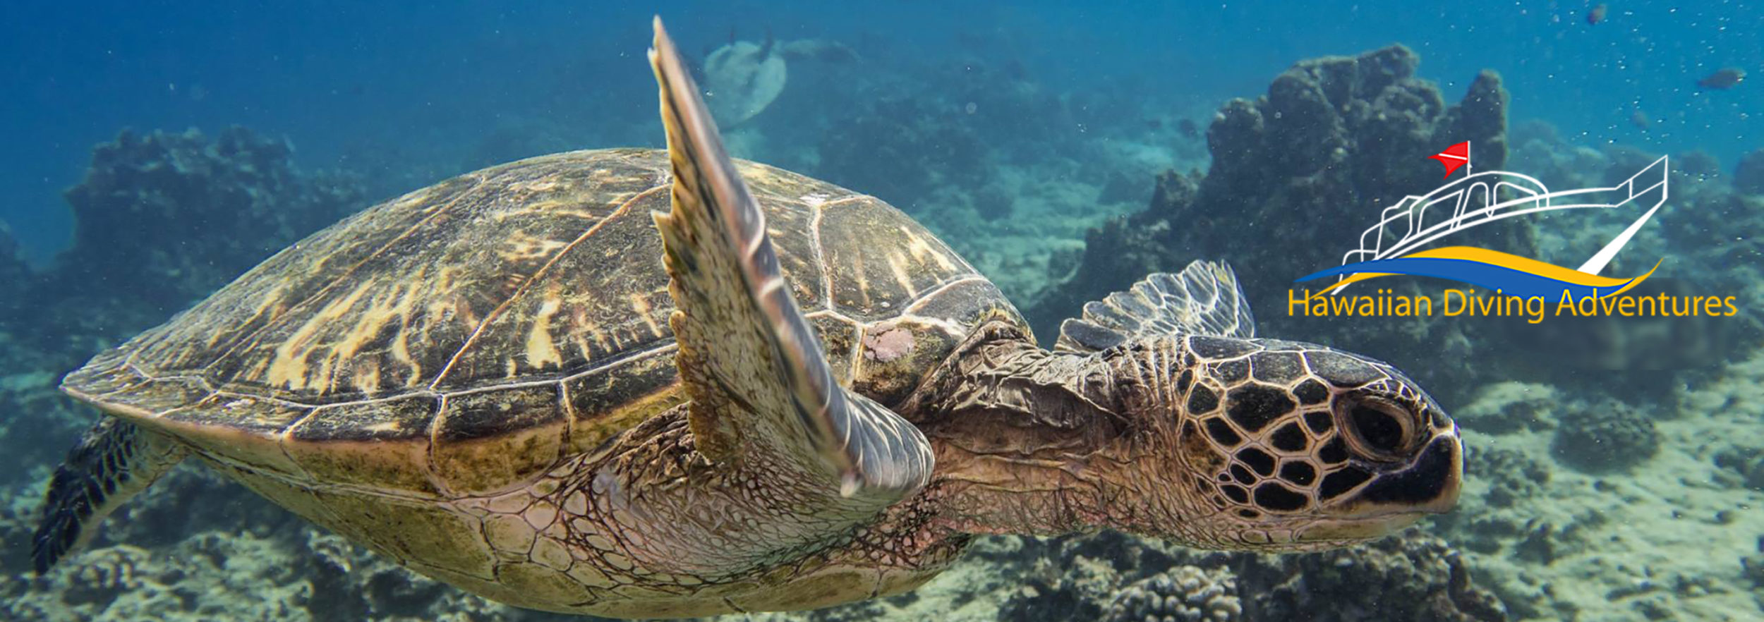
Adventures in Hawaii
Written by: Jordan Baker
Designed by: Jordan Baker
Adventure on: Hawaii

Slide 2
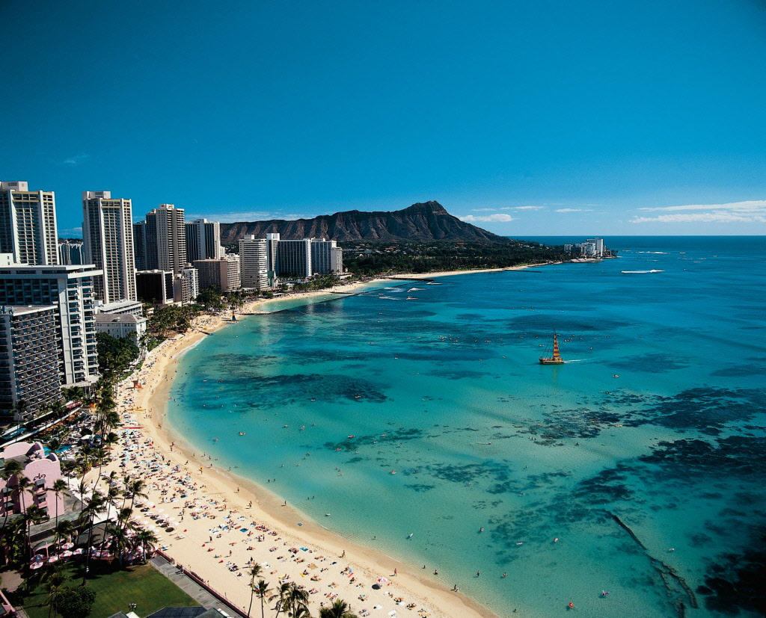
Introduction
This story will take you on a journey through Hawaii and keep you entertained throughout the story. It will tell you places to go and tell you things that you could do in the world of Hawaii.

Slide 3
Table of Contents
Slide One: Table of Contents
Slide Two: Introduction
Slide Three: Surfing in Hawaii
Slide Four: Climbing
Slide Five: Zip Lining
Slide Six: Fishing
Slide Seven: Swimming
Slide Eight: Food
Slide Nine: Hotels
Slide Ten: Snorkeling
Slide Eleven: Conclusion

Slide 4
Surfing in Hawaii
If you want to know how to surf in Hawaii,
then go to Kahuluu to learn how to surf.
They give lessons on how to surf. They teach you how to swim so if you jump off the board you won’t drown.

Slide 5
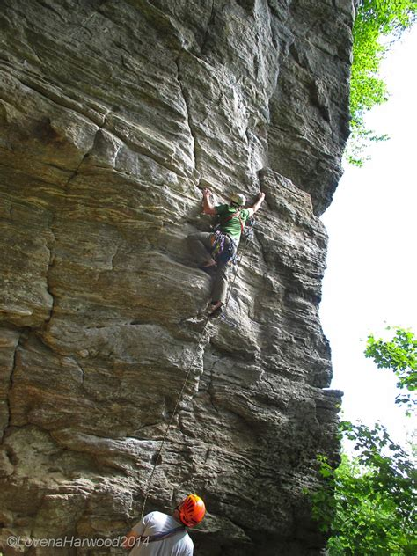
Climbing
In Hawaii there are many mountains and volcanoes. If you want to climb mountains or volcanoes you need some gear. Maybe just maybe the Hawaiian people might have some supplies for you to use for climbing. You could go to Pawtuckaway State Park and start your adventure to rock climb.

Slide 6
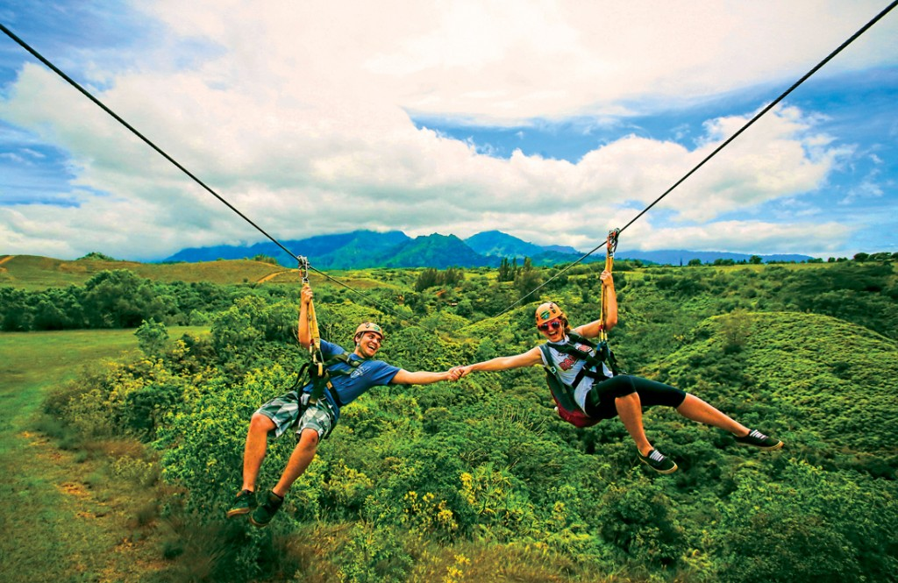
Ziplining
In Hawaii there is a lot of fun to be had but one of the most fun things to do in Hawaii is ziplining. You could go to the Branson Forest to zipline in the trees.

Slide 7
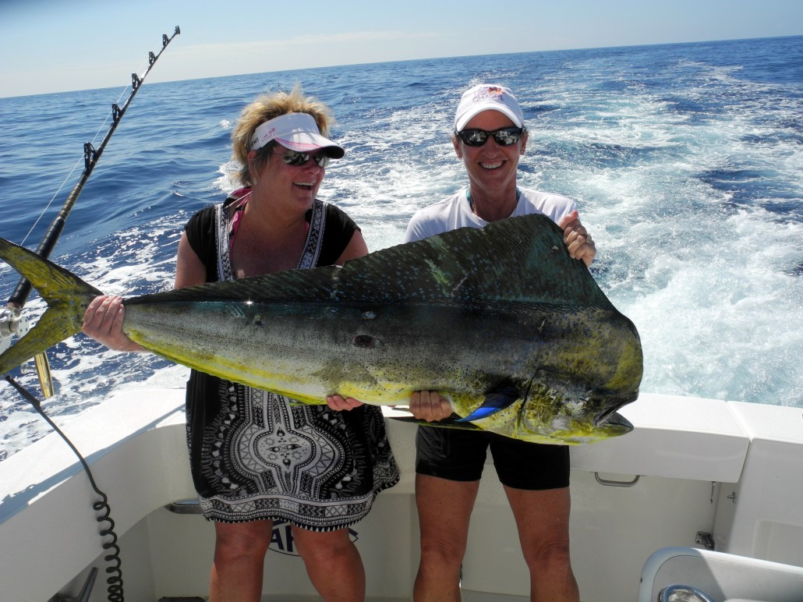
fishing
In Hawaii there are many fishers. They only go out on the ocean and grab their fishing rod but if they get a big catch they might get pulled in or let go of their fishing rod. You could go to Guadalupe Island to start fishing in Hawaii.

Slide 8
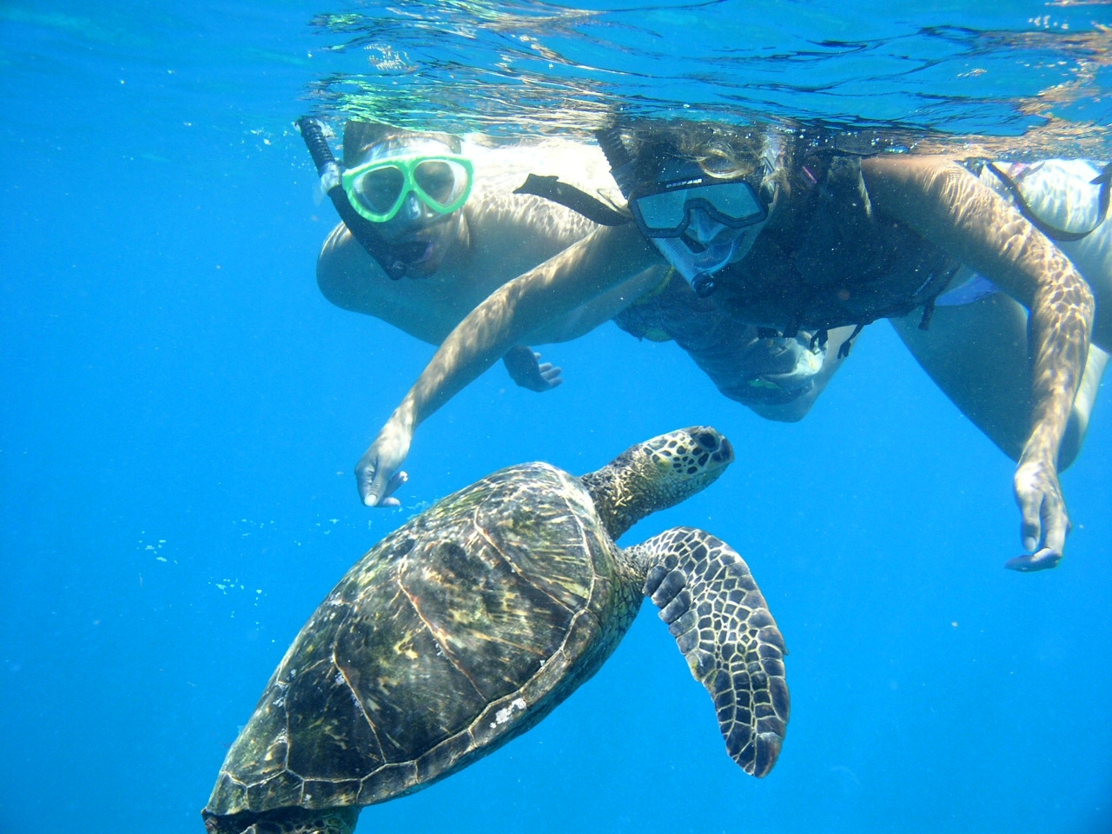
Swimming
In Hawaii there are many places to swim at is the ocean. There is sharks in the water though; they won’t attack you unless they are close to you. You could go to the beach and start your swimming lessons.

Slide 9
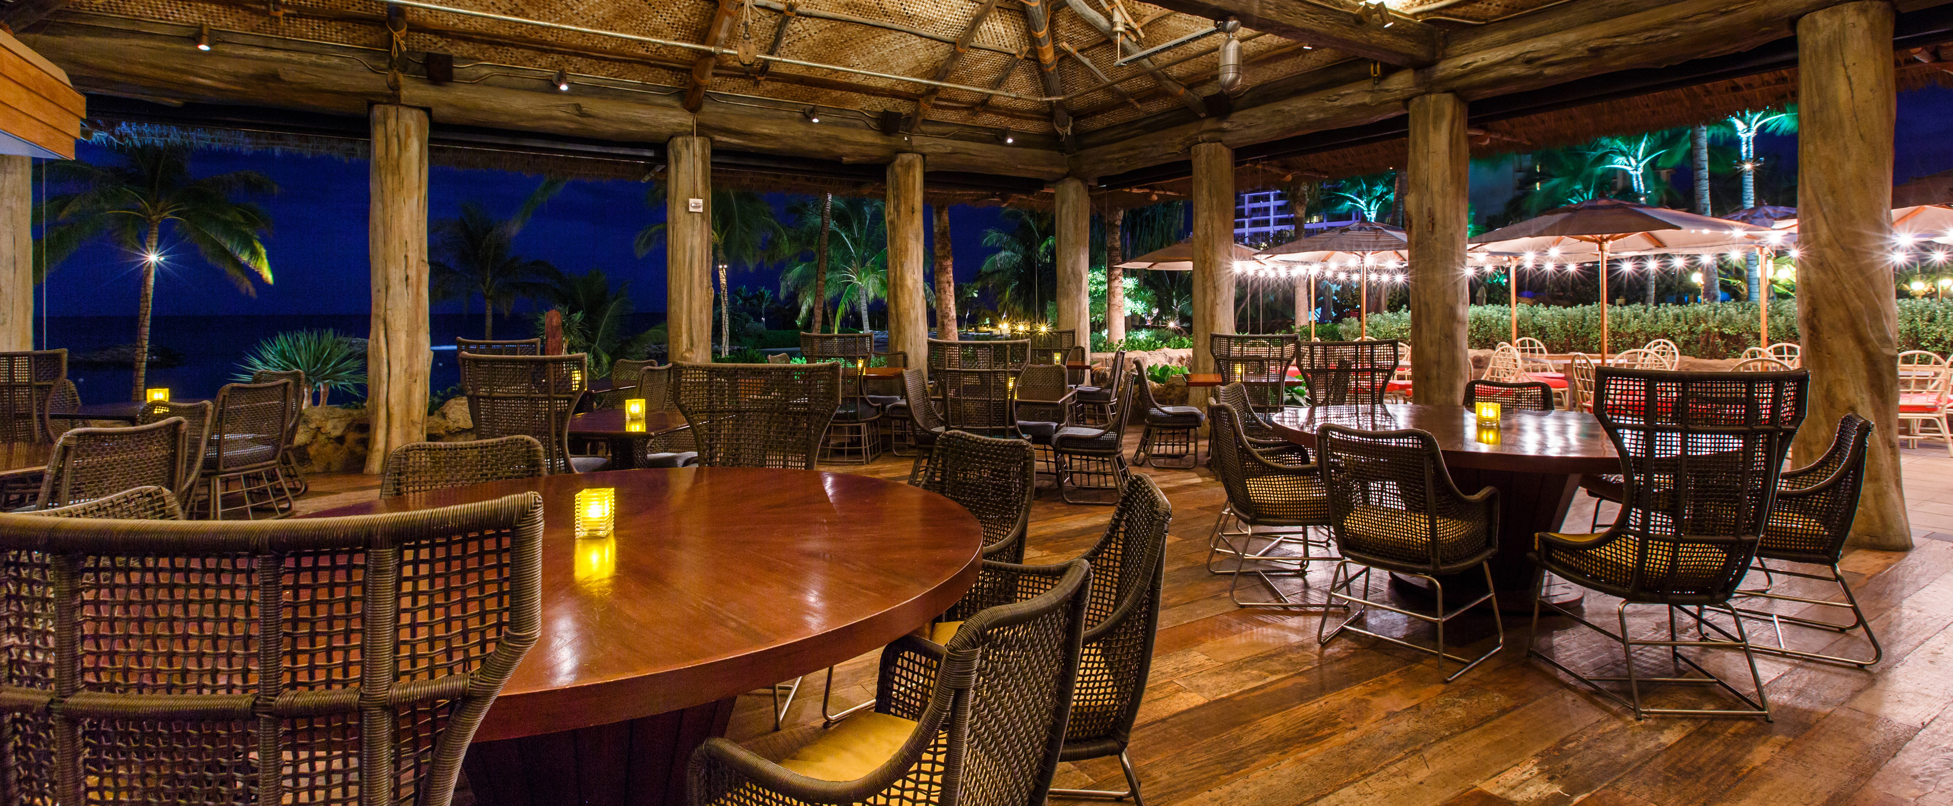
food
In Hawaii you can go to many restaurants to get food from there but they cost a lot of money. Their food is very good to some people but some might not like is. Did you know that Hawaii gets their milk from the coconuts that they get from their trees. You could go to the restaurant Tropis in Hawaii to get your food.

Slide 10
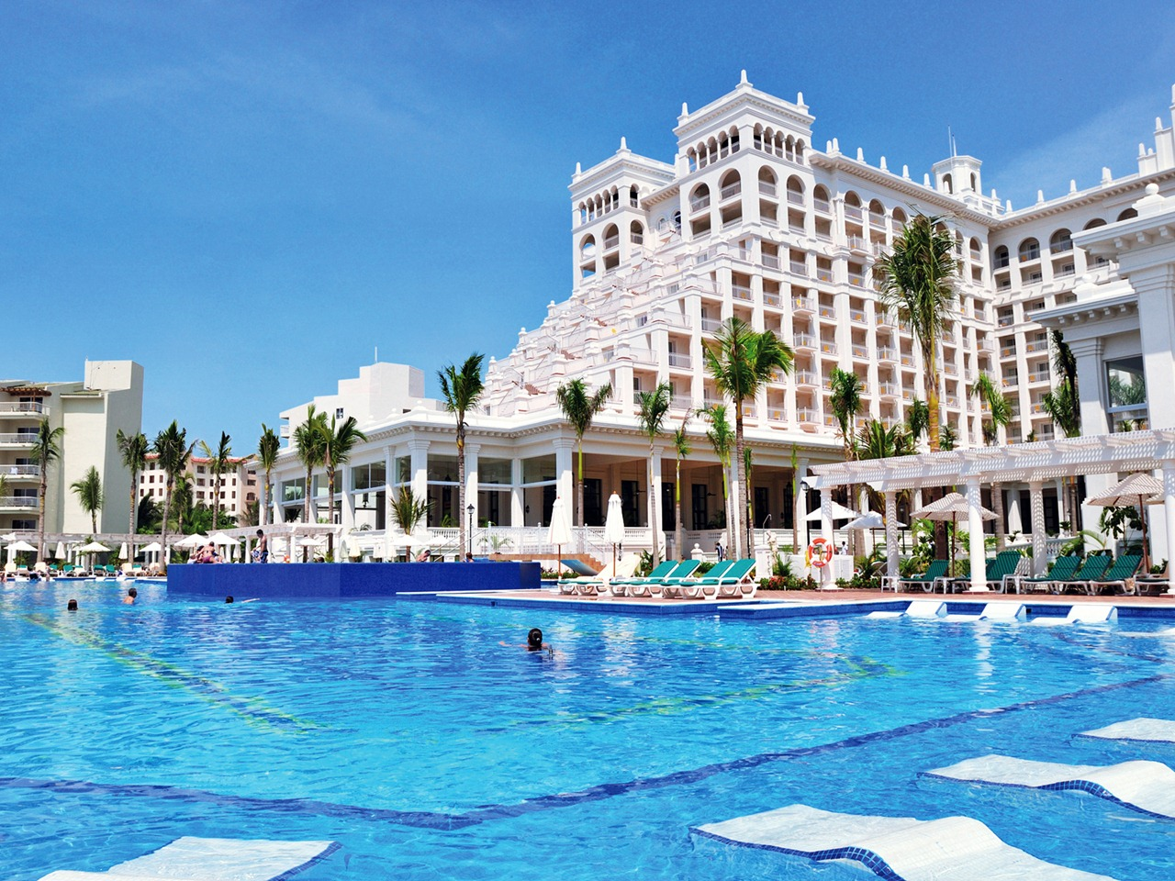
hotels
In Hawaii you can stay at many hotels there but it depends on the cost. It also depends on how long you stay at the hotel. In Hawaii you can play a game called paradise run you could do that to win prizes and stay at the hotel. You could go to the Wakawaka Hotel to get some rest when your fun day is over.

Slide 11
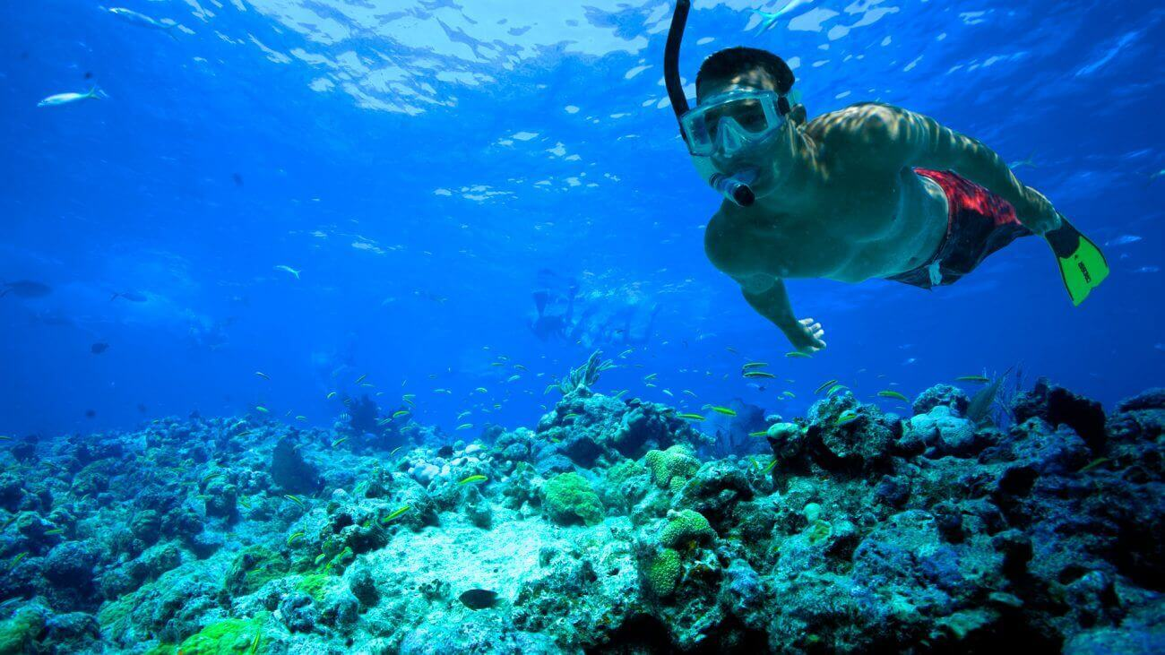
Snorkeling
Hawaii has many sports as to snorkeling that is the one sport you need to practice for a while to stay underwater as long as you think you can. You could go to the Hawaii to go snorkeling.

Slide 12
Conclusion
This journey ends here. There are many things to do in Hawaii. You can dance sing and even surf. The most thing I love to do there is to have a good time.

