Slide 1
Geography and Climate Of Canada
By Cole

Slide 2
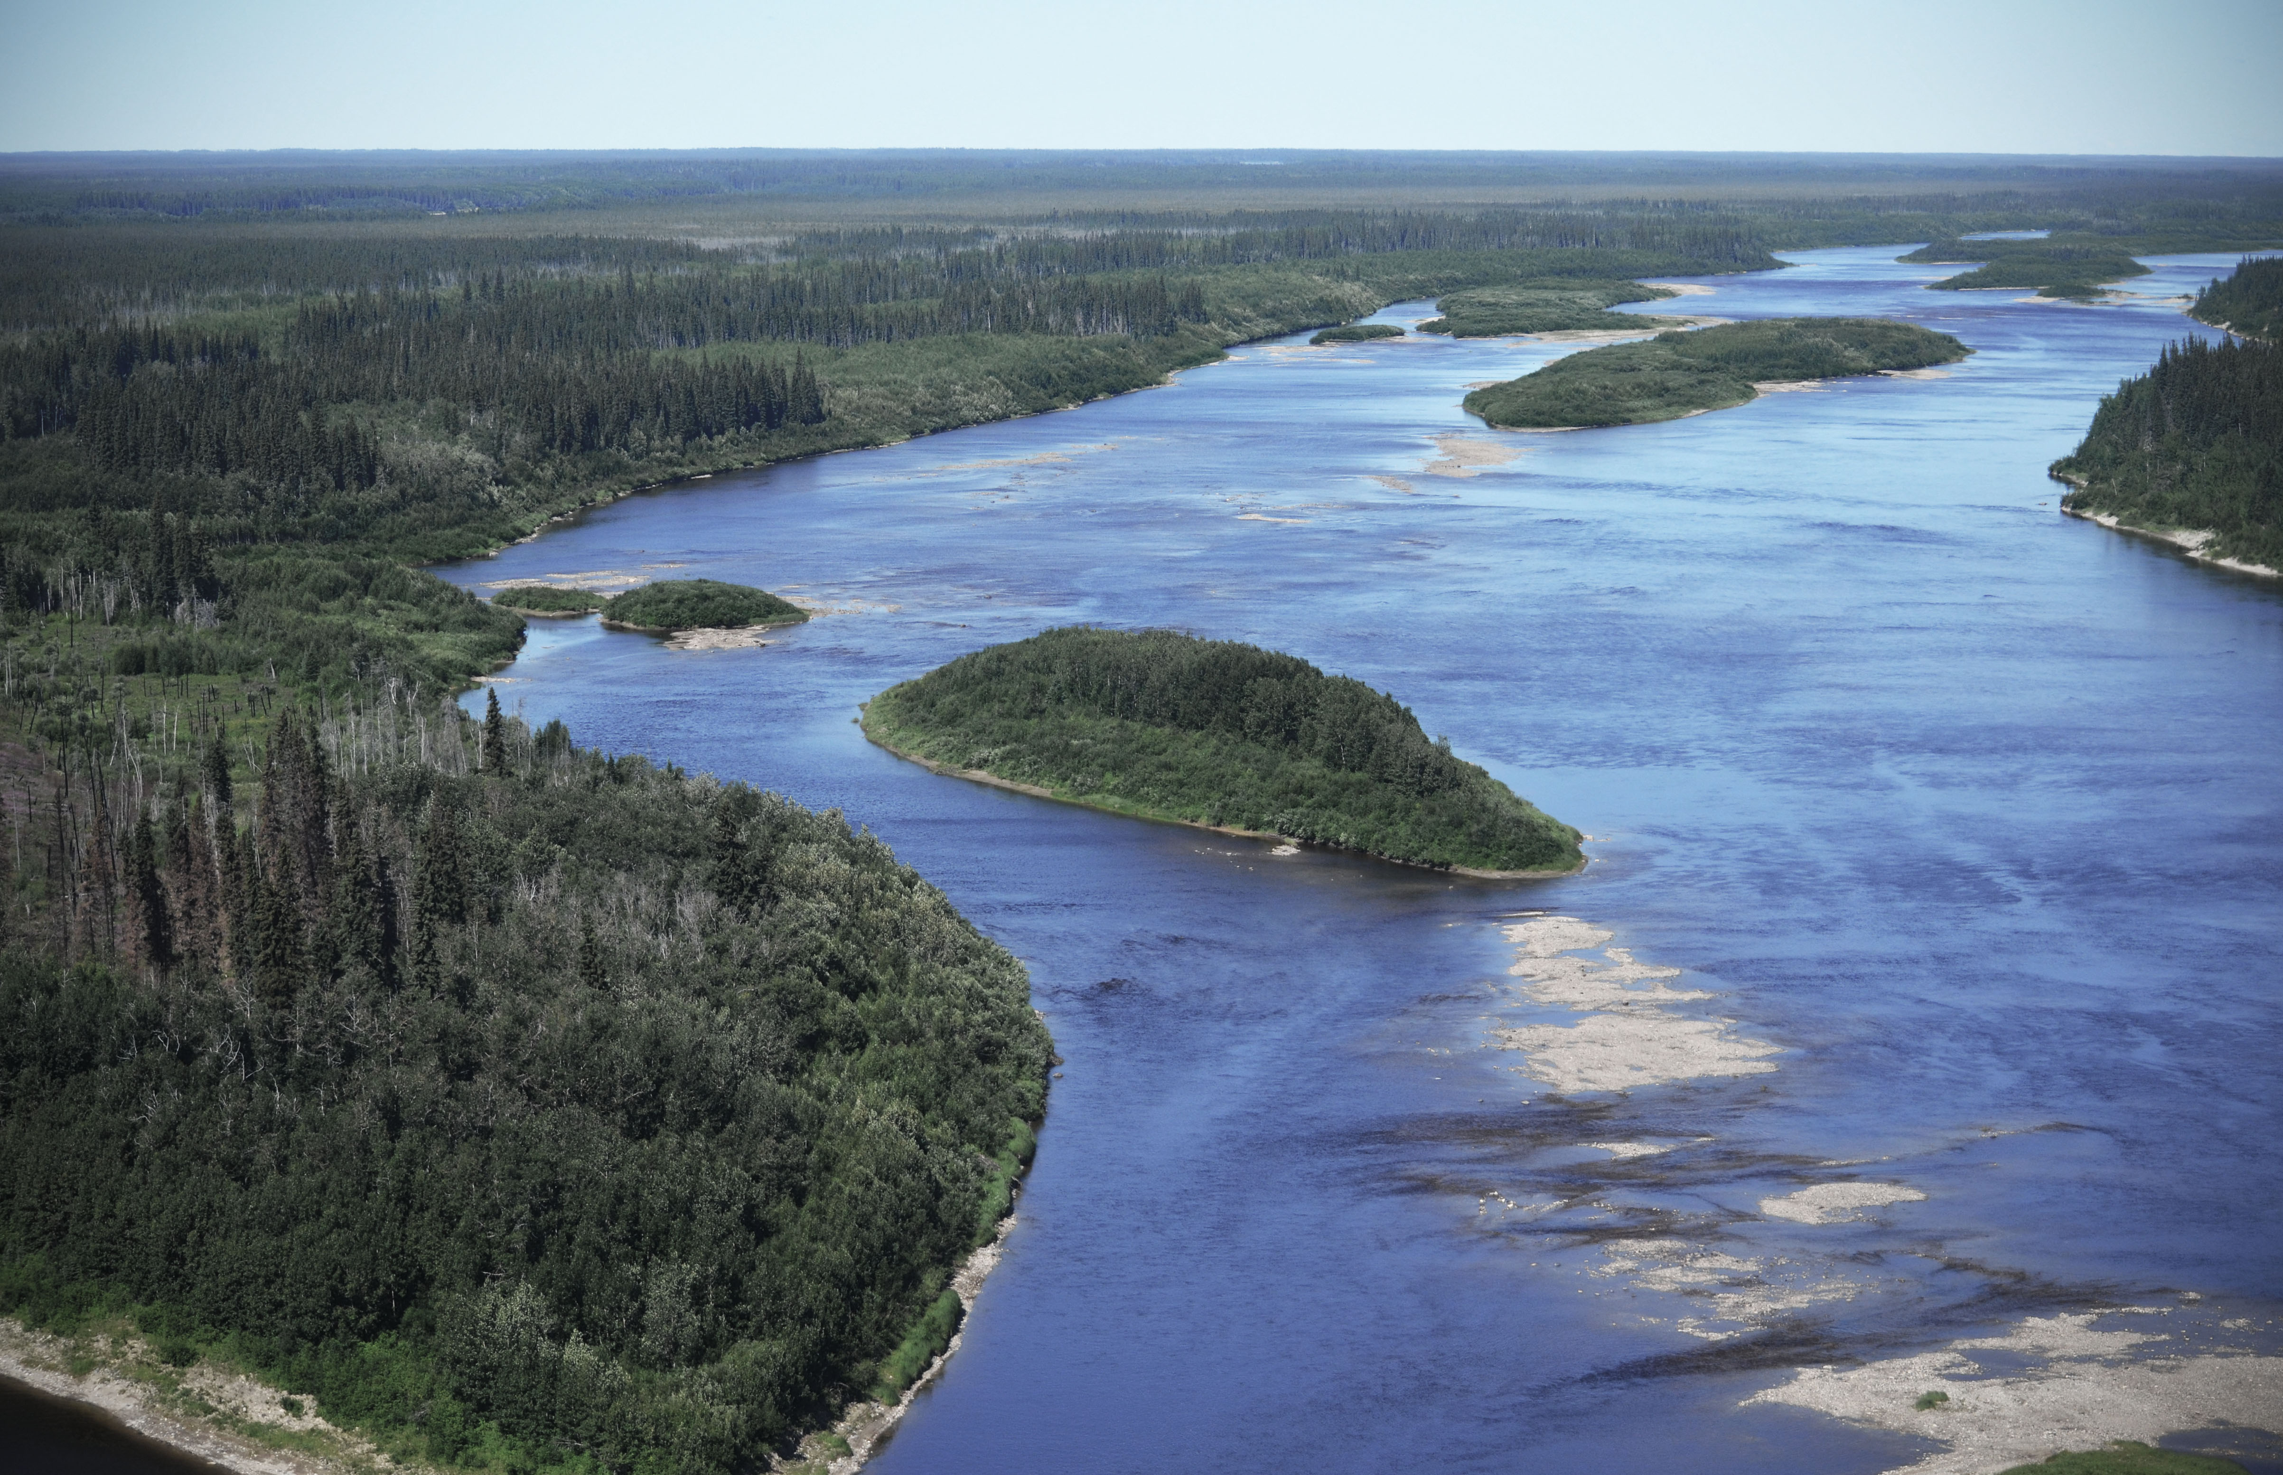
The Hudson Bay
The Hudson Bay is a large body of water in Canada. It is (as its name suggests) named after Henry Hudson, who discovered it in 1610. It is, on average, 300 feet deep.
In January the temperature is usually about negative twenty degrees Fahrenheit. July temperatures are about
forty- seven degrees Fahrenheit.

Slide 3
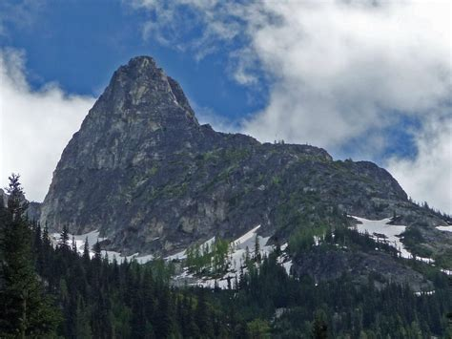
Mount Logan
Mount Logan is the tallest mountain in Canada. It measures 19, 551 feet (5,959 meters). It is named after Sir William Edmond Logan, who is a Canadian geologist and founder of the GSC. It has the largest base circumference
of any non-volcanic mountain on Earth.

Slide 4
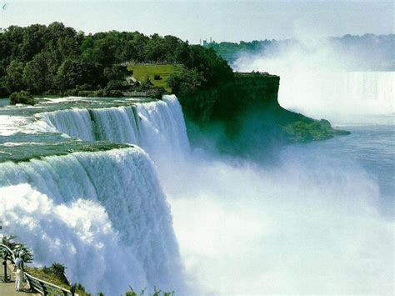
Niagara Falls
Niagara Falls is the most famous of all of the natural tourist attractions in Canada. The falls are about 176 feet high. It is the second largest waterfall in the world. It drops 150, 000 gallons of water per second!

Slide 5
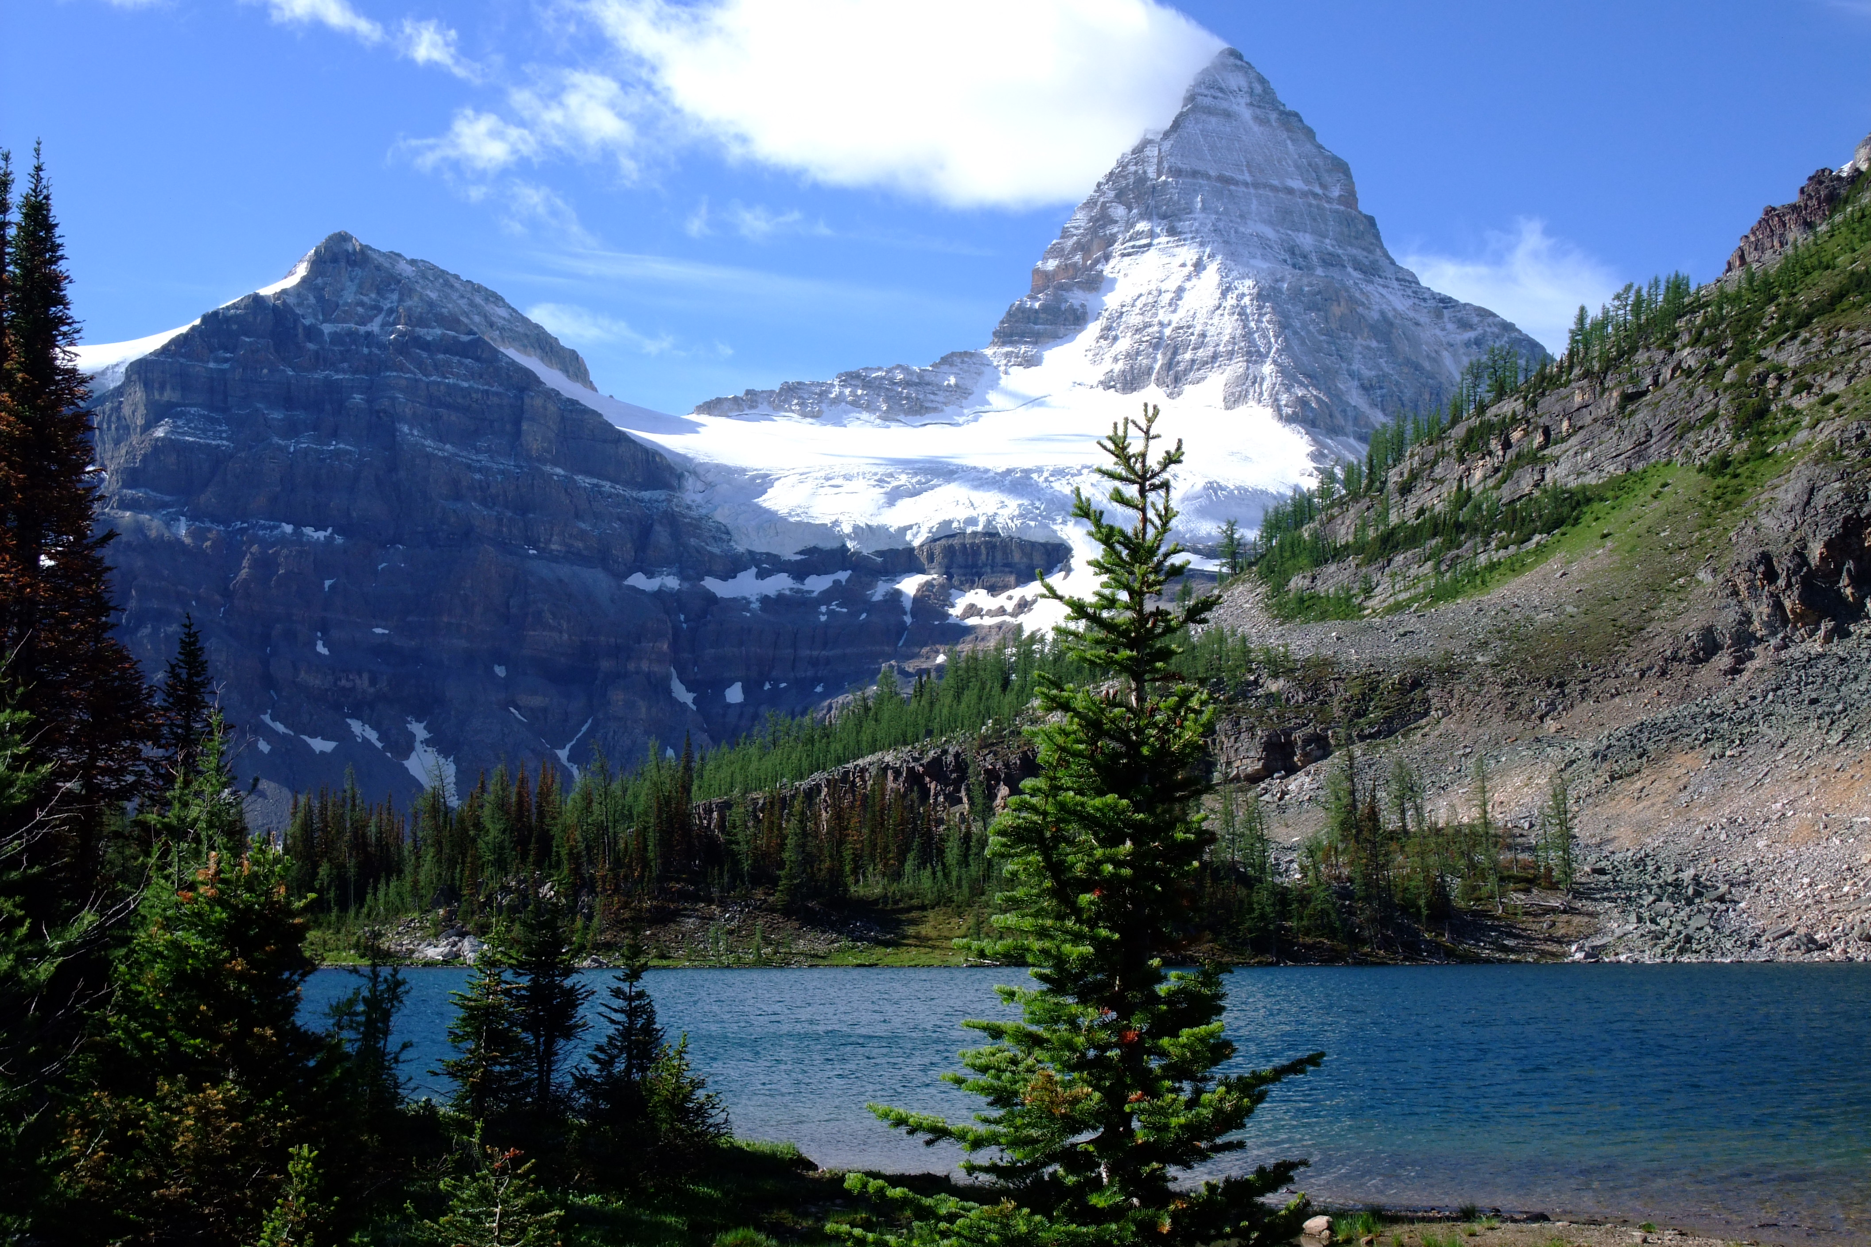
Mount Assiniboine
Mount Assiniboine is a mountain in Canada, it is 11,870 feet high. It was given its name by George Dawson who noticed a cloud over it and it reminded him of the smoke that came out of the homes of the Indians of the same name. It is very popular among climbers.

Slide 6
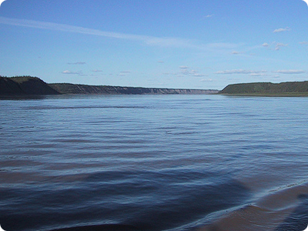
Mackenzie River
The Mackenzie River is a river in Canada, it is 1,080 miles long. It is the longest river in Canada. It is named after an explorer named Alexander Mackenzie.

Slide 7
Climate of Canada
Canada is one of the most cold regions of North America. It has four different seasons This weather helps Canadians play their favorite sport games like hockey. Hockey is the most popular sport in Canada. This country is usually characterized by freezing winters.

