Slide 1
Ancient Egypt and Kush
4500 BC- AD 400

Slide 2
Lesson 1: Geography and Ancient Egypt

Slide 3
The Nile River
The Nile River was on of the most important features of Ancient Egyptian geography.
The Nile flows from south to north and empties into the Nile Delta which is an area of rich fertile farmland.
The Nile would flood every year leaving behind deposits of rich fertile soil which allowed for farmers to grow crops.
Without the Nile, Egypt never could have developed.
The Nile provided the Egyptians with food and their were natural barriers, such as the Red Sea and the Mediterranean Sea surrounding the Nile River to protect the people from invasion.
Menes was a pharaoh who unified Upper and Lower Egypt. He wore the red crown of Lower Egypt and the white crown of Upper Egypt to symbolize this unity.

Slide 4
Lesson 2: The Old Kingdom
The Old Kingdom existed from 2700 BC to 2200 BC.
It was under the rule of the Pharaoh who was seen as a king and a god and had complete control over the land.
Pharaoh Kufu is a well known ruler from this time period.
HS: Kufu built the Great Pyramid at Giza.

Slide 5
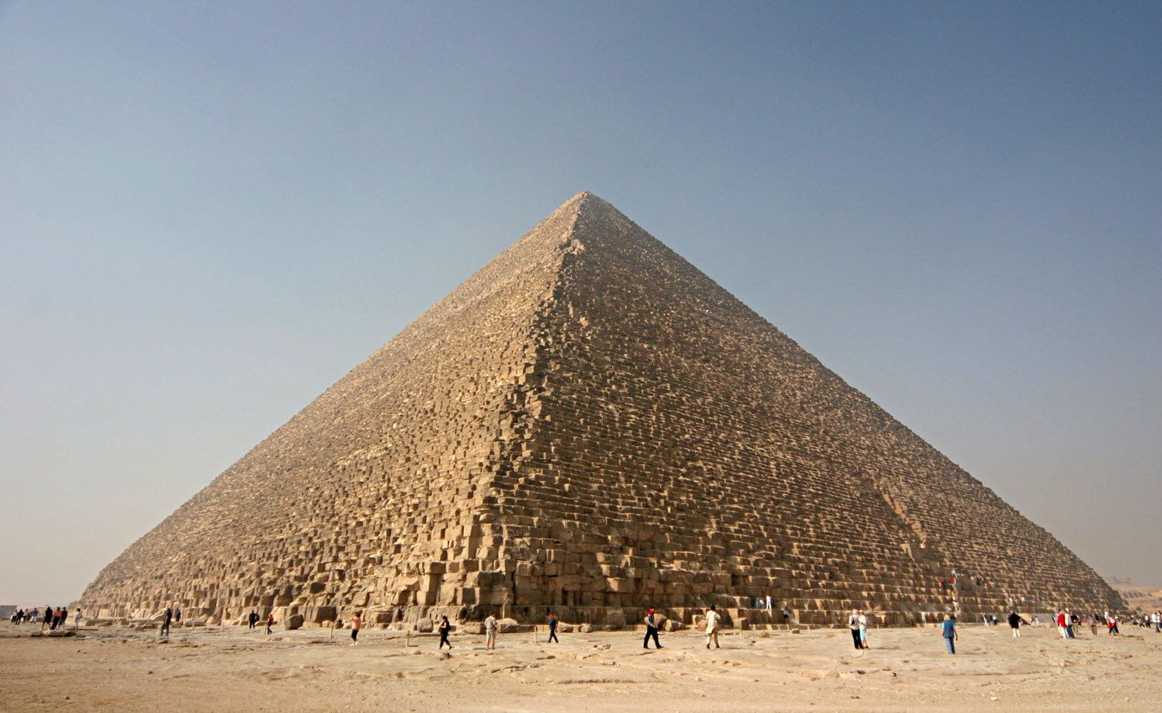

Slide 6
Egyptian Social Pyramid
The Egyptian social pyramid governed how Egyptian society functioned.
Each level depended on all of the other levels in order for society to survive.
HS: This structure enabled Egypt to thrive and function. Similar social structures (or remnants of them) remain in some societies today.
See the following slide for how the social classes were arranged.

Slide 7
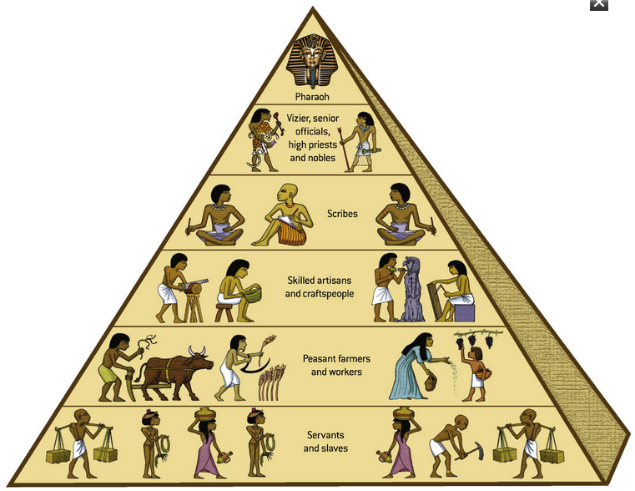

Slide 8
Egyptian Religion
Religion was very important to the Egyptians and governed much of their lives.
The Egyptians were polytheists and had may gods for different parts of the world. Each god has a specific role and specific characteristics.
They built impressive temples to worship in and to honor their gods.
Egyptians believed that they would be judged based on their deeds in life which would determine if they could pass on to a happy afterlife. Thoughts on the afterlife were the main focus of Egyptian religion.
HS: Egyptian religious culture has remained to influence society and customs today. Similarities between the Egyptian belief system and other polytheistic groups can be seen as well.

Slide 9
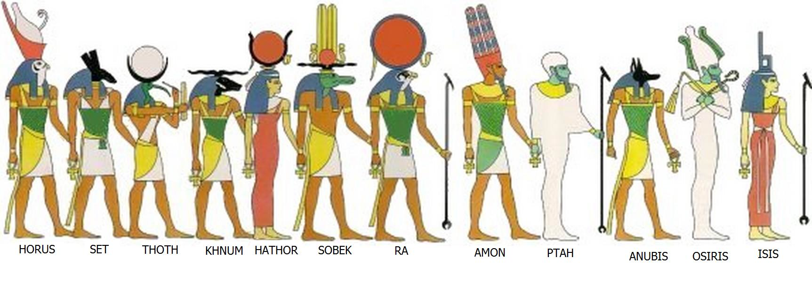

Slide 10
Mummification
Egyptians believed that it was important to preserve the bodies of the dead for the afterlife.
They believed that a person’s spirit or “ka” remain connected to their body after they died and that the “ka” needed to be fed and cared for like a real person.
If a person’s body was preserved as a mummy the “ka” could recognize the body in the afterlife so the “ka” could receive what it needed and be happy.
Embalming was a very complicated and nasty process that took weeks to complete. Then the dead were placed in coffins and in tombs. Only the very wealthy could afford this.
HS: The existence of Egyptian mummies tells historians a great deal about Egyptian life and culture.

Slide 11
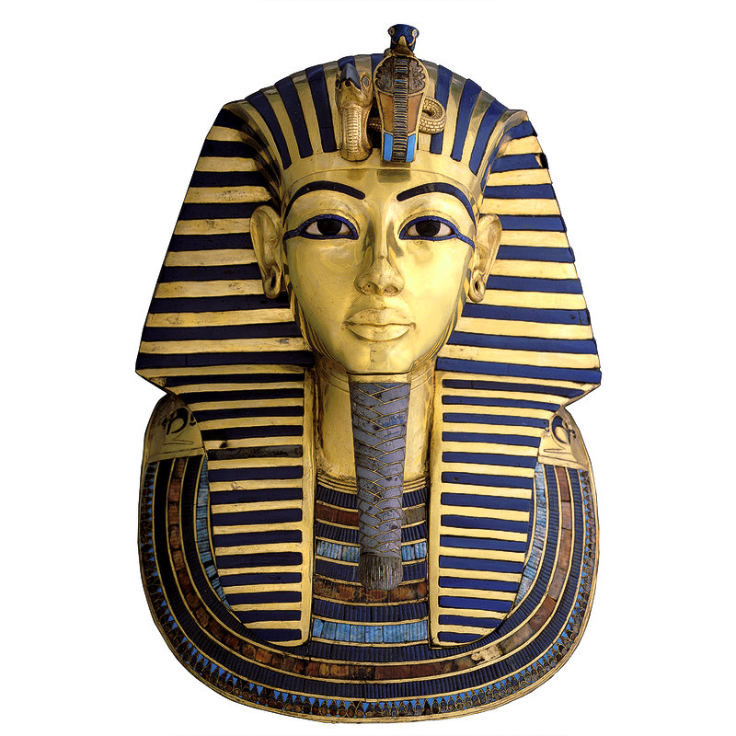

Slide 12
The Pyramids
The Egyptians built great pyramid structures as tombs for pharaohs. They would contain the pharaoh's mummy and riches to take to the afterlife.
The size and grandeur of a pyramid would show how important a pharaoh was. They represented his journey to the afterlife and helped to connect Egyptians to their gods.
No one is really sure how the Pyramids were built, but they were amazing structures built using hand tools and stones weighing up to 5,000 lb.
Farmers and laborers built the Pyramids.
The most impressive pyramid is the Great Pyramid at Giza.
The Pyramids would have cost billions of dollars to build today.
HS: The Pyramids are amazing feats of engineering and building that tell us about Egyptian culture and what the Egyptians were capable of.

Slide 13
