Slide 1
Chapter 7: Judaism and Hebrews
Part 1: The early Hebrews

Slide 2
Objectives
Explain who Abraham and Moses were and their significance
Analyze features in the text to further your understanding of maps, settlement, and specific routes taken by Jews by their leaders.
Evaluate specific vocabulary and why it is significant to Israelite history.
Judaism, Exodus, Moses, Abraham, Diaspora, Ten Commandments David, Solomon
Identify the kings who united the Israelites

Slide 3
Big idea
Hebrews established a great kingdom called Israel

Slide 4
GRAFFITI Board
Judaism

Slide 5
Introduction to Judaism
https://www.youtube.com/watch?v=auM94_yDD40
Take notes: 5 Bullet points
Notes:
Definition of concept: Judaism – Show Video: https://www.youtube.com/watch?v=auM94_yDD40
Take notes: 5 Bullet points
Examples: Refer back Graffiti Board Judaism: What can we add?
Why is this topic academically important to learn?

Slide 6
How would you feel?
Turn to p.202 in text book
“If you were there…”
Notes:
Read the scenario and then answer the question: How would you feel about moving to a far away land? Add in some background about Abraham…Abraham was told by God to move to a faraway land.

Slide 7
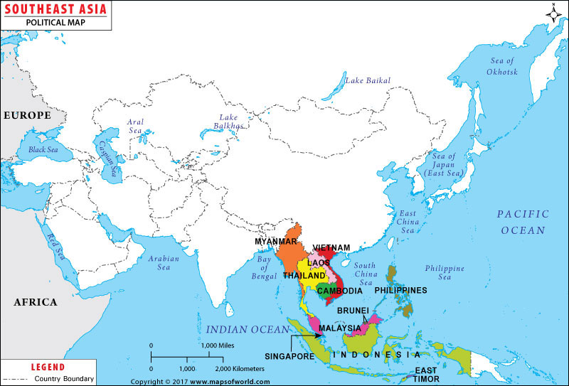
Abraham and Moses lead their people
Between 2000 – 1500 BC Hebrews appeared within southeast Asia
Their early discovery comes from archeologists and Hebrew SCRIBES
These accounts described the beliefs of Judaism
examples OF archeology
http://www.chabad.org/library/article_cdo/aid/588025/jewish/Jerusalem-Archaeology.htm
Notes:
Does anyone know what a political map shows?
Political map focus on the boundaries of countries and generally have brighter colors
Physical maps focus on the geography of the land in a region (p.203)
What is an archeologist: the study of human activity
Does anyone know what a scribe is?
- Scribes are record keepers; think of basketball, coaches have all the plays and the stats of players recorded in books

Slide 8
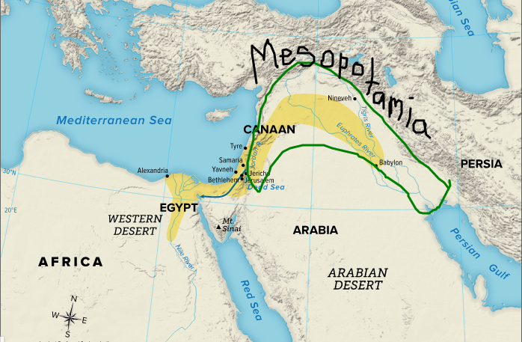
Abraham and Moses lead their people
Abraham was told by god to move to Mesopotamia to lead his descendants into a mighty nation
Abraham moved to Canaan, which was on the Mediterranean sea
There was a famine in Canaan; therefore people moved to Egypt
Notes:
p. 203: what can we infer about Abraham’s voyage based on the geography we see?
What is a famine? Food is scarce
What would you do? Think back to the question we answered first in the beginning of class.
Why do you think so many civilizations settled near water? What is so important about water?

Slide 9
Israelites move to Egypt
Lived a comfortable life
Began to grow and grow
Pharaoh becomes threated by their prescence and makes them slaves because he thinks they will become too powerful

Slide 10
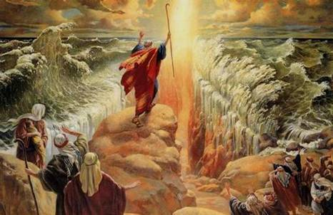
Abraham and Moses lead their people
The Exodus:
In 1200s god told Moses to lead the Israelites out of Egypt.
He went to the pharaoh and his request to move his people was denied
Soon afterward there was a series of plagues that made pharaoh frightened.
He agreed to free the Israelites from Egypt
Israelites were overjoyed
Moses moving the Israelites out of Egypt was none as the exodus
Notes:
Moses is a descendant of Abraham, meaning he
Pharaoh was the Ruler in Egypt who had power over the Israelites. Background: When Moses was a baby, Israelites were not allowed to have baby boys so his mother put him in a basket in a river and trusted God with him. Moses ended up being seen by Pharaoh’s daughter who took him in as her own son. Moses was a Israelite raised by an Egyptian family who had Israelite as slaves in Egypt. Kind of crazy right?
Whenever Pharaoh would deny Moses the right to free the Jewish slaves, God would “punish” Pharaoh. For example: Pg. 203 read: “disease and plagues struck Egypt.”
Analyze the map on p.203

Slide 11
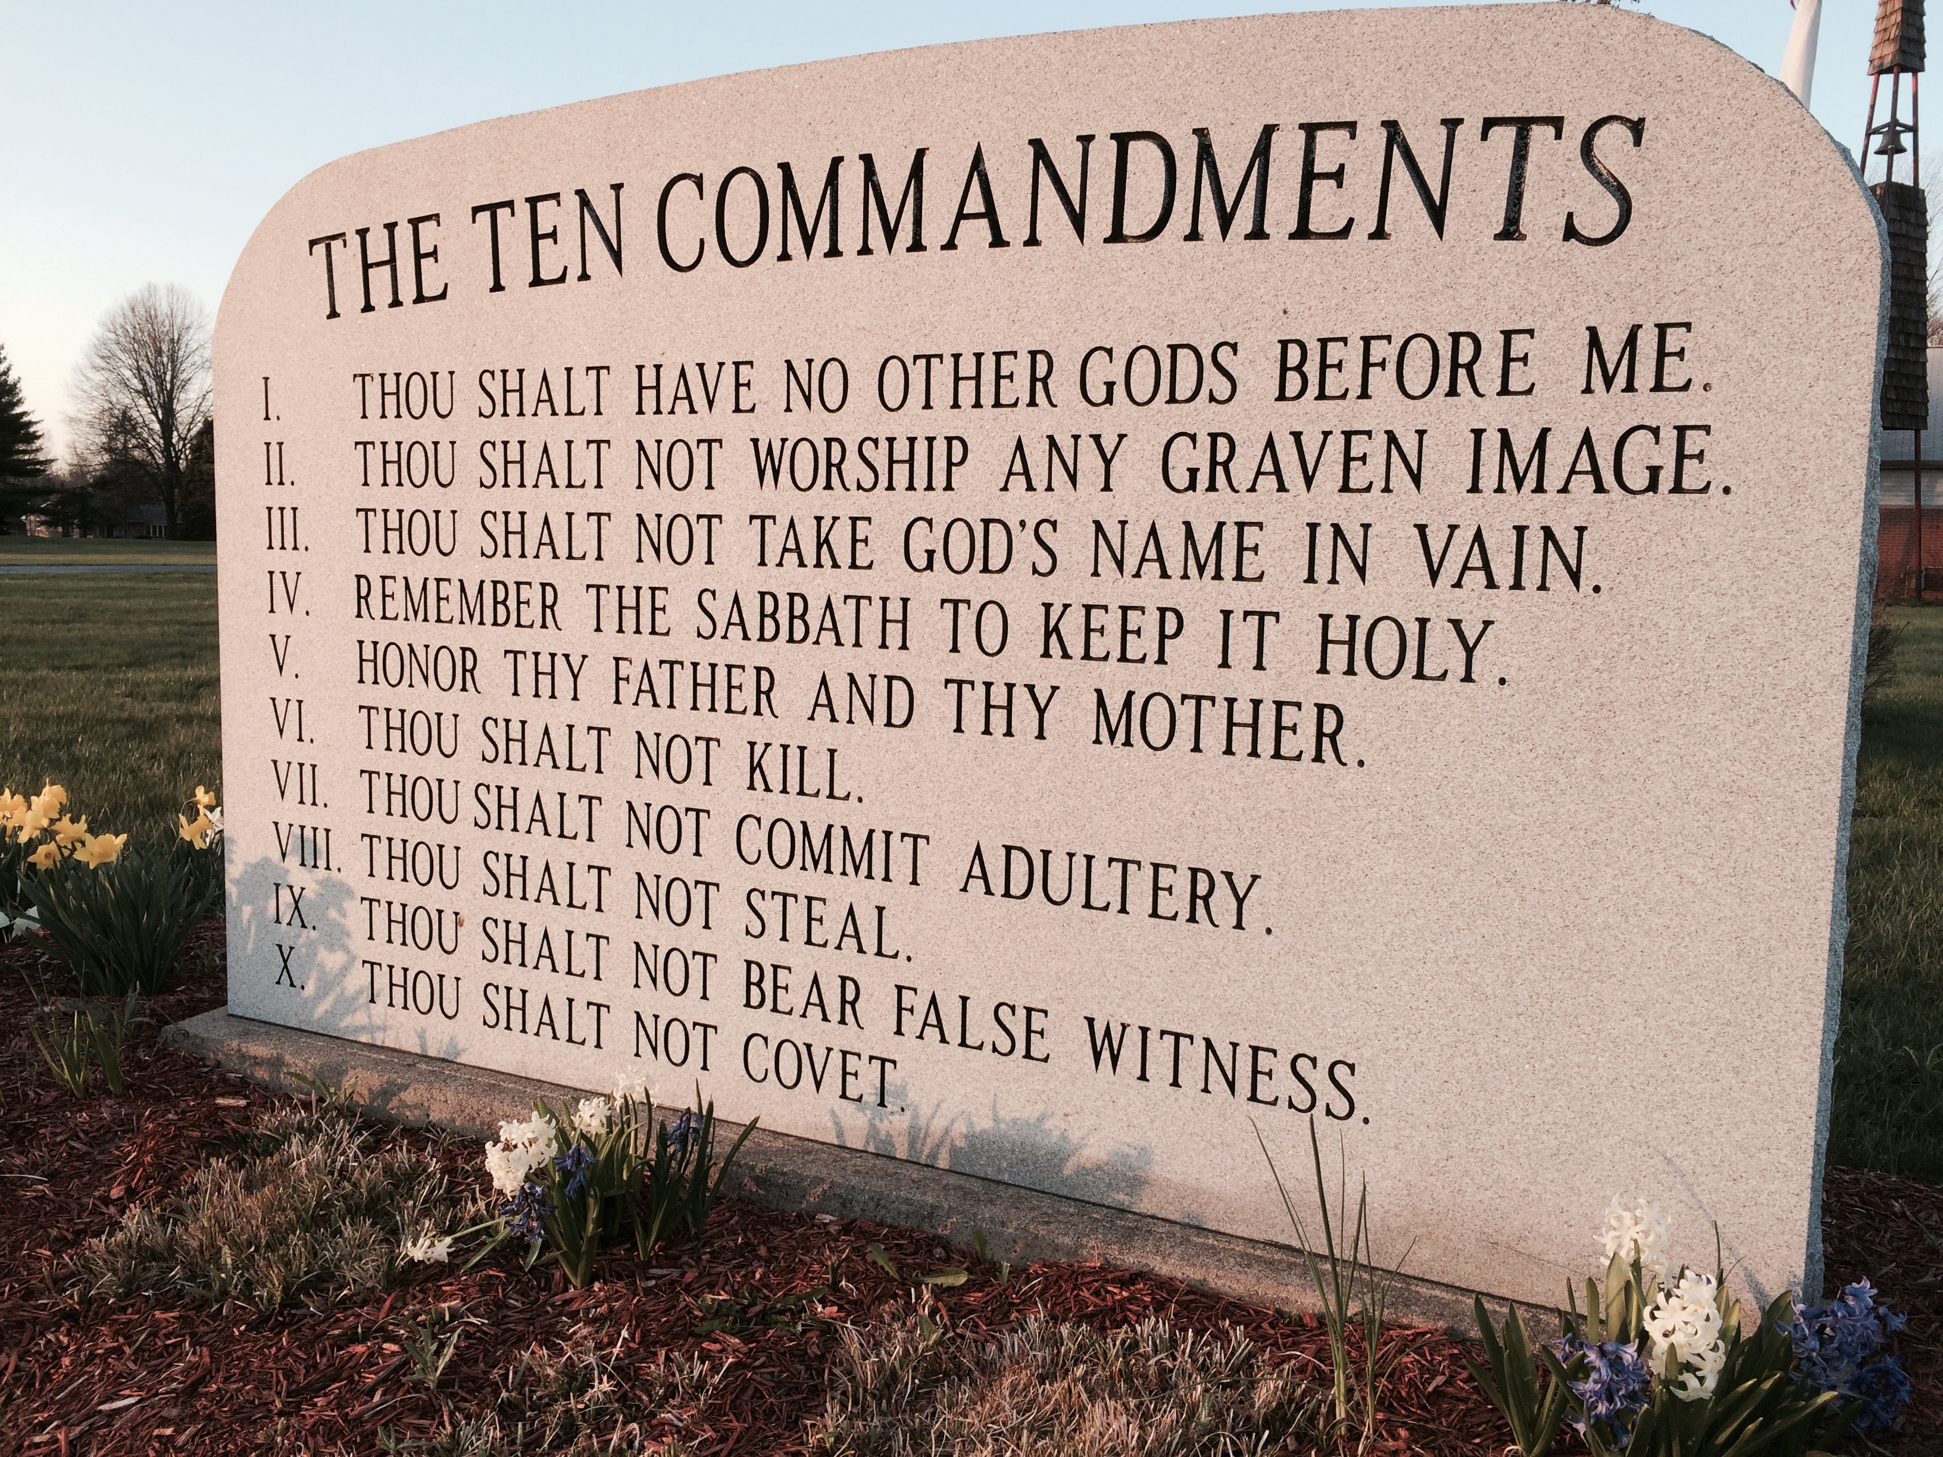
Abraham and Moses lead their people
Ten commandments
Notes:
Read p. 204 top of page until “Ten Commandments”
Moral laws! The way of behaving

Slide 12
Return to Canaan
When the Israelites made it back to Canaan they had to fight the people who were living their to gain control over the land.
They had small communities with no intentional rulers
Until…..
Notes:
If you had land, what was that considered? Powerful!!!

Slide 13
Kings unite the Israelites
David
https://www.youtube.com/watch?v=fdyFGUh_Kpo
When Saul died, David took over as king because of the support he gained from the people after defeating Goliath
Established capital of Jerusalem in Israel
King Solomon took the throne at 965 b.c.
Expanded the kingdom and made new kingdoms such as: Egypt and Phoenicia, his allies
What is an ally?
These allies made Israel very rich: Solomon built a temple which became the center of the Israelites religious life and symbol of faith

Slide 14
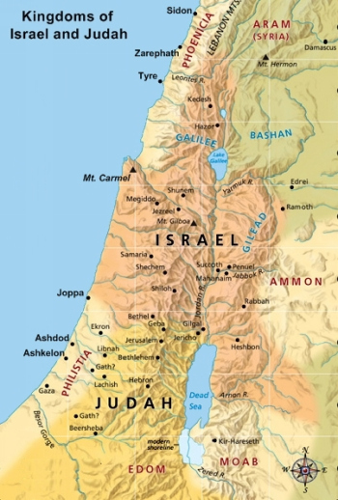
Invaders conquered and ruled
After Solomon died, fights and rebellions broke out over who was going to be king. This conflict tore Israel apart
Israel split into two different kingdoms: Israel and Judah..
Notes:
Turn to p.206 in textbook and analyze the picture shown. Answer the question: How did Israel and Judah compare in size to Solomon’s kingdom?

Slide 15
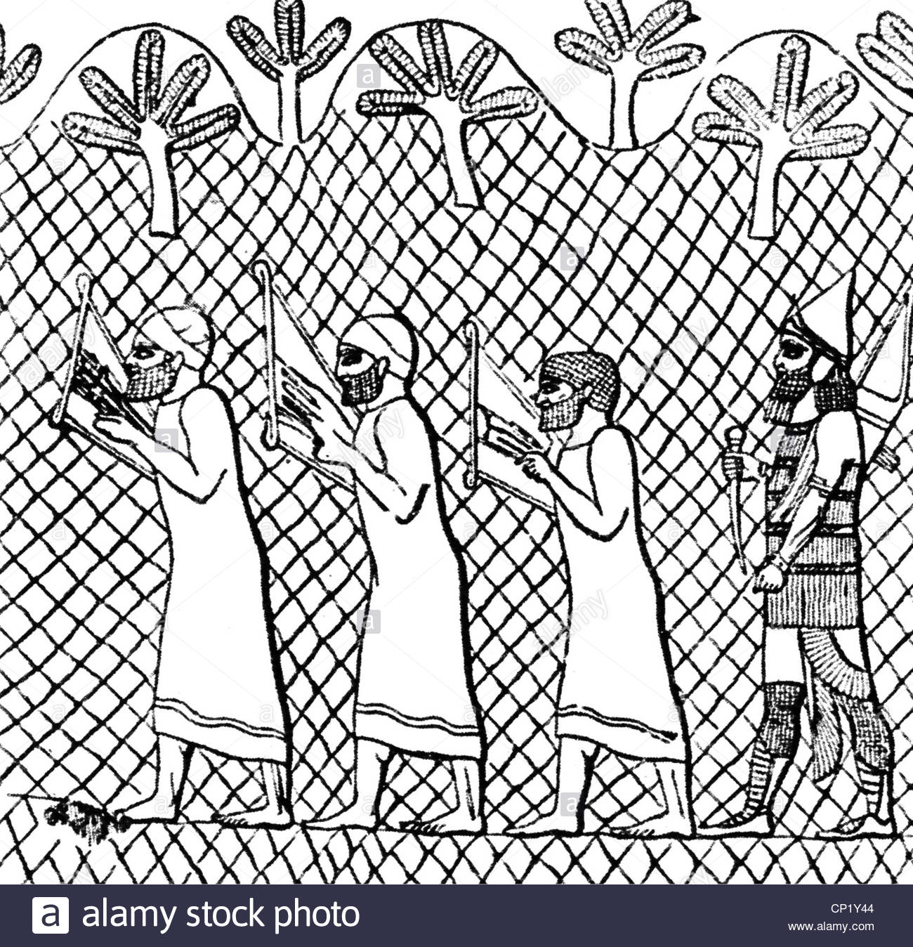
Invaders c0nquer and rule
The Assyrians defeated the kingdom of Israel in 722 b.c.
Judah was defeated by a group called the Chaldeans; they destroyed Solomon's temple
The Chaldeans then brought Jews to their capital city called Babylon, and they worked there as slaves
Notes:
Read p.206 as class

Slide 16
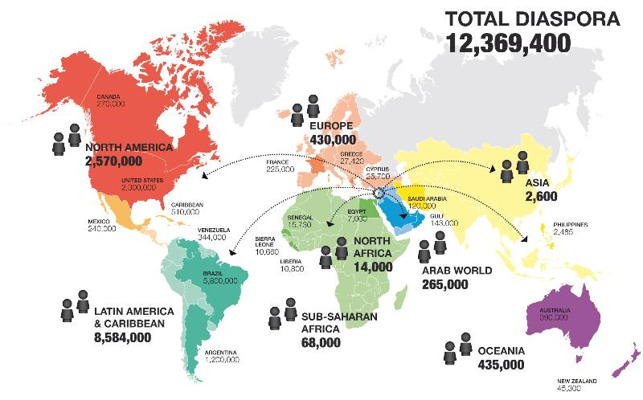
Diaspora
The Persians then came along and defeated the Chaldeans
The Persians allowed for the Jews to return to Jerusalem but many Jews decided to move to other parts of the Persian empire
The dispersal of Jews is known as the diaspora
Notes:
All these Israelites being spread out…what does it mean? What is going to happen?

Slide 17
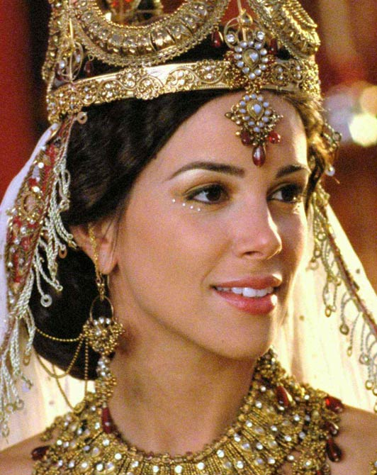
Women in Israelite society
Women had very little rights.; they had to listen and do whatever their husbands said
Queen Esther

Slide 18
Classwork
Create a ”figure: contribution” chart in your notebook.
Figures you must add into chart:
Abraham
Moses
King David
King Solomon
Temple
Ten Commandments
Queen Esther (Knowledge from Mrs. Taggart)

Slide 19
Homework
Read pages: 208-213
Question to be answered:
What were the Jewish beliefs and sacred texts in their society?

Slide 20
Exit ticket
Cause and effect:
write the effect of each of these causes and hand to me before you leave
Abraham moving away from Mesopotamia
Solomon becoming king
Chaldeans conquering Jerusalem

