Slide 1
Clothing, Weather, and Climate of France
Explore France deeper than before.
By Kylee Elliott

Slide 2
Average Temperature
As you see, Frances’ (specifically Paris’) average temperature does not get too warm during the summer. According to the chart it states that during the summer it gets about to the high 60s’. Paris’ temperature usually stays in the range of 40s to 70s.

Slide 3
Average Rainfall
Average Sunshine

Slide 4
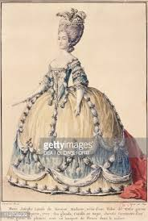
Women’s Wear
Please sir may I have some more
I’m so fancy, you aleady know

Slide 5
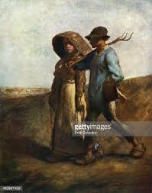
Men’s Wear
Thank you, thank you
Ha, they are wearing dish rags
Honey I found the dish rags

Slide 6
Hats
In France there are many different styles of hats their jewelry and other accessories are the same as here.

Slide 7
Conclusion
Therefore, if you plan on visiting France I hope this is a helpful guideline of some of their culture. I also hope that this was a fun way to describe all of the wonderful aspects about Paris, France.

