Slide 1
The Clothing and Fashions of Kenya
By: Lily Babbitt

Slide 2
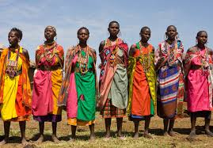
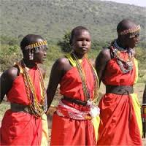
Typical Clothing Styles and Past Clothing Styles

Slide 3
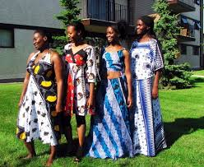
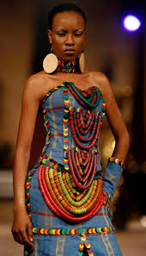
The Present

Slide 4
Conclusion
As you can see their style didn’t change too much over the years. They have very traditional clothing. Kenyans also wear clothing similar clothing to us, but the ones that I showed were just traditional styles. You can also see that they love colorful clothing.

