Slide 1
Helpful Hints while working on your PowerPoint.
1) Using a photo image as the background of a slide is very powerful and informative, such as this slide.
2) Be sure to use either black or white as the letter coloring. Many times, if you use another color, the words don’t show up as vividly. For example, Can you see these words well?
3) This probably isn’t the best photo to use as a background. It is too busy.
3) Also, this student did not site where he found his photos, images or information. BE SURE TO LIST THE WEBSITES FROM WHICH YOU FOUND YOUR INFORMATION AND/OR PHOTOS AND IMAGES.

Slide 2
Holy See
By Corey and Jaxson

Slide 3
Table of Contents
*****Notice how the first letters of the important words in the titles are capitalized.
Slide ONE: Title Page
Slide TWO: Table of Contents
Slide THREE: Introduction
Slide FOUR: Passport Application, Costs, and Other Informatio
Slide FIVE: Required Vaccinations
Slide SIX: Airline Itinerary
Slide SEVEN: Airline Costs
Slide EIGHT: Transportation with the Holy See
Slide NINE: Hostels in the Holy See
Slide TEN: Least Expensive Hotel in the Holy See
Slide ELEVEN: Reasonably Priced Hotel in the Holy See
Slide TWELVE: Most Expensive Hotel in the Holy See
Slide THIRTEEN: Conclusion

Slide 4
Introduction
This student did not write an introduction. It is really helpful and informative to include an introductory slide.
What is this PowerPoint about?
Include at least one paragraph describing what the PowerPoint is about.

Slide 5
Helpful information while purchasing a passport:
*****Include where to purchase a passport, an image of the application, an image of a US passport, and any other helpful information.
Do you see how this is hard to read because the photo is so busy?

Slide 6
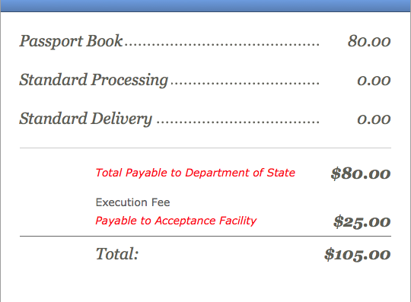
Passport Costs
This is how much it costs to buy a U.S Passport book. If you buy a passport card it is $40 but you can’t go anywhere but Canada, Mexico, Bermuda, and the Caribbean.

Slide 7
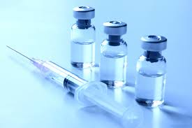
Vaccinations
When you go to Holy See, you must get certain vaccinations. You must get measles-mumps-rubella vaccine, diphtheria-tetanus-pertussis vaccine, chickenpox vaccine, polio, and a yearly flu shot. Other people also have to get hepatitis A shot, hepatitis B shot, and a rabies shot.

Slide 8
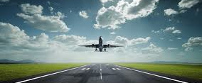
Airline Information
Notice how difficult it is to see the purple and black text.
When you fly to Holy See it takes about 16 hours and 55 minutes from Buffalo New York to Rome. It would take more than 17 hours because it is about a hour and a half to Buffalo from Scio and 20 minutes from Rome to Holy See. So it is an estimated 19 hours.

Slide 9
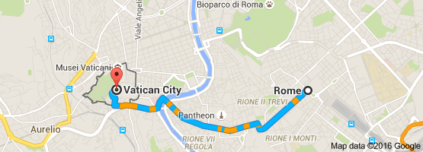
Driving
Because there was no direct flight to Holy See or Vatican City we flew to Rome. If you fly to Rome you can take a cab to drive there because it is only 20 minutes. The cost to take the cab is 30 euros or 34.16 U.S dollars.

Slide 10
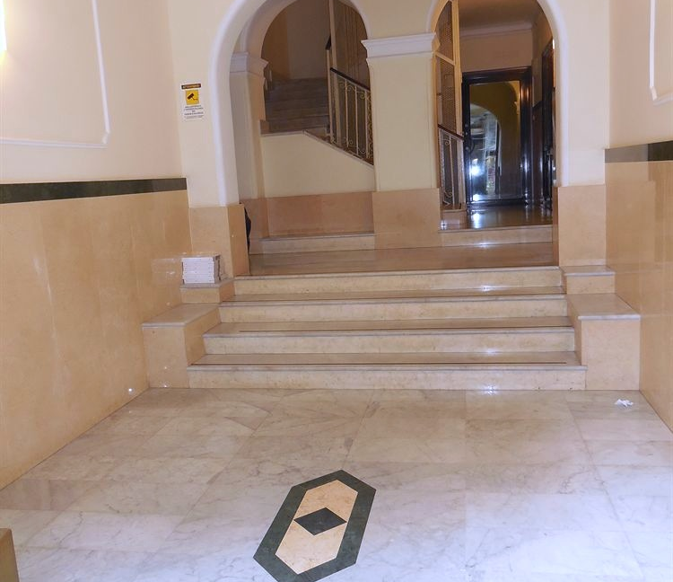
Hotels
(Cheapest Price)
Notice how difficult it is to see the purple and black text.
This hotel is $29 for one night. And it is $522 for eighteen nights. It is a 1 star hotel. The hotel Cressy has a 3.7 service satisfaction.

Slide 11
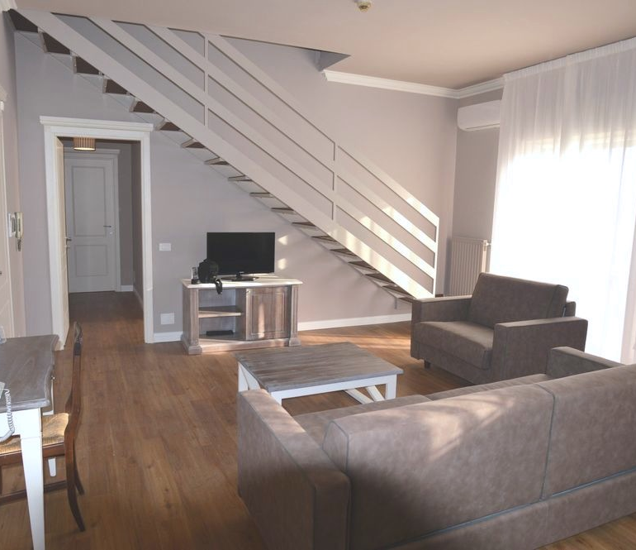
Hotels
(Reasonable price)
This hotels is in Rome which is near Holy See. It is a three star hotel that is $46 a night. If you stay for 18 days it is $828. The service at the Hotel La Genziana is a satisfaction of 4.2 out of 5.

Slide 12
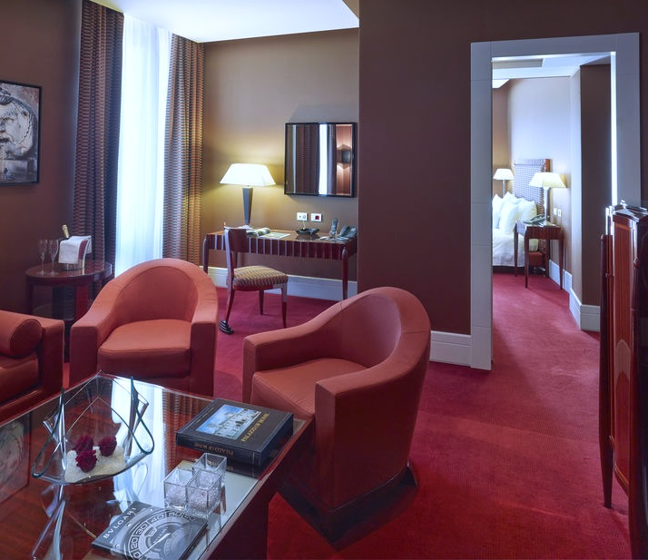
Hotels
(Highest Price)
This hotel is in Rome and is a five star hotel. It is $424 a night so for 18 nights it is $7,632. The Grand Hotel Via Veneto has a 4.4 out of five service satisfaction.

Slide 13
Conclusion
Please note, that this student did not add a conclusion.
To make this PowerPoint more affective, please add a conclusion.

