Slide 1
Dialogue
PowerPoint written by Ashley Gay

Slide 2
BrainPOP!
Write three ideas or facts you learned from the video
1.
2.
3.

Slide 3
What is dialogue?
Dialogue is “conversation given in a written story or play.” (from Merriam Webster Word Central)
If characters are talking, you write what they are saying as dialogue.

Slide 4
What does dialogue look like?
Liza and Marcus looked out the window at the city below.
“Have you ever been here?” Marcus asked.
“No, my family rarely left the capitol,” Liza said sadly. “I wish we’d travelled more.”

Slide 5
Dialogue Rules
Always start a new paragraph when a new character is talking!
Use quotation marks at the beginning and end of each piece of dialogue. “ ”
Use correct punctuation.
  Periods, question marks, commas, and exclamation points go inside of the quotation marks “I love writing.”

Slide 6
Tips for good dialogue
Say your dialogue out loud.
Don’t use only dialogue or only description.
Make sure dialogue is only one or two lines.
Dialogue should move your story forward.
Use varied dialogue tags (see next slide).

Slide 7
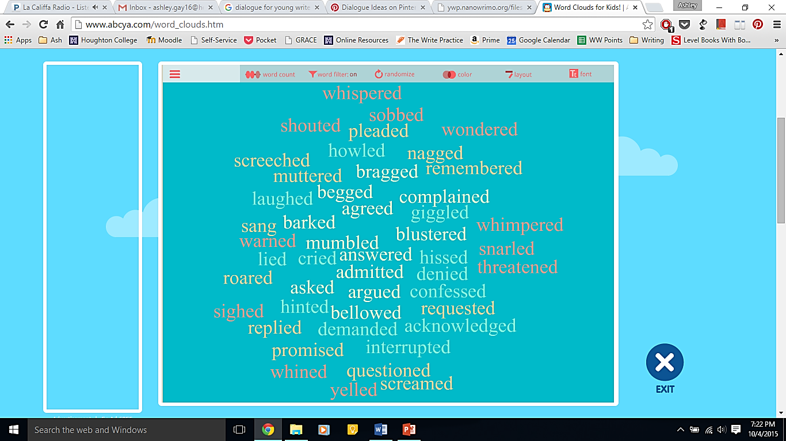
Dialogue Tags
A dialogue tag is a clause of two words that define who is speaking.
“I like you,” said Victoria.

Slide 8
On the lines below, write a short conversation using dialogue.
Example:
“I’m never speaking to her again!” Victoria decided. Marcus frowned at his friend.
“It wasn’t Carter’s fault, Vic,” Carter reminded.
“I don’t care. She worries me,” Victoria said with a cross of her arms.

