Slide 1
“Rise up
you Dreamers and Troubadours
of the endless journey...
Your dream begins."
Francis of Assisi

Slide 5
Dream it.
Be it.

Slide 6
My Learning Objectives:
I can identify and explore MY dreams, hopes, and aspirations for MY journey.
I can write a list of MY dreams, hopes, and aspirations for MY journey.

Slide 7
My Learning Objective:
I can identify and make inferences about Gandhi and rules that he lived by.

Slide 8
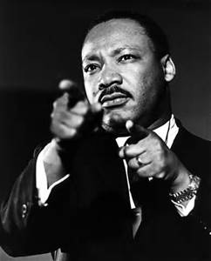
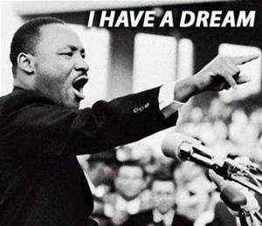

Slide 9
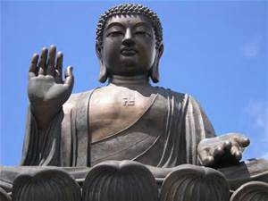
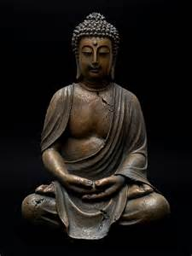

Slide 10
My Learning Objective:
I can identify and discuss reasons why the colonists were upset about the Stamp Act.

Slide 11
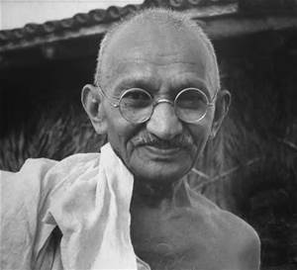
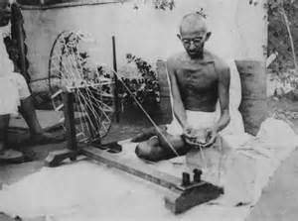
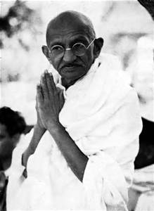

Slide 12
My Learning Objectives:
I can ask questions that would help me to think deeper about my dreams and about how one little person could change the world
I can choose words from Malala's speech that I could use in my poetry.

Slide 13
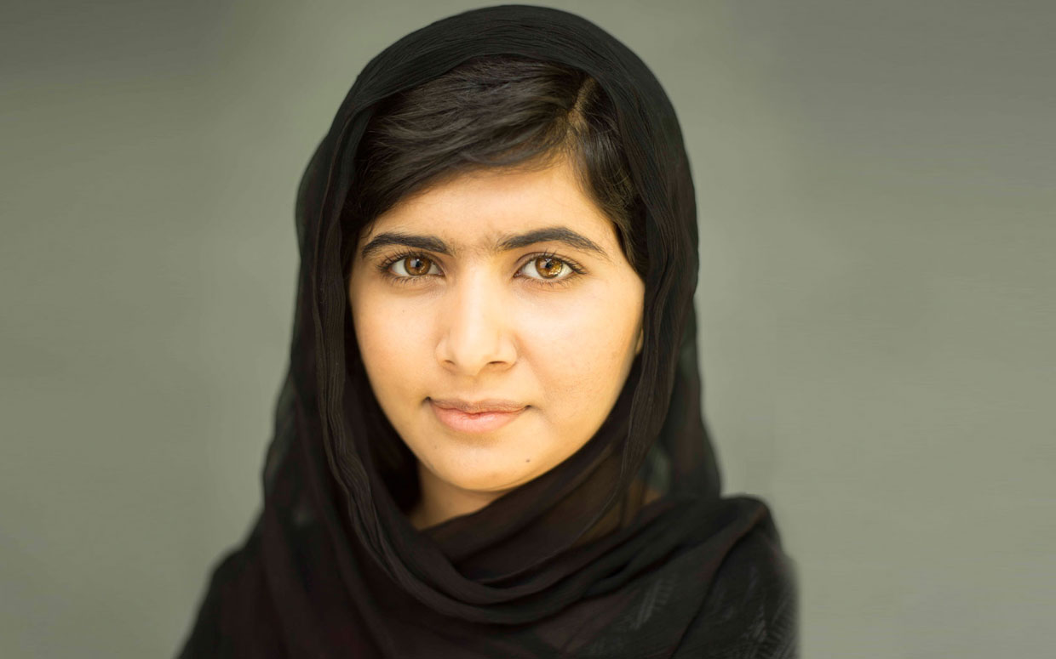
What if Malala came to our school? What would you say to her? What would you ask?
1240 × 775 - thebottomline.as.ucsb.edu

