Slide 1
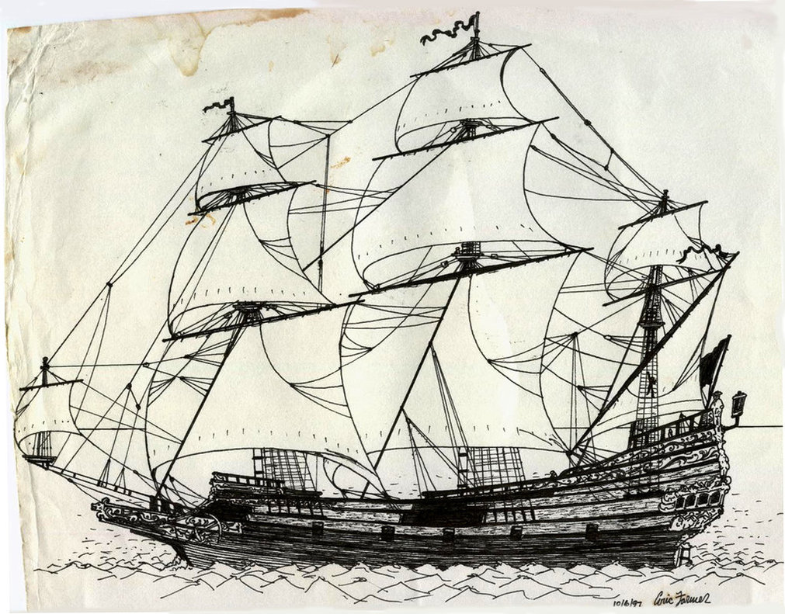
Explorers

Slide 2
Lesson 1

Slide 3
Marco Polo
Wrote The Travels of Marco Polo
Many Europeans wanted to go to Cathay (China).
Interested in the riches Marco Polo talked about No Europeans traveled to Asia by sea at this time.
No Europeans traveled to Asia by sea at this time.

Slide 4
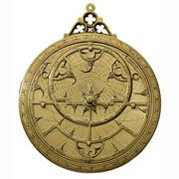
New Technology
Prince Henry of Portugal opened a school of Navigation.
Improved the compass and the astrolabe.
Improved maps
Learned how to sail a new ship called the caravel.
Long, narrow ship

Slide 5
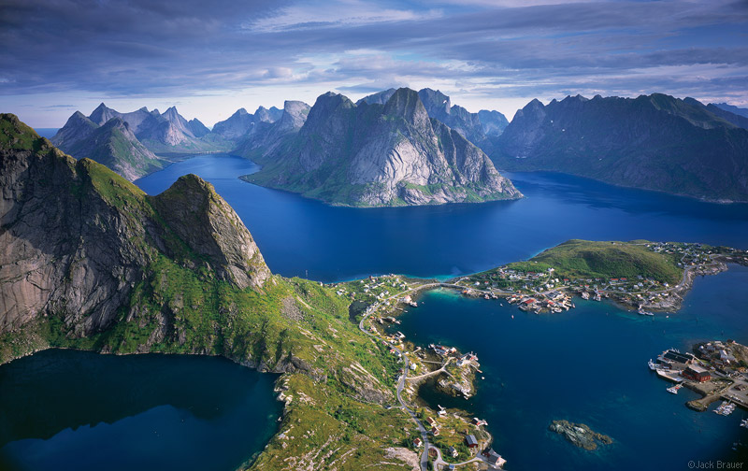
More of the World to Discover
Few Europeans knew there were other continents besides Europe.
Leif Erickson led a group called the Vikings to Norway.
Europeans traded with Africa.

Slide 6
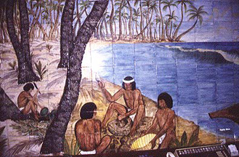
Christopher Columbus
Believed he could reach Asia by sailing west across the ocean.
King Ferdinand and Queen Isabella supported Columbus’s trip if he converted the people he encountered to the Catholic religion.
On October 12, 1492 Columbus, with his 3 ships landed on San Salvador.
Thought he was in Asia
Met Taino tribe

Slide 7
Route Columbus took

Slide 8
Lesson 2

Slide 9
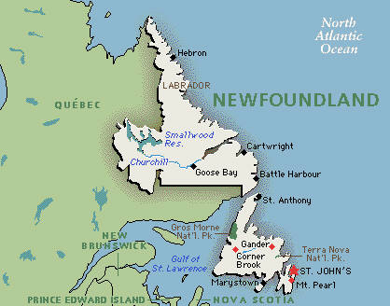
John Cabot
King Henry VII paid John Cabot to claim land.
Italian
Cabot claimed land for England.
Actually reached present day Newfoundland and Labrador.

Slide 10
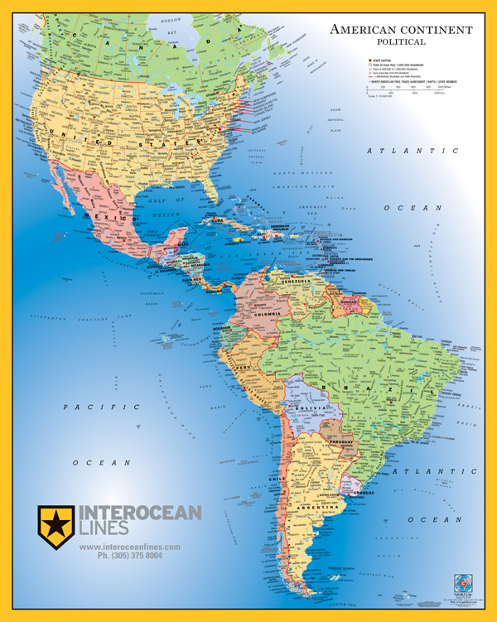
Amerigo Vespucci
Didn’t believe Columbus and Cabot found Asia.
Martin Waldseemüller drew a map of the new land and named it America after Vespucci.

Slide 11
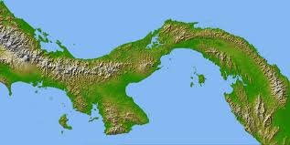
Vasco Núñez de Balboa
One of the first Europeans to settle in America.
Farmed on Hispaniola.
Fled Hispaniola and started settlement in Panama.
Traveled from South to North America by the isthmus.

Slide 12
Ferdinand Magellan
Portuguese explorer

