Slide 1
FOOD!!!
By: Harland L.Geffers
Food in Oregon

Slide 2
Food definition
Any nutrition substance that people or animals eat or drink, or that plants absorb, in order to maintain life and growth

Slide 3
Menu
Meals
Charbroiled Sicilian Marinated Zucchini 10.99 (11.00)
Garden burger an extra vegan burger 9.99 (10.00)
OPH Vegetarian Nachos 7.99 (8.00)
Beer Fondue Cheesy Fries 4.99 (5.00)
Beer Battered Fries 4.99 (5.00)
Hummus, Pita, & Seasonal Veggies 8.99 (9.00)
Desserts
White Chocolate & Toasted Coconut 8.99 (9.00)
Blondie with Ice Cream (GF)
English Heath Brownie with Ice Cream 5.99 (6.00)
Saint Cupcake 4.99 (5.00)
Sides
Green Beans with Cheesy Chess 3.50
Bressolsprots with butter3.25
Homemade Coleslaw 2.50

Slide 4
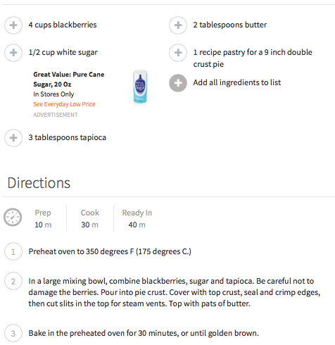
Black
Berry
Pie

Slide 5
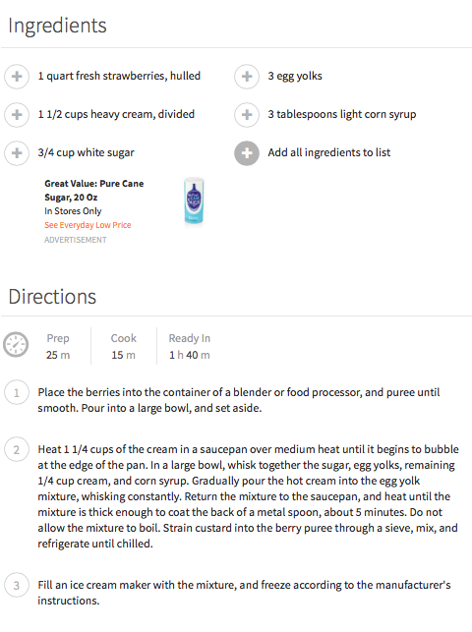
Strawberry Ice Cream

Slide 6
DINNER PLANS!!!
A cook out or picnic. At 12:00 to 10:00pm
Play soft ball
Invite the softball team Kiara, Haley, Tierney , Alley, Summer, Baileghy, and Me: Harland !!!
Have Garden burgers and chilly dogs
Side: Mud fries corn on the cob and baked potatoes
Desserts: homemade ice cream/ sundaes

Slide 7
Shopping List
Hamburger Rolls Potatoes
Hot dog Rolls French Fries
2 cans of Chilly Sour cream
Bacon bites
Corn on cob
Ice cream
Peanuts
Syrup up

Slide 8
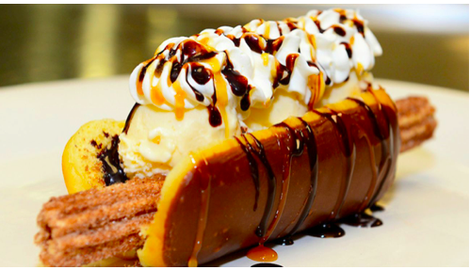
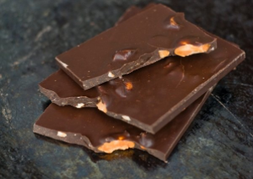
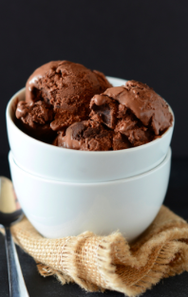
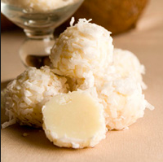
DESSERTS
Chocolate Bars with olive oil
Banana
With Bread
Sundae
Coconut Donuts
Health brownie with ice cream
White Chocolate with toasted
coconut

Slide 9
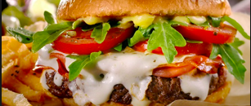
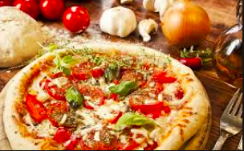
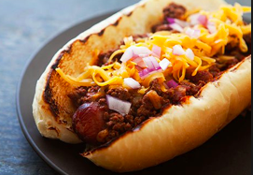
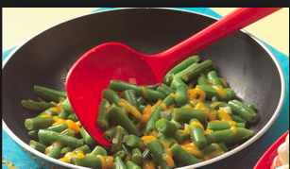
Meals in Oregon
Garden Burgers
Chilly Dogs
Pizza!!!
Cheesy Green beans
Pasta salide

