Slide 1
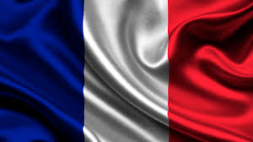
The Many Languages of France
By Kylee Elliott

Slide 2
Introduction
France is well known for its profound language, French, which is also France’s official language. But, France also has many other languages, to be exact there are neuf (nine) other. In which includes…Brenton, Occitan, Catalan, Basque, Alsatian, Picard or Chtimi, and Corsican. All of these languages have a story and important history to them. Also, if you ever plan on visiting France, you would need to know some of the more popular languages’ important terms and phrases that you might need to know and use one day while visiting.

Slide 3
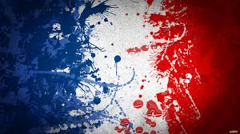
French
The language of French has a extensive amount of history. French is descended from Vulgar Latin. French also inherited several hundred words of Celtic source. Also, French also inbred several hundred more from Germanic. It mostly owes the greater part of its vocabulary also, its structure to Latin. By the ninth century French became separate from Latin ( Which is known as Old French, through the 9th to the 13th century) . The earliest text written in Old French, was Oaths of Strasbourg. Of the many syntacticals of Old French, Francine ( the north central linguistic spoken in Paris and the areas around it) in its time it was the the standard form of language increasing the political importance also, the cultural importance of Paris. During the 14th through the 16th French is known as Middle French. In this time many words and phrases were developed from Latin, Greek, and Italian. In the 17th century the modern French began . French didn't’t change much sence the Middle French.
https://en.wikipedia.org/wiki/Vulgar_Latin

Slide 4
Words and Phrases
English
French
Bathroom
Food
Store
Bakery
Chicken Tenders
Fries
American
Macaroon
Twelve
Thirteen
Thirty-nine
Hello
Yes
No
My name is…
HI
Grocery
Salle de bains
Aliments
Boutique
Boulengerie
Offres de poulet
Frites
Américain
Macaron
Douze
Trezie
Trente neuf
Bonjour
Oui
Non
Mon nom est
Salut grocery

Slide 5
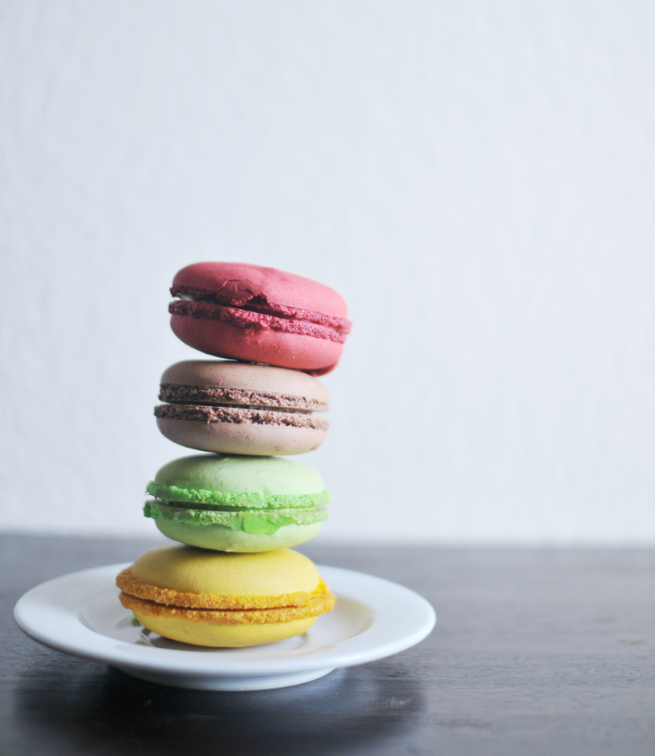
Alphabet
French
une | b | c
rè | e | f
g | h | je
j | k | l
m | n | la
p | q | r
s | t | dans
v | w | x
et | à partir de

Slide 6
Numbers
English
French
One
Two
Three
Four
Five
Six
Seven
Eight
Nine
Ten
Un
Deux
Quatre
Cinq
Six
Sept
Huit
Neuf
Dix

Slide 7
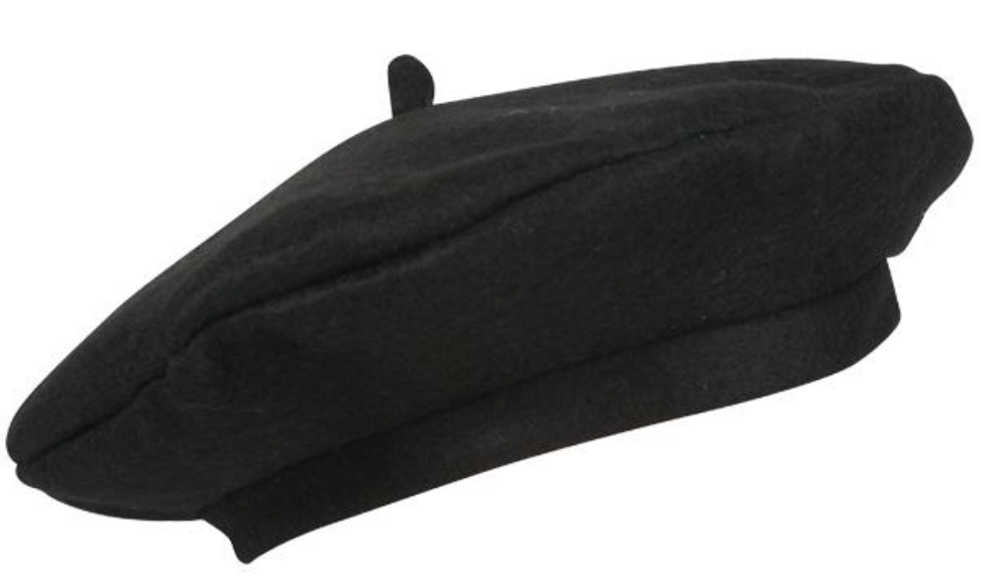
Other Languages
The less popular languages include Brenton, Occitan, Catalan, Basque, Alsatian, Picard also known as Chtimi, and Corsican. All of these are unique in their own way, but each, I have noticed, sound very similar. Although these language aren’t as common, you still should be able to recognize all of the languages identified in France.

Slide 8
Conclusion
Therefore, France has many different spoken languages. French is the official language of France. French has a great history and background. There are also other languages spoken in France. Some which might include Brenton, Occitan, Catalan, Bosque, Alsatian, Picard or Chtimi, and Corsican. Most of the people there will speak French, so you have to learn specific words or phrases to get around Paris or wherever you are traveling. Also, learning their alphabet and numbers would be useful.

