Slide 1
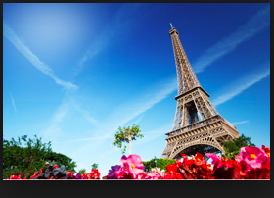
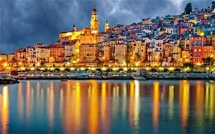
The geography of FRance
By: Payton Walsh

Slide 2
Table of contents
Slide 1………………………………………title page
Slide 2………………………………………………... Table of contents
Slide 3…………………………………France’s size
Slide 4………………………………highest point
Slide 5………………………………………temperatures
Slide 6………………………….greatest features
Slide 7………………………………… population

Slide 3
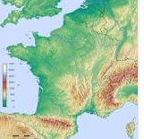
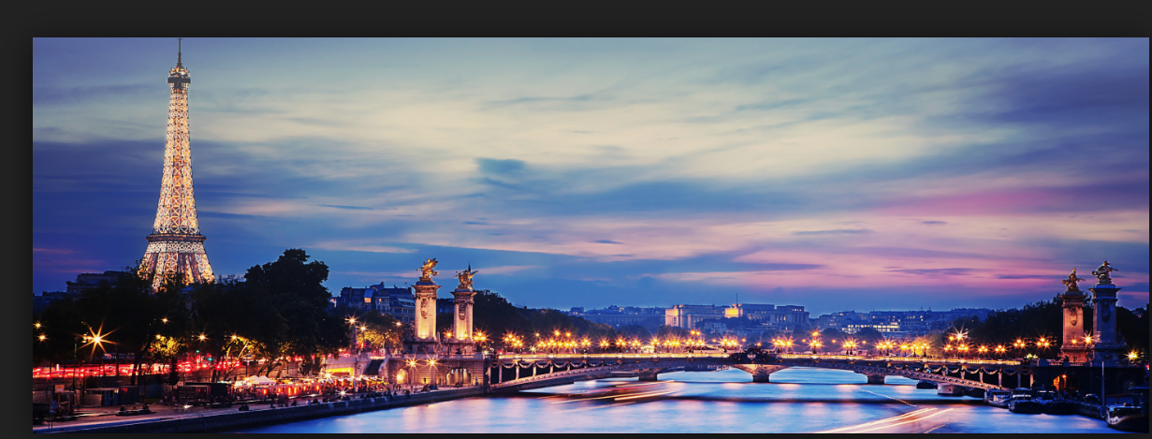
All about France
France all together is about 248,573mi squared. France is located in Western Europe. The country is known for fashion houses, classical art, and museums. OFFICIAL NAME: French Republic
FORM OF GOVERNMENT: Republic
CAPITAL: Paris
POPULATION: 66,259,012
OFFICIAL LANGUAGES: French
MONEY: Euro
AREA: 210,026 square miles (543,965 square kilometers)
MAJOR MOUNTAIN RANGES: Alps, Pyrenees, Massif Central
MAJOR RIVERS: Seine, Rhine, and Rhône

Slide 4
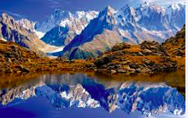
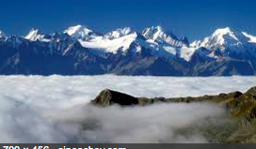
Highest point
The highest point in France is Mount Blanc. The summit of Mount Blanc is measured at 4,810.02m (15,781 ft).

Slide 5
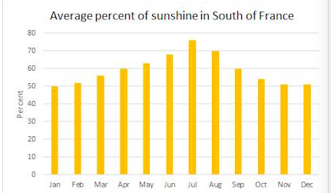
temperatures
The temperature in France on a hot day is 80 degrees. On a regular day france is about 50 degrees. On a cold day france is about 20 degrees or lower.

Slide 6
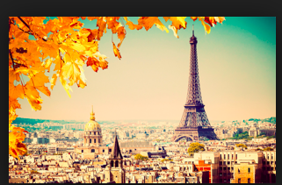
Greatest feature
One of the greatest features in France is the Eiffel Tower. The Eiffel Tower is located in Paris, France. The address for this is Champ de Mars, 5 avenue Anatole France, 75007 Paris, France. The height of this is 984’ the construction that started building the Eiffel Tower is January 28, 1887.

Slide 7
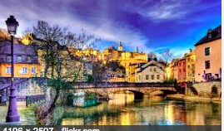
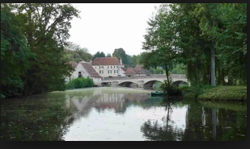
rivers
One river in France that is amazing and jaw dropping is the Alzette. The alzette river is the length of 73 kilometers (45 miles). It is located right at the tributary of the Sauer. This river is in Lexembourg City and Mersch. Another river is the Benaize river in France. This river is 79-kilometers (49 miles). This source is located near the La Souterraine.
The Alzette
The Benaize

Slide 8
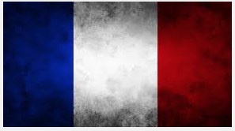
The end

