Slide 1
Judaism over the Centuries
Today you will learn about different revolts, migration, cultural traditions, and how Jews celebrate their holidays

Slide 2
If you were there…
“Foreign soldiers have taken over your homeland and are forcing you to obey their laws. Some people are urging you to stand up and fight for freedom. Your conquerors come from a huge, powerful empire. If your people revolt, you have little change of winning.
Will you join the rebellion? Why or why not?

Slide 3
Success?
Read the bottom of page 242.
Were the Jews successful in their revolt?
What happened?
Notice/Wonder on pg. 243

Slide 4
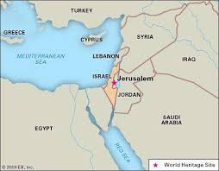
Migration
After the Second Temple was destroyed, thousands of Jews decided to leave Jerusalem and move to parts of Egypt

Slide 5
Judaism
For the Jews that did not move, their religion changed
Synagogues became more important after their temple was destroyed
Rabbis – religious teachers
They were responsible for interpreting the Torah and teaching the Jews their religion.

Slide 6
Two Cultures
Diaspora – the dispersal of the Jews
Jewish communities began to develop all around the world
Jews everywhere believed in God and the sacred texts, but since they were spread out, their customs were different
Language, rituals, and cultures changed

Slide 7
Traditions and Holy Days
Big Idea Worksheet
Hanukkah
Passover
High Holy Days

Slide 8
Homework
Read pages 92 – 94 and answer ALL of the questions

