Slide 1
The Early Hebrews
Today you will learn about Judaism, several important people, and many conquests of the Hebrews
October 1, 2018

Slide 2
If You were there…
You and your family are herders, looking after larger flocks of sheep. Your grandfather is the leader of your tribe. One day your grandfather says that your whole family will be moving to a new country where there is more water for your sheep. The trip will be long and difficult.
How you do you feel about moving to a faraway land?

Slide 3
The Hebrews
A new people group appeared called the Hebrews
A group of herders that developed a civilization that influenced later people groups
Everything we know about them comes from archaeologists and scribes

Slide 4
The Bible
The accounts from the scribes and archaeologists describe the history of these people
The laws of Judaism – Hebrew religion
These accounts became known as the Hebrew Bible
In Christianity, this is known as the Old Testament
https://www.youtube.com/watch?v=dM0fDtuRXdE

Slide 5
Abraham
God told Abraham to leave his home in Mesopotamia.
He left Mesopotamia and settled in Canaan
His descendants, the Israelites lived there for many years, but some of them eventually moved to Egypt.
Read “The Beginnings in Canaan and Egypt” on page 228-229.
What caused these people to move to Egypt?

Slide 6
The Exodus – 1200 BC
Moses – the leader of the Israelites
God told Moses to lead the people out of Egypt
Moses went to the pharaoh and demanded that his people were to be freed, but the pharaoh refused.
https://www.youtube.com/watch?v=HbFU_nHAdD8

Slide 7
The Plagues
Pharaoh finally agreed to let the Israelites go
Moses led his people out of Egypt in a journey called the Exodus
This was their release from slavery and it proved that God loved them

Slide 8
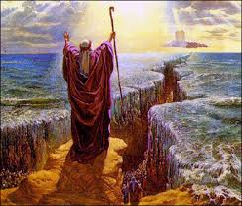
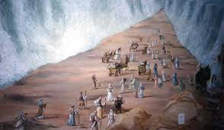
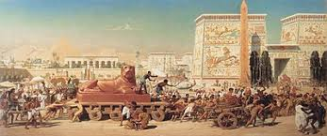

Slide 9
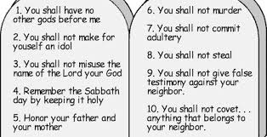
The Ten Commandments

Slide 10
Shaping their Society
The Israelites agreed to worship only God, they valued human life, self-control, and justice.
The Ten Commandments shaped the development of their society
They lived by these rules
What are some rules that you live by and that shape your life?

Slide 11
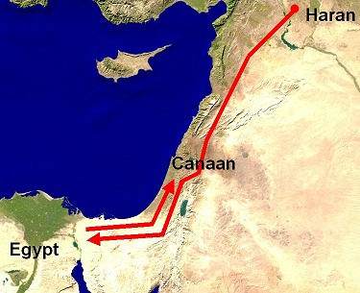
Reaching Canaan
The Israelites gained control of this land,
This land was an important source for farming and grazing
Called the “Promised Land”

Slide 12
Division
The Israelites divided into 12 tribes and lived in small communities
Each community had its own set of leaders.
There was no central leader at this time

Slide 13
Kings Unite
Frightened by powerful invaders, the Israelites came together under one ruler.
Why would this help them?

Slide 14
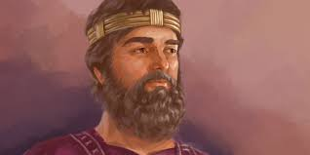
King Saul
First king of Israel
He was not a strong king – he did not win many battles

Slide 15
King David
David was admired for his military skills and the people respected him.
He was loved by the Israelites
David defeated Goliath
What can we learn from this story?

Slide 16
King Solomon
David’s son
Took the throne in 965 BC
Solomon improved the city’s walls and roads
These were paid for in taxes and built by slaves
How do you feel about the slavery? Weren’t the Israelites slaves to Egypt?

Slide 17
Invaders
After King Solomon’s death, people argued over who should be king
Conflict tore Israel apart
The kingdom split into two – Israel and Judah
The people of Judah became known as the Jews

Slide 18
Women in Israelite Society
Government and society were dominated by men.
Men made decisions and a woman’s husband was chosen by her father.
How do you feel about this?
How does this compare with our society?

Slide 19
Contributions
Read “Women in Israelite Society” on page 235
Who were some of the women who made contributions?

Slide 20
Summary
Write down two things that your learned today. Use your notes to help you.
The instructions that God gave to the Hebrews shaped their religion.

