Slide 1
Dynamic vs. Static Characters
Miss Gay
6th Grade Writing

Slide 2
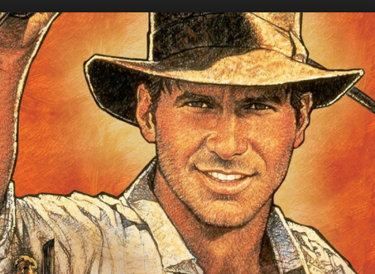
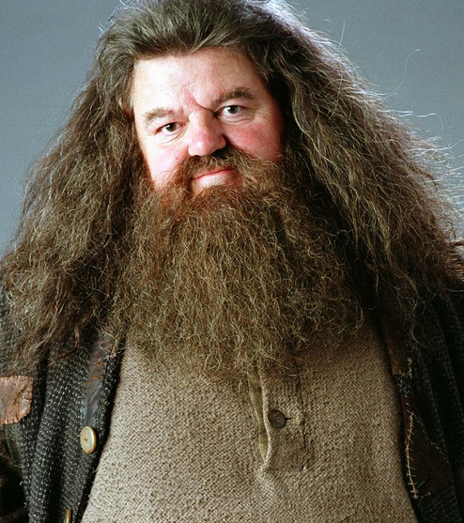
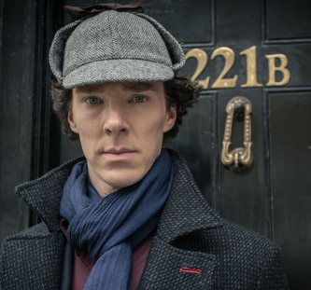
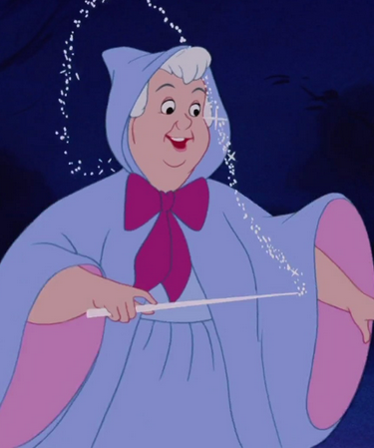
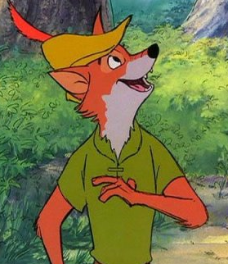
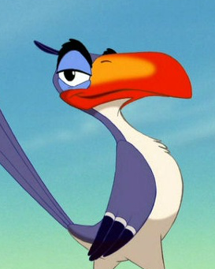
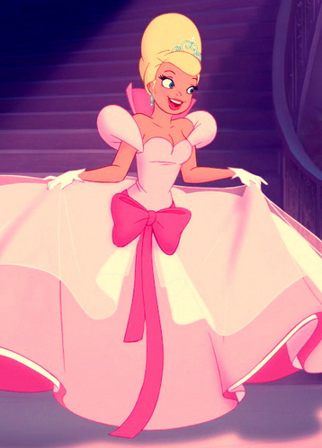
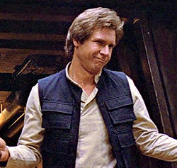
Static Characters
A static character is a character that does not change throughout the course of the story.
Examples:
Indiana Jones
Hagrid
Sherlock Holmes
Fairy Godmother
Robin Hood
Zazu
Charlotte La Bouff
Han Solo

Slide 3
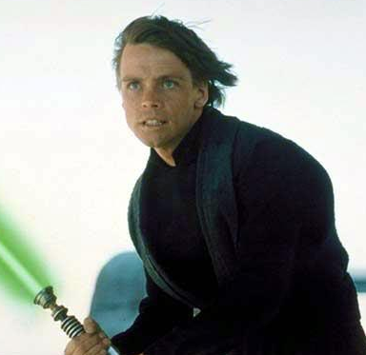
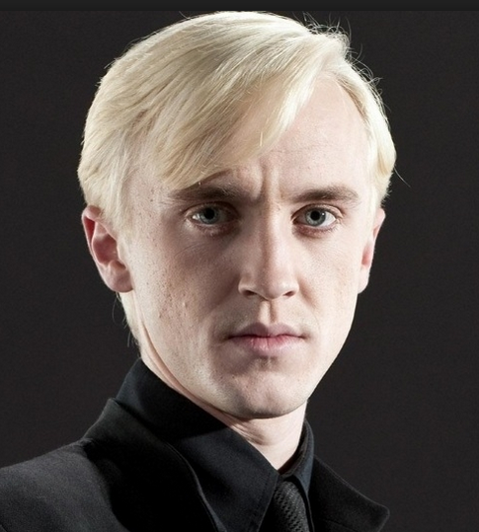
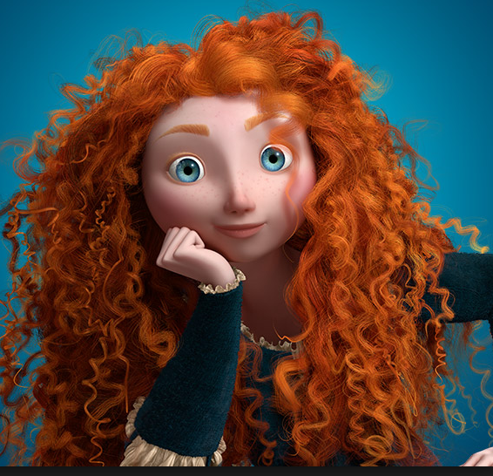
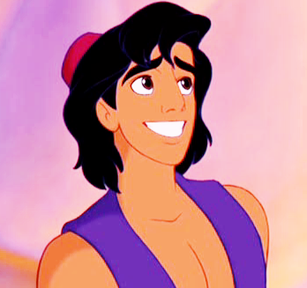
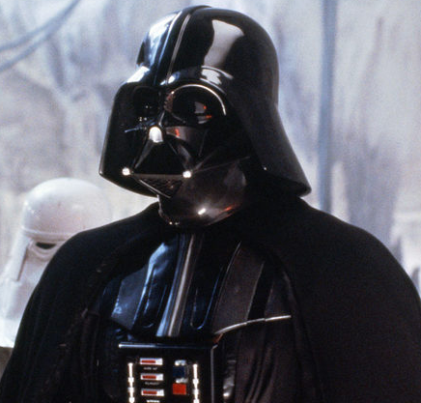
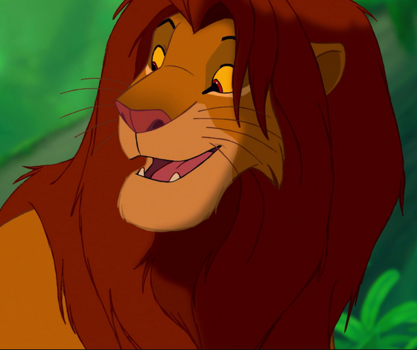
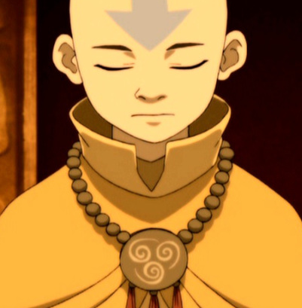
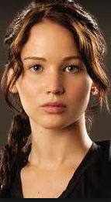
Dynamic Characters
A dynamic character is a character who does change throughout the story.
Examples:
Merida
Aladdin
Luke Skywalker
Draco Malfoy
Darth Vader
Simba
Aang
Katniss

Slide 4
Practice!
With your small group come up with 6 more static characters and 10 more dynamic characters.
Put these on your Dynamic vs. Static organizer.

