Slide 1
Ireland Recipes
By Allison Sumeriski

Slide 2
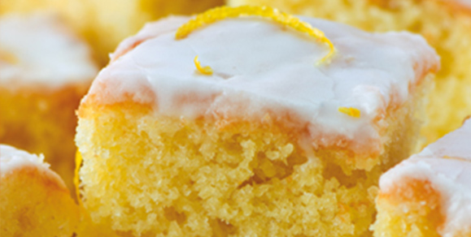
Lemon Drizzle Squares
1 ½ cups of self raising flour
1 tablespoon of baking powder
I cup and 2 tablespoons of caster sugar
16 tablespoons of kerrygold salted butter
4 large eggs
2 grated rinds of lemons
3 tablespoons of milk
Icing: 1 cup of icing sugar 1 rind and the juice of a lemon

Slide 3
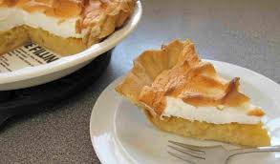
Apple Amber
Pastry dough= single crust pie
4 cooking apples
2 tablespoons of water
Juice of 1 strained lemon
3 large eggs separated
4 ounces of sugar

Slide 4
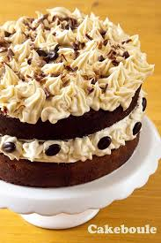
Irish Coffee Cake
1 ½ cups of butter
1 ½ cups of caster sugar
1 ½ cups of self raising flour
½ tablespoons of salt
6 teaspoons of instant coffee
4 tablespoons of hot water
4 large beaten eggs
Butter and flour for the pan
Baking parchment

Slide 5
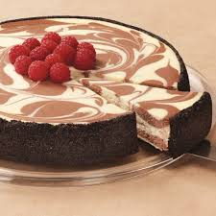
Marble Cheesecake
Crust- 1 cup of flour
2 vanilla beans
¼ cup of granulated sugar
1 teaspoon of lemon zest
½ cup of unsalted butter cube
1 egg
For the cheesecake-
1 ¾ cups of granulated sugar
1 ½ teaspoons lemon zest

Slide 6
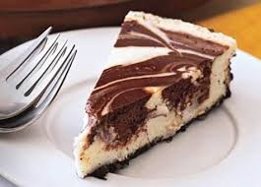
Marble Cheesecake
1 ½ teaspoons orange zest
1 ½ teaspoons of vanilla
5 large eggs
3 large egg yolks
¼ teaspoon of salt
2 ½ pounds of softened cream cheese
4 tablespoons of flour
¼ cup of Irish Cream

Slide 7
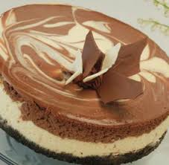
Marble Cheesecake
1 tablespoon of instant coffee crystals
1 tablespoon of cocoa
2 tablespoons of hot water

