Slide 1
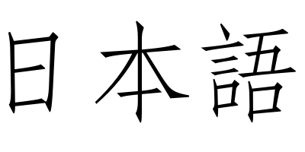
History Of Japanese Language.
The Japan language is spoken by 125 million people across the world, mostly in Japan. Japan Language is the member of the language Japonic family. In the years (794-1185) Japan language had started to be taught, by (1185-1160) the language became more fluent and most people in the generation were starting to learn it or already learned the language.

Slide 2
Modern Japanese Language
The Japanese language has made a lot of progession since they have created it. Modern Japanese is considered the Edo period in 1600. Since 1854 the population in people staring to learn Japanese almost doubled in the year 1854. Not only kids in Japan are trying to learn there home language people all over the world are learning Japanese Language for other purposes

Slide 3
English Alphabet In Japanese
This is a keyboard that shows what letter a Japanese letter is in the English language. It is helpful for people learning Japanese because (if they speak English) they can look at the English letter, and see what that letter would be in Japanese.

