Slide 1
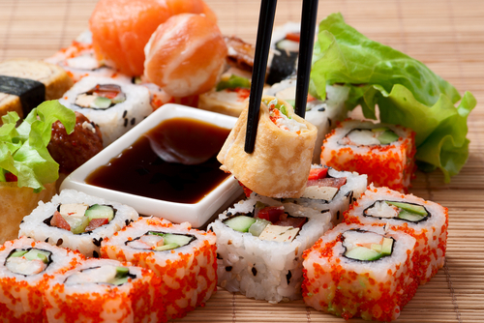
Japanese Food
By: Trace Woodruff

Slide 2
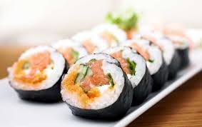
Variety Of Japanese Foods.
Most people think that Japanese food is mostly sushi and different styles of it. Sushi is one of the most popular foods in Japan. But, there is way more than sushi (or fish) they have vegetables, fruits, meats, etc. Some of the food there we don’t have in America. Some of their food is only in the country Japan.

Slide 3
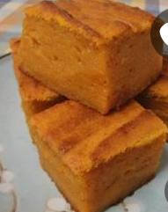
Pumpkin Moch’i
2 ½ cups of Rice Flour
2 teaspoons of Baking Powder
2 cups White Sugar
4 eggs
1 can Pumpkin puree
1 can sweet condensed milk
1 cup butter, melted
2 teaspoons, vanilla extract

Slide 4
How To Bake Pumpkin Moch’i
Preheat Oven to 350 F. Lightly Grease a 9x13 inch baking dish.
Sift together the rice flour, baking powder, and sugar in a large bowl. Mix together eggs, pumpkin puree, condensed milk, butter, and vanilla extract in a separate bowl. Stir the egg mixture in the rice flour. Pour into Pan.
Bake for 1 hour. Allow to cool before serving.

Slide 5
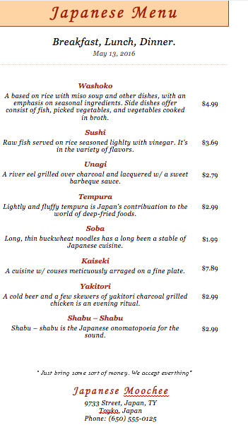
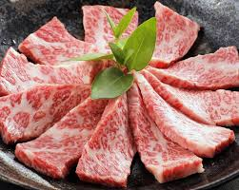
What a Japanese Menu would probably look like.

Slide 6
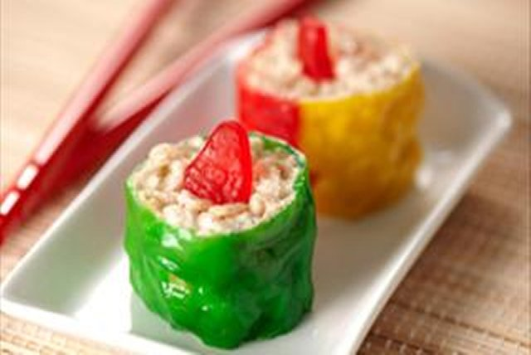
DIY Candy Sushi
Ingredients
Fruit Roll Ups
Favorite Kind of Cereal
Swedish Fish ( For décor)
Instructions
Roll Out Fruit Roll Ups and sprinkle flour. Add your cereal on the left side and start to roll your “sushi” up .

Slide 7
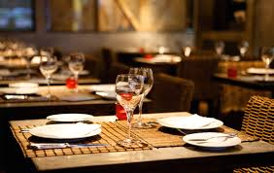
Planning My Dinner
When I create my food, I’m going to invite my friends & family. Most of my friends and family have never had Japanese food. I personally never had Japanese food. 5 people will be coming to my food event. At 4:30 PM on Friday, May 20, 2016. I will be serving Pumpkin Moch’I with Japanese carbonated soda, also with a side of candy sushi

Slide 8
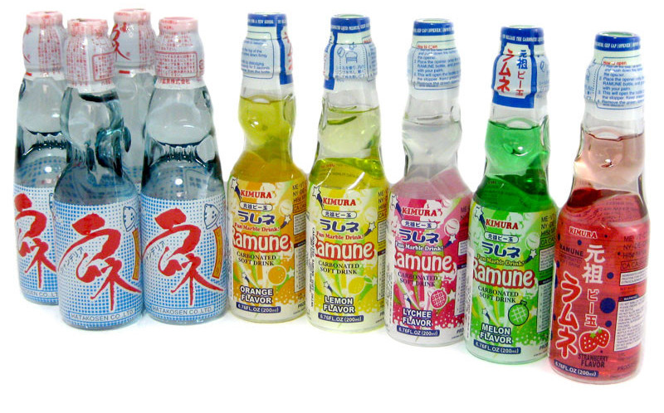
Japanese Carbonated Soda
This kind of “odd” soda has been around since the 1940’s. And has sold over 100 million bottles. This soda is odd because there is a little ball at the top full of chemicals to help make the drink fizzy so when you drop the carbonated ball it fizzed up and you have just made Japanese Carbonated soda.

