Slide 1
Language of France
By: Payton Walsh

Slide 2
Hello my name is Payton
Im going to tell you about the history of the spoken language French
im also going to tell you how to say some sentences or words that are spoken in French

Slide 3
French
People who live in France speak the language of French
“la vie est belle”
In English that quote stands for “life is beautiful”

Slide 4
quotes
“la vie est belle” stands for “life is beautiful
“c'est cela l' amour, tout donner tout sacrifier sans 'espoir de re tour.” this stands for “this is love, give everything, sacrifice everything without any hope of re tower.”
“je t’aime” stands for “I love you”.

Slide 5
phrases
Im running late= je suis en retard
How are you?= comment allez-vous
Hello= bonjour
Je vous remercie= thank you
Love of my heart= amor de mi corazón
Sweetheart= amoureux
My love= mon amour
Good bye=

Slide 6
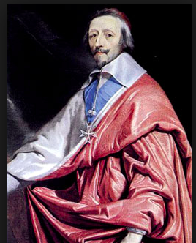
History
The language French is that French was very important to people who moved there from a different place. The language French was discovered/made up Vulgar Latin. He discovered this at the Roman Empire. For a while what is now called French language used to be called Old French from the 9th to the 13th cent. “In 1635 the French Academy was founded by Cardinal Richelieu to maintain the purity of the language and its literature and to serve as the ultimate judge of approved usage” this quote shows that the language French is important because it helped a lot of people understand eachother back then and now.

