Slide 1
Hebrews and Judaism

Slide 2
If you were there…
You and your family are herders, looking after sheep. Your grandfather is the leader of your family and says your whole family will be moving to a new country where there is more water and food for your flocks. The trip will be long and difficult.
How do you feel about moving to a faraway land?

Slide 3
Who were the Hebrews?
A group of herders that developed a civilization that influenced later groups of people

Slide 4
Bible
Accounts describing the history of the Hebrews
These accounts became known as the Hebrew Bible.
In Christianity, this is known as the Old Testament.
Judaism:
the Hebrew religion

Slide 5
Abraham
God told Abraham to leave his home and go to new land in the west.
Abraham settled in the Canaan where the Israelites lived.
Israelites moved to Egypt.
Egypt’s ruler, the pharaoh, feared the Israelites might become too powerful, so he made the Israelites slaves.

Slide 6
Moses
God told Moses to lead the Israelites out of Egypt.
Moses went to the pharaoh and demanded the Israelites be freed, but the pharaoh refused.
After the pharaoh refused, plagues struck Egypt.
The plagues frightened the pharaoh so he freed the Israelites.
https://www.youtube.com/watch?v=HbFU_nHAdD8

Slide 7
Exodus
The journey of Moses leading the Israelites out of Egypt
The release from slavery showed the Israelites that God loved them and was protecting and watching over them.
Throughout history, slaves have found hope in the stories of Moses.

Slide 8
Examine the Map
Examine the map on page 229 of your textbook.
What natural features did Abraham and Moses follow on their long journeys?
How do you think this impacted their journeys?

Slide 9
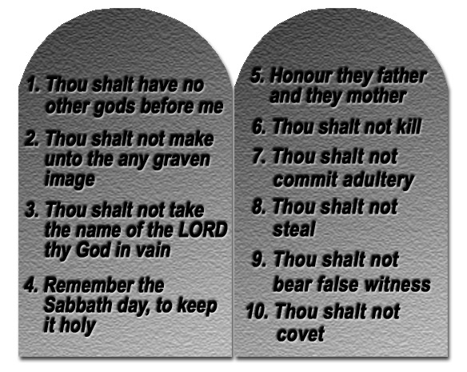
Ten Commandments
Moral laws written on stone tablets.
God gave Moses the stone tablets on top of Mount Sinai.
The Ten Commandments shaped the development of Israelite society.

Slide 10
Reaching Canaan
The Israelites reached Canaan and took control of the land.
The land was important for farming and grazing.
This land was called the “Promised Land”.
The Israelites divided into twelve tribes.
There was no central government; however, each tribe had its own set of leaders.

Slide 11
Uniting Together
Israelites were threatened by the Philistines, so they banded together under a single ruler named Saul.
Why would uniting under one ruler help the Israelites?

Slide 12
King Saul
First king of Israel
Saul was not a strong leader and never won total support.

Slide 13
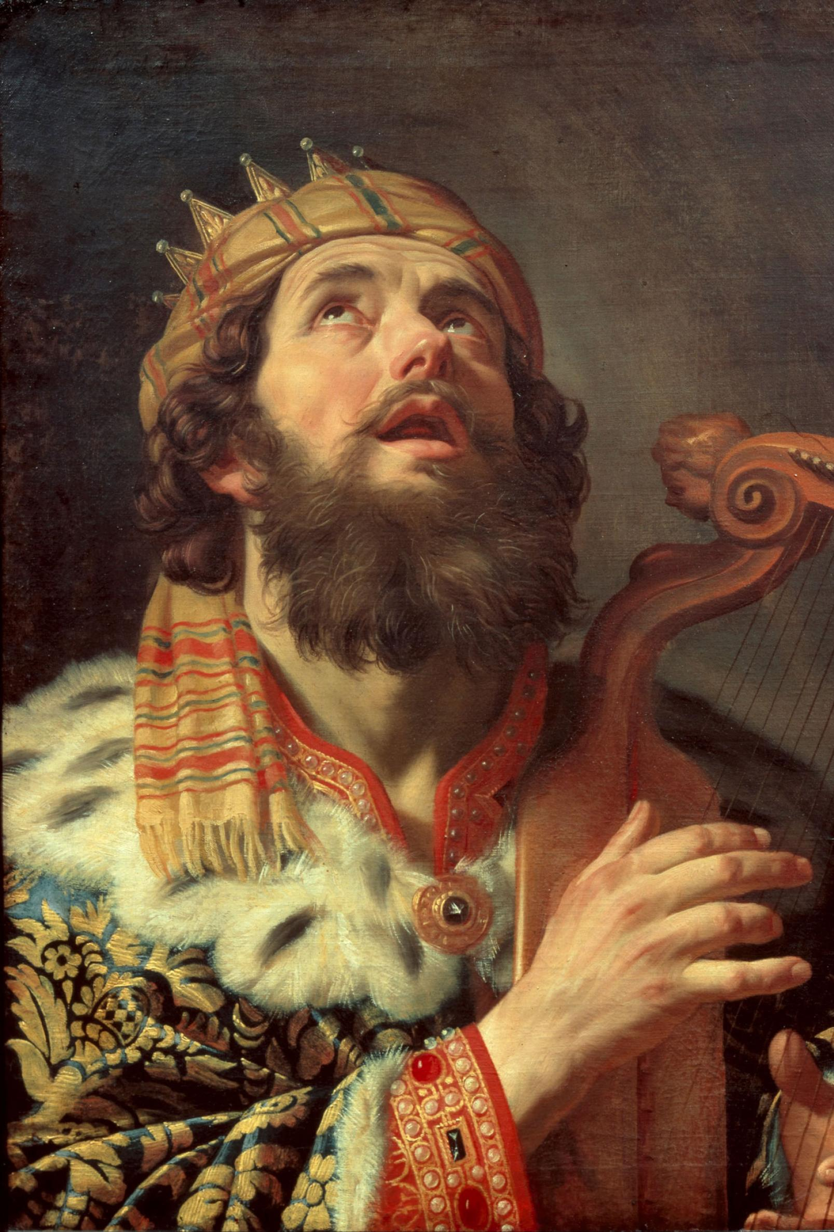
King David
David had support from the people to become king.
Defeated the Philistines
Established the capital of Israel in Jerusalem

Slide 14
King Solomon
David’s son
Improved the city’s walls and roads
The walls and roads were paid for in taxes and built by slaves.

Slide 15
Revolts Broke Israel Apart
After Solomon’s death, revolts broke out over who should become king.
This tore Israel apart and split it into two parts: Israel and Judah.
The people of Judah became known as Jews.

Slide 16
Women in Israelite Society
Government and society were dominated by men.
Men made the decisions
A woman’s husband was chosen by her father.
How do you feel about this?

