Slide 1
My dream Vacation to
Alaska: planning the trip
By Eli Wade

Slide 2
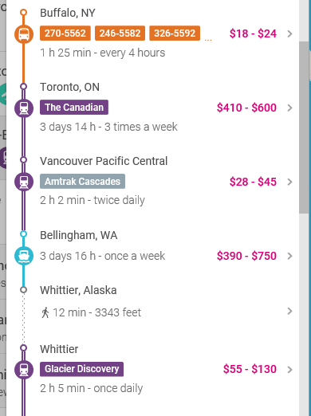
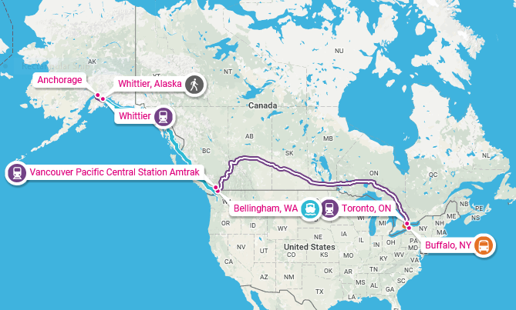
Multi-vehicle transportation

Slide 3
Using bus, train, and boat
One way to get to Alaska would be using multiple vehicles to transport. This could cost up to $1,549. At first you would ride the bus to Toronto Canada. The time to get there would be 1h 25 mins. In Toronto you would get on the Canadian railroad for 3 days and 13 hours. After that you get on another train for 2 hours so you can get on a fairy for 3 days. Then you hop on a train for 2 hours and walla, you are in Alaska. In all, it will take you more than 7 days. So you will want to stay for quite a bit in Alaska.

Slide 4
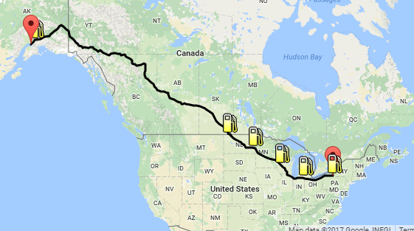
Car
To get to Alaska, it will cost $382.74. The total distance would be 4,145.18 miles. The time would be 70 hours. Although you might stop at hotels. You will need a passport though because you are driving into Canada. The passport would cost about $140.

Slide 5
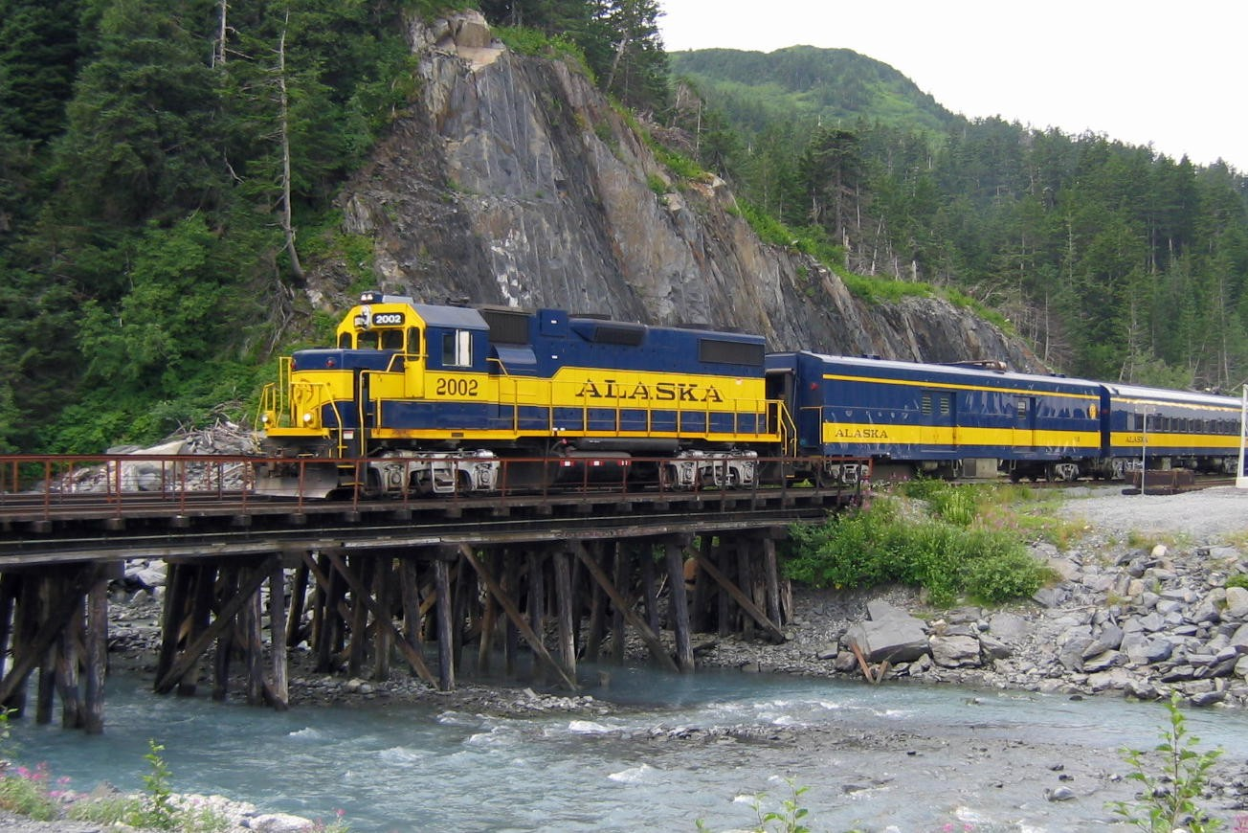
Train
You can not ride a train to Alaska, but there are many train rides in the National Parks though.

Slide 6
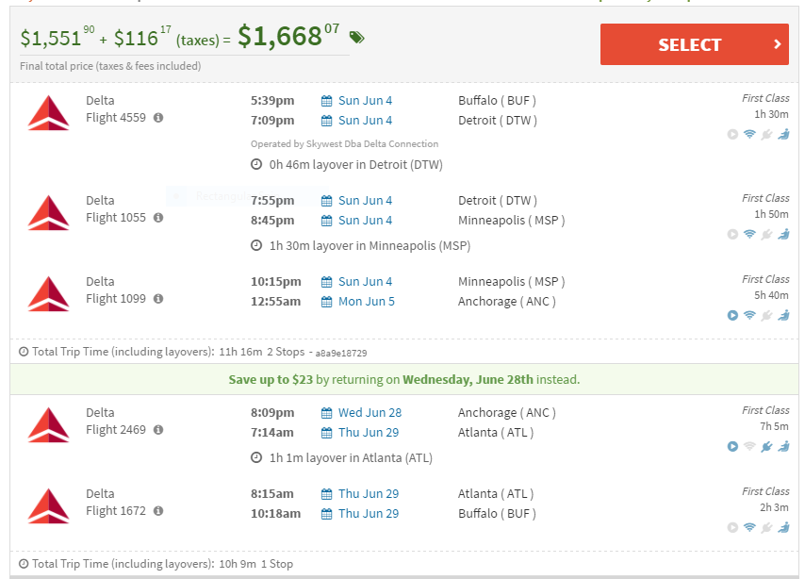
Flying
Flying to Alaska will cost $1,668.07, it will take about 9 hours to get to Alaska. From the Buffalo airport to Alaska is a bit more than 4,00 miles.

Slide 7
The luxury of riding in first class
The first luxury would be that you can now get tons of leg room, your chair can even go back so you can fall asleep. You also get a TV on the chair in front of you.
You can also get free WIFI and outlets for your phone.
And because you would be traveling over 1,500 miles, you get a full meal.
You can get on and off the plane first and everything goes faster.

Slide 8
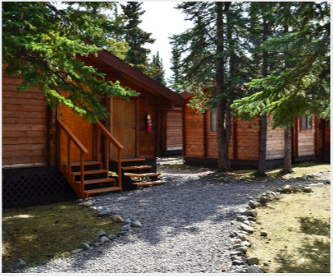
Cabin
At this cabin in McKinley Park you get free WIFI, free parking, and there is even a restaurant. A good thing to if you are an outdoor type person, is that you are in the middle of the woods.

