Slide 1
Chapter 2 Native Americans

Slide 2
Timeline of Events
Page 1 – shows the time that events took place 12,000 years ago to the present
Page 2 & 3 – Overview of the people groups we will be studying throughout this chapter.

Slide 3
Comparing and Contrasting
To compare means to determine the similarities between two topics.
To contrast means to determine the differences between two topics.
Being able to determine the similarities and differences between two topics is a very valuable skill. We will be comparing and contrasting throughout this unit.

Slide 4
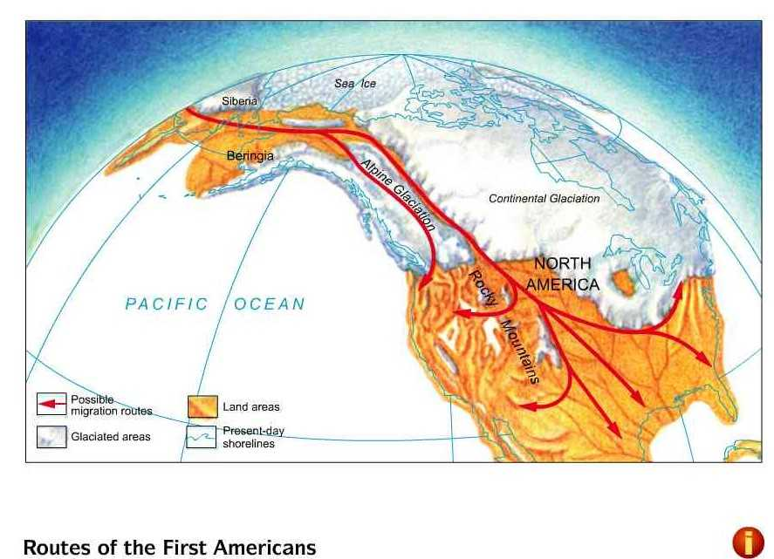
Land Bridge Theory

Slide 5
LAND BRIDGE THEORY Page 53
12,000 years ago
Bridge of land between Asia and North America
Hunters and families crossed from ASIA to North America
Migration: movement of people

Slide 6
EARLY WAY OF LIFE Page 55
Early people lived a nomadic lifestyle –moving from place to place.
Scientists know this because they found spear points near bones of animals. These are called ARTIFACTS because they are objects made by people.
Hunting and gathering of food was the main source of survival, but eventually this changed when the climate became warmer and drier.
Agriculture or farming allowed people to settle in one place (planting and growing crops).

Slide 7
Civilization Page 56
A civilization is a group of people who all have similar:
ways of life
Religion
learning

Slide 8
OLMEC CIVILIZATION
MAYAN CIVILIZATION
SIMILARTIES BETWEEN THE OLMEC AND MAYAN CIVILIZATAION

Slide 9
OLMEC
MAYA
Came to be between A.D 300 and A.D 900.
Ruled in Guatemala, and northern Belize.
Developed their own writing system based on hieroglyphs.
They developed a counting system that included the number zero.
Maya was divided into social classes.
Built more than 100 cities.
Earliest in the Americas (1500 B.C to A.D 300)
Used rivers to travel between cities.
They built trade systems, created writing and counting systems.
They developed the 365 day calendar.
Called the “mother culture”
Both ruled in modern day southern Mexico.
Developed their own writing systems.
They both had their own counting systems.
No one is sure why either civilization feel from power.
Both civilizations have influenced many other cultures.

