Slide 1
THE NORTHWEST AND THE ARTIC

Slide 2
Region of Plenty
Present day Oregon, Washington, and western Canada.
Ocean winds brought heavy rains, which produced tall and thick forests.
Kwakiutl and Chinook people groups of the North
People met their needs by fishing, hunting and gathering.
Natural resources used: waters, salmon, and whales. Whales provided food and fat that was melted to make oil for lamps.

Slide 3
Resources of the North
Trees provided wood for houses, tools, and boats.
Makah longhouses: all members of the family clan (extended family) lived there.
Trading was a large part of the region’s economy (or how they use resources to meet their needs).

Slide 4
The Arctic
near the North Pole
flat plain that is frozen all year
Aleut and Inuit people groups
People hunted foxes, caribou, and polar bears.
Seals were caught for food and skins to make clothes and tents.
lived in homes made of ice called igloos

Slide 5
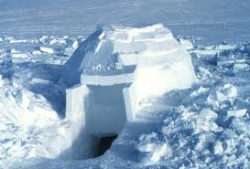
Shelter: igloo

