Slide 1
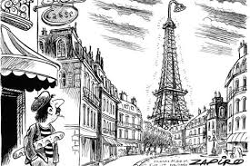
Beinvenue À Ma Belle Maison
Welcome to My Beautiful Home

Slide 2
Objects to bring
A food from your country
A beverage from your country
Wear something from your country
Decorate house using Eiffel tower from downstairs
Also use cheap decorations from Dollar General such as streamers glitter and possibly balloons
Create gift bags for invites including a macaroon, Paris socks, Paris lotion, and a home made charm macaroon necklace
Buy berets for everyone who is invited
Get French music on my phone to play on the speaker
Shirts with x or o on them

Slide 3
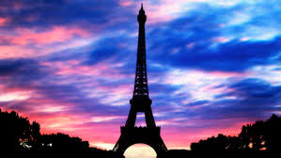
Things to do
Play air-hockey
Play corn hole
Jump on the trampoline with balloons on them
Confetti eggs
Play ping pong
Play volley-ball
Have a campfire
Play human tic-tac-toe
Play soccer
Play catch

Slide 4
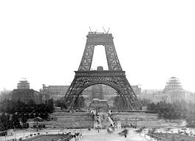
Invites
Lia and Emily Kopsaftis
Brooke , Lexi, and Alivia Crossley
Sophia Griggs
All girls in six grade
Melena
Abby Coble
Rachel Porter
Analiese Babbitt
Amy and Mike Berardi

Slide 5
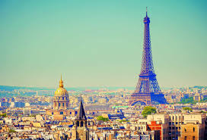
When and where
Av. Basquet, Paris
July 16th 2016
Be here at 10:00am
Leave 17th
Leave: 1:00pm
Bring Snacks from your Country

Slide 6
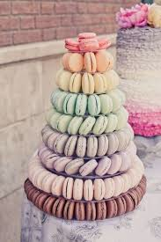
Food
Gougeres
Croissant
Stackaroons
Paris brest
Ratatouille
Stroodle waffles
Croque monsieur
Chips
Chocolate covered strawberries
Fruit tray
Vegetable tray
Smores

Slide 7
Shopping list
Stroodle waffel
Chips
Vegetable tray
Fruit tray
Yeast
White sugar and confectioners’ sugar
Almonds
Shredded Gruyère cheese
Grated nutmeg
Heavy cream
Onions
Minced garlic
Eggplant
Squash
Red bell pepper
Yellow bell
Mini sweet peppers
Thyme leaves
mascarpone
Streamers
Glitter
Balloons
Confetti
Eggs
Chocolate squares
Paris socks
Berets
Itunes music
Paint
Paris lotion

Slide 8
Invites need to…
Sleepwear
Outside clothing
Bring food from your country
If have any activities bring those
Get along with everyone
Pet Sobe and Skylar
Behave or we will kick you out … ☺

