Slide 1
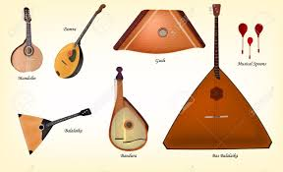
Russian Music
By: Shawn Patrick

Slide 2
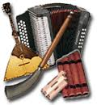
Introduction
Welcome to the world of traditional russian music.

Slide 3
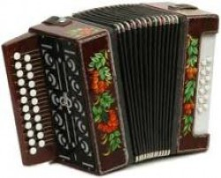
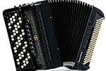
Accordions
Garmon: A traditional reed
instrument with two key rows; one
for melodies and one for accompaniments.
Bayan: An accordion known as the
“button accordion” due to the 97
buttons on both handholds.

Slide 4
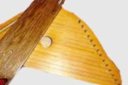
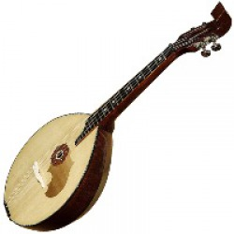
String Instruments
Gusli: An Old Russian string
instrument that can play chords or
melodies by plucking.
Domra: A banjo-like Russian folk
music instrument with four strings
And played with a mediator; was a prototype of the balalaika.

Slide 5
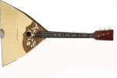
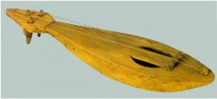
String Instruments Continued
Balalaika: A guitar-like string
instrument that emerged from the
Domra; has three strings and a triangular base
Gudok: A pear shaped string
instrument

