Slide 1
Steve Jobs Commencement Speech
By: Ms. Boucher

Slide 2
Lesson 6

Slide 3
Who was Steve Jobs?
Started Apple
A company who makes ipad, iPhones and macs, and Pixar, the animation company.
Steve Jobs died of cancer in 2011.

Slide 4
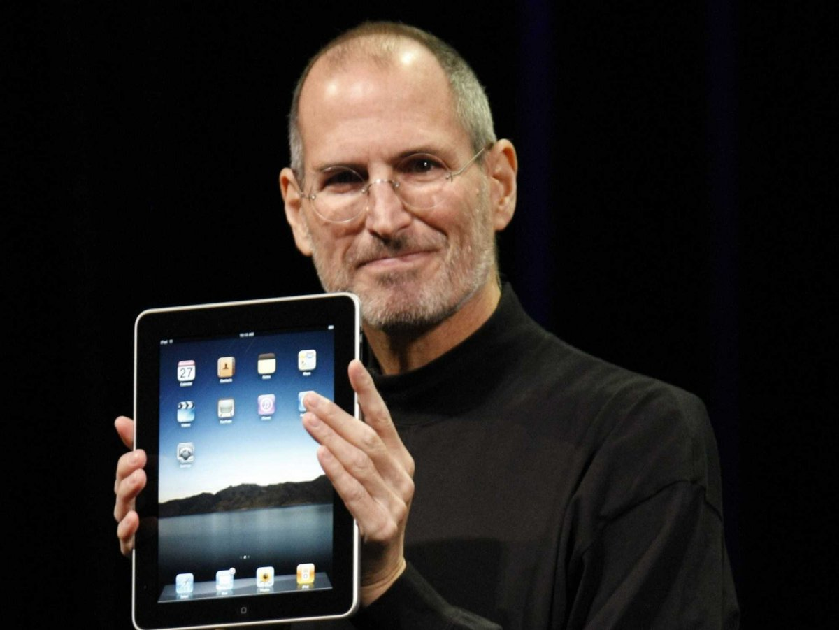
Steve Jobs

Slide 5
Discuss these questions in pairs
What does this introductory paragraph tell you?
What do we learn about Steve Jobs?
What is the structure of this speech going to be?
Why would he structure it this way?

Slide 6
Steve Jobs Speech
http://www.ted.com/talks/steve_jobs_how_to_live_before_you_die?or%20http:/www.youtube.com/watch&v=UF8uR6Z6KLc

Slide 7
Reading Closely: Guiding Questions handout
Look at the “Questioning Texts” row of the chart.
Which of these questions do you think will help our understanding to find the gist of Steve Jobs speech?

Slide 8
Read paragraphs 6-8 again
What do you understand from this excerpt so far?
Reread paragraph 6 and “what is the gist of this paragraph? What is this paragraph mostly about?”
Record gist in margins of Steve Jobs speech. Circle unfamiliar words.
Share with class what you wrote.

Slide 9
Strategies for determining unknown words
Accompany glossary at the end of the page.
Read sentence around word to help understand the word from the context of the sentence.
Invite other students to help you explain the word.

Slide 10
Lesson 7

Slide 11
Learning Targets
“I can read Paragraphs 6-8 of the Steve Jobs speech closely in order to answer text-dependent questions.”
“I can choose details from Paragraphs 6-8 of the Steve Jobs speech to support a claim.”
“I can connect the events described by Steve Jobs in Paragraphs 1-8 of his speech to those experienced by Bud in the novel Bud, Not buddy.”

Slide 12
Close Reading Guide

Slide 13
Forming Evidence-Based Claims

Slide 14
Forming-Based Claims Graphic Organizer
Claim: “You have to trust that the dots will somehow connect in your future.”
What do you think was the question that prompted this claim?
Focusing Question: “How will having an idea of the question help you to find details to support the claim?”

Slide 15
Steve Jobs speech
Annotate. Underline “I decided to take a calligraphy class…typography great.” In margins write “connects to his future”

Slide 16
Lesson 8

Slide 17
Learning Targets
“I can get the gist of paragraphs 12-14 of the Steve Jobs speech.”
“I can identify the meaning of unfamiliar vocabulary from the context.”

Slide 18
Lesson 9

Slide 19
Learning Targets
“I can read paragraphs 12-14 of the Steve Jobs speech closely in order to answer text-dependent questions”
“I can make a claim using details from paragraphs 9-14 of the Steve Jobs speech.”

Slide 20
Complete Text Dependent Questions for paragraphs 12-14.
Have teacher guide on screen to assist the students.

Slide 21
Question
“What does paragraph 14 suggest he is trying to tell the graduates?”

Slide 22
Example of a detail
“He is telling the graduates a rule to follow.”

Slide 23
Forming Evidence-Based Claim task card

Slide 24
Claim Example
The claim should be something such as Steve Jobs is telling the graduates that sometimes we can hit unexpected challenges, but we need to keep trying and not settle for less then what we really love.

