Slide 1
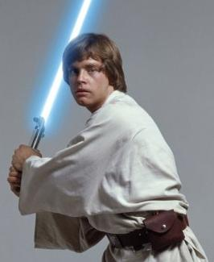
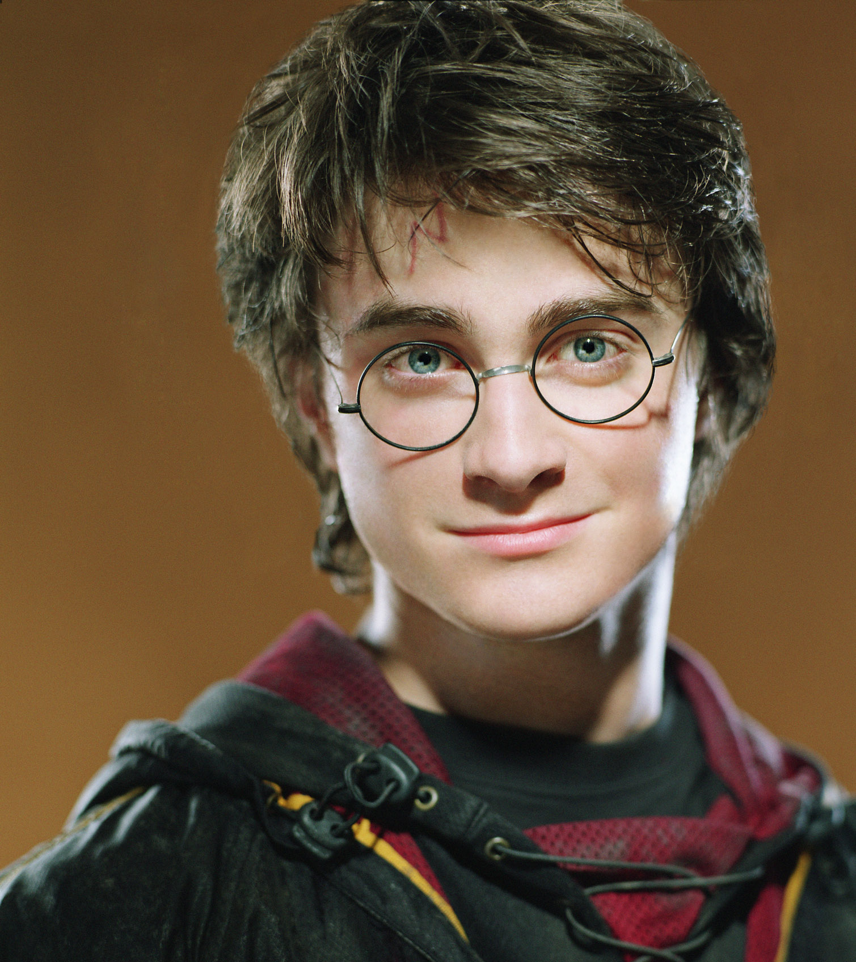
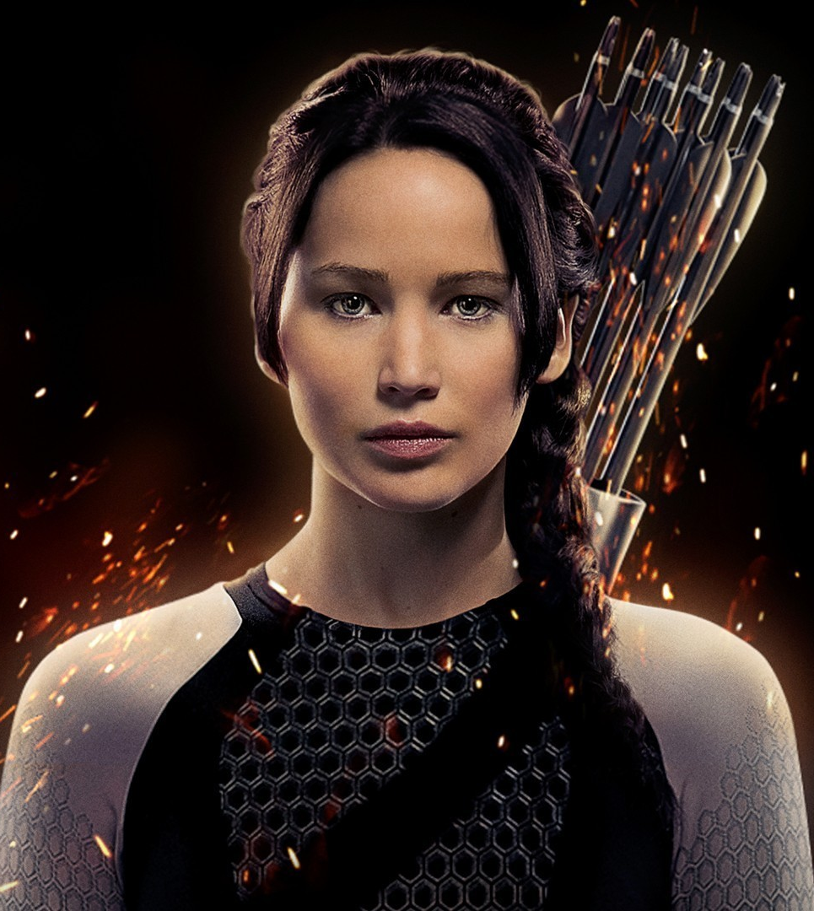
The Hero’s Journey
Writing 6

Slide 2
Stages of “The Hero’s Journey”
Start
The Ordinary World
The Call to Adventure
End
Magic Flight/ Confronting the Father/ Restoring the World
Entering the Unknown
Supreme Ordeal
Supernatural Aid/Meeting with the Mentor/Allies and Helpers
Road of Trials

Slide 3
Video: “What Makes A Hero?”

Slide 4
What is “The Hero’s Journey”?
A storyline used over the course of centuries.
It contains elements from mythology.

Slide 5
What makes a myth?
Myths have repeated elements.

Slide 6
Why do myths matter?
Myths have elements and themes that teach us lessons.

Slide 7
Stage 1: Ordinary World
Heroes live in the ordinary world.
People in the ordinary world think the heroes are odd.
The heroes possess some ability or characteristic that makes them feel out of place.

Slide 8
Stage 2: The Call to Adventure
A hero starts on their heroic path by either:
A discovery
An event
Some danger
Heroes usually come across their quest by accident.

Slide 9
Stage 3: Entering the Unknown
Heroes start their journey in a place they have never been before.
It may be filled with:
Supernatural creatures
Breathtaking sights
Constant threat of death
The unknown world has their own rules.
The hero’s strength and courage is tested by the rules.

Slide 10
Stage 4: Supernatural Aid/Meeting with the Mentor/Allies and Helpers
A character who has mastered the laws of the outside world gives the hero a gift they need to complete their quest.
This gift can include:
Wisdom
Object with magical powers
Every hero needs a helper, or sidekick.

Slide 11
Stage 5: Road of Trials
A series of tests or tasks the hero must go through to begin a transformation.
The hero often fails one or more tests.
These tests make the hero stronger as they prepare for “the final showdown”.

Slide 12
Stage 6: Supreme Ordeal
The obstacle that the hero has journeyed so far to overcome.
“The final showdown”
Once the obstacle is overcome, the worst has passed, and the quest has succeeded.

Slide 13
Stage 7: Magic Flight
The hero returns home.
There may be obstacles on the return home to overcome.
At some point, the hero must escape with the reward such as:
A chase
A battle

Slide 14
Stage 8: Confronting the Father
The hero must confront whatever holds the ultimate power in his or her life.
Many times it is a father figure who has life or death power.
This does not have to be a male, just someone/something with incredible power.

Slide 15
Stage 9: Restoring the World
By achieving victory, the hero has changed or preserved their original world.
The hero often returns with object or ability that allows them to save the world.
The hero has grown in spirit and strength.
Their success allows the hero to return and be a hero in their own world.

