Slide 1
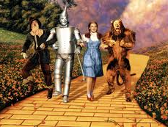
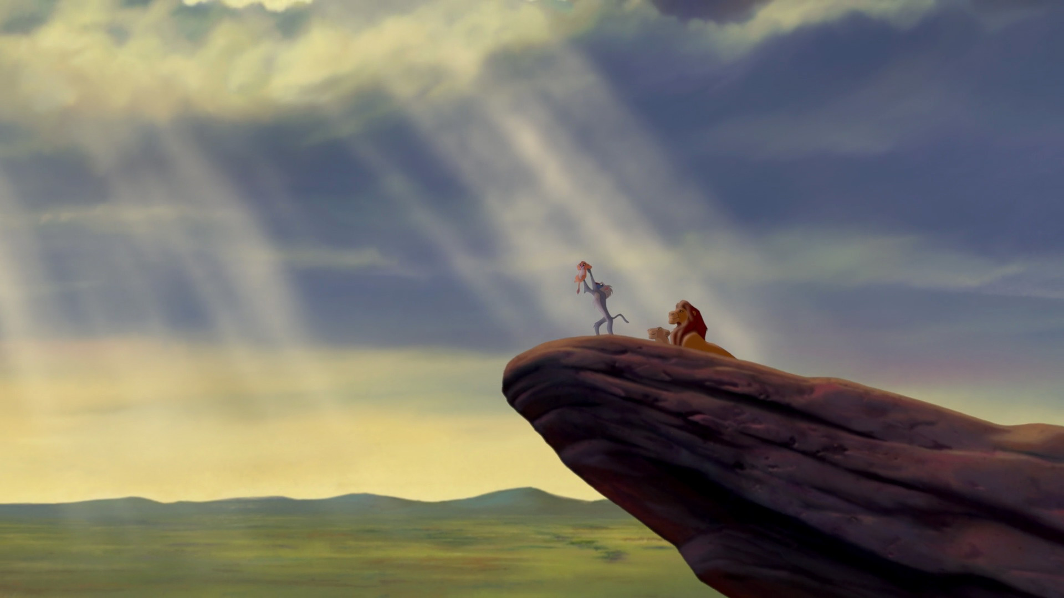
The Hero’s Journey
Miss Gay
6th Grade Writing

Slide 2
Abridged Hero’s Journey
We will be using a shortened or abridged version of the Hero’s Journey archetype.
It has seven steps.
The Ordinary World
The Call to Adventure
Entering the Unknown
Supernatural Aid/ Meeting the Mentor/Allies and Helpers
Road of Trials
Supreme Ordeal
Magic Flight/ Master of Two Worlds/ Restoring the World

Slide 3
Abridged Hero’s Journey
The Ordinary World
The Call to Adventure
Entering the Unknown
Supernatural Aid/ Meeting the Mentor/ Allies and Helpers
Road of Trials
Supreme Ordeal
Magic Flight

Slide 4
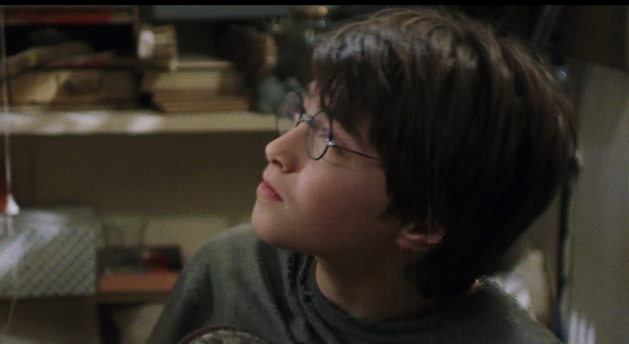
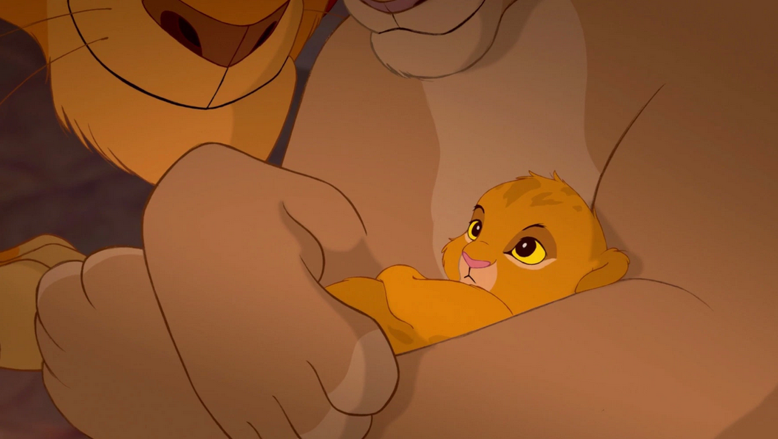
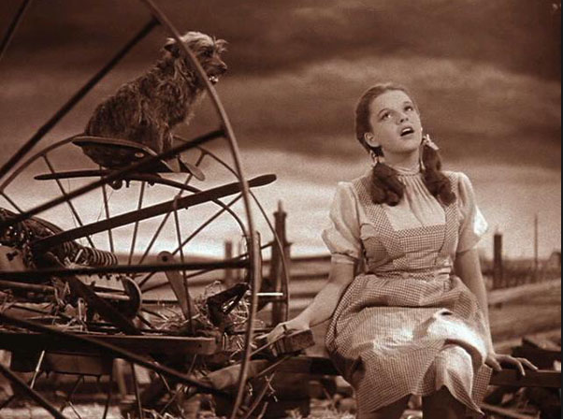
1. The Ordinary World- how and where do we meet our hero?

Slide 5
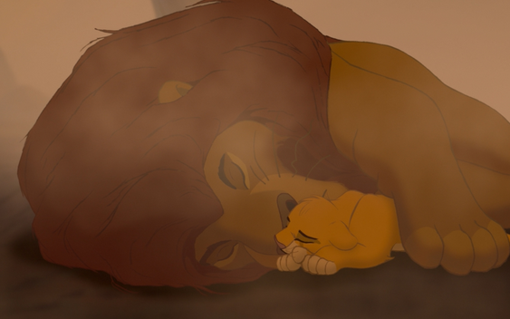
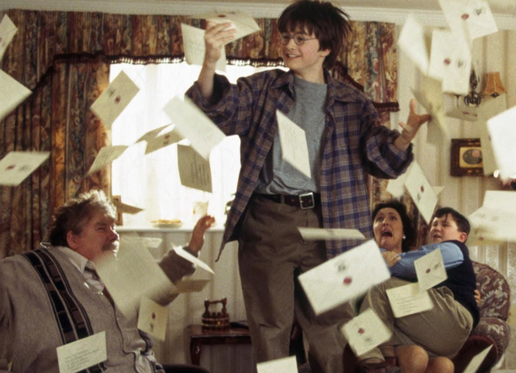
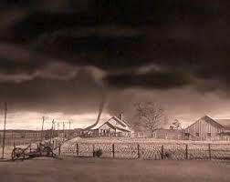
2. The Call to Adventure- What sets your hero on their journey?

Slide 6
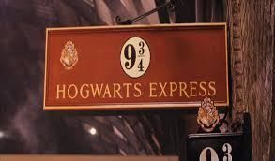
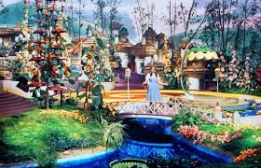
3. Entering the Unknown- What is the new world that your hero enters?

Slide 7
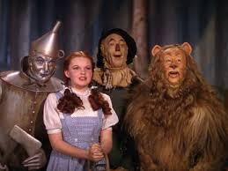
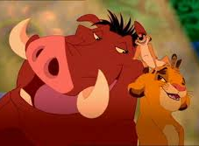
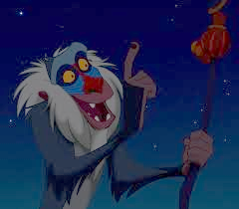
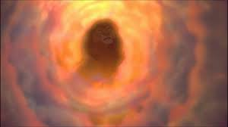
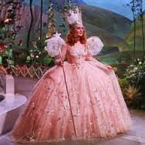
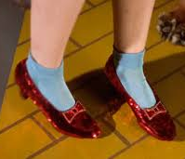
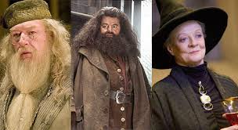
4. Supernatural Aid/ Meeting the Mentor/ Allies and Helpers- Who is helping your hero on their journey?

Slide 8
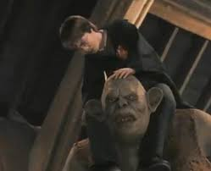
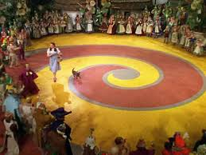
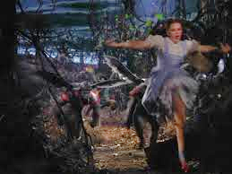
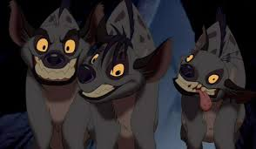
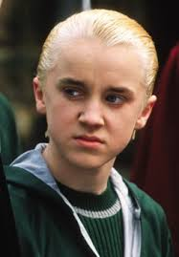
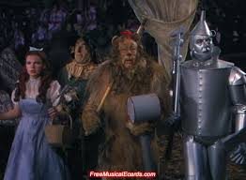
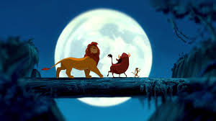
5. Road of Trials- What obstacles does your hero face?

Slide 9
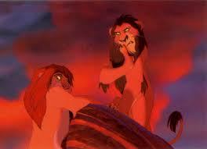
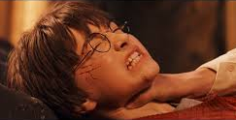
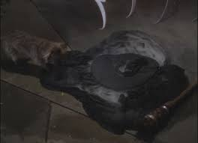
6. Supreme Ordeal- What is the climax of your Hero’s Journey?

Slide 10
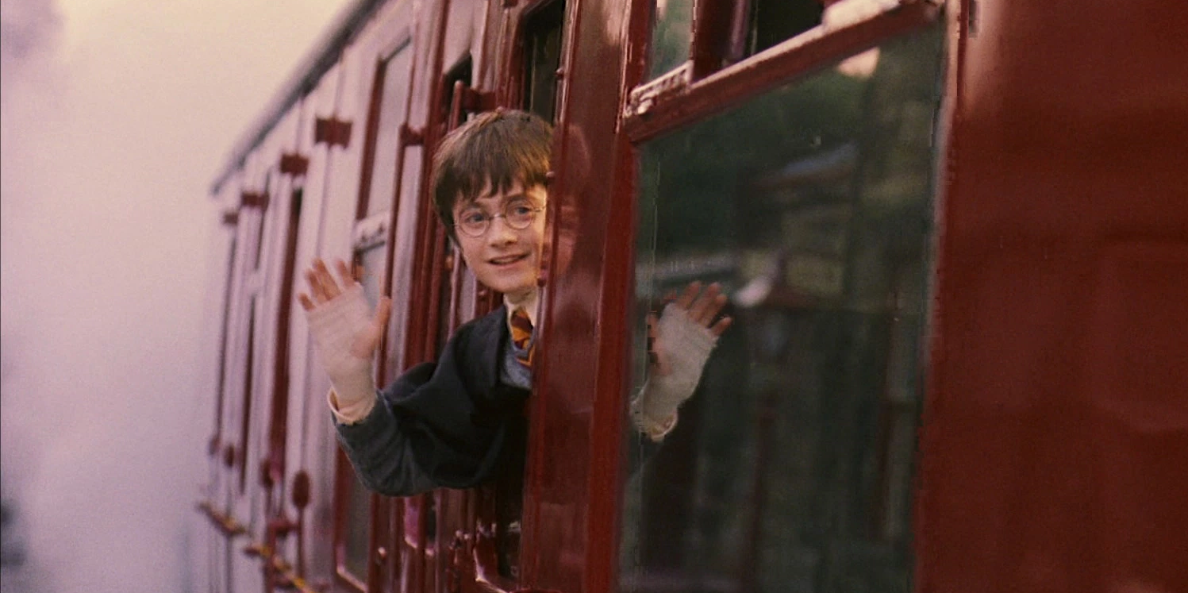
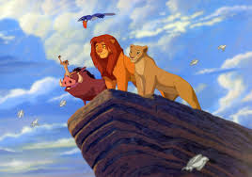
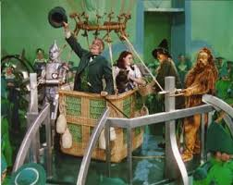
7. Magic Flight/ Master of Two Worlds/ Restoring the World- How does your hero get home? How has he or she changed?

