Slide 1
Holy See
By Corey Field and Jaxson Warboys

Slide 2
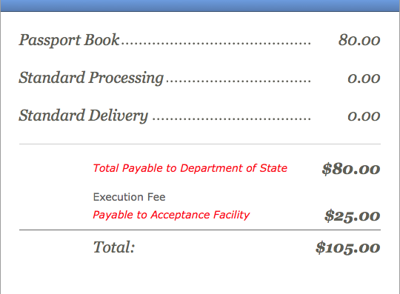
Passport costs
This is how much it costs to buy a U.S Passport book. If you buy a passport card it is $40 but you can’t go anywhere but Canada, Mexico, Bermuda, and the Caribbean.

Slide 3
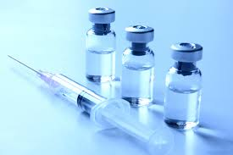
Vaccinations
When you go to Holy See, you must get certain vaccinations. You must get measles-mumps-rubella vaccine, diphtheria-tetanus-pertussis vaccine, chickenpox vaccine, polio, and a yearly flu shot. Other people also have to get hepatitis A shot, hepatitis B shot, and a rabies shot.

Slide 4
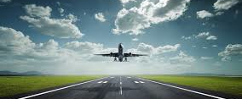
Airline Information
When you fly to Holy See it takes about 16 hours and 55 minutes from Buffalo New York to Rome. It would take more than 17 hours because it is about a hour and a half to Buffalo from Scio and 20 minutes from Rome to Holy See. So it is an estimated 19 hours.

Slide 5
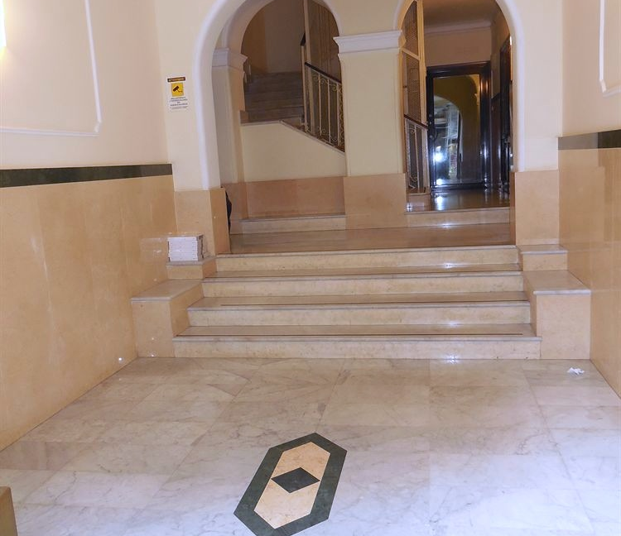
Hotels
(Cheapest Price)
This hotel is $29 for one night. And it is $522 for eighteen nights. It is a 1 star hotel. The hotel Cressy has a 3.7 service satisfaction.

Slide 6
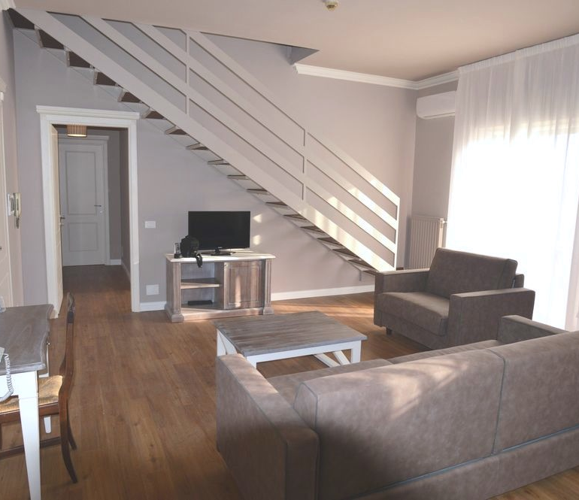
Hotels
(Reasonable price)
This hotels is in Rome which is near Holy See. It is a three star hotel that is $46 a night. If you stay for 18 days it is $828. The service at the Hotel La Genziana is a satisfaction of 4.2 out of 5.

Slide 7
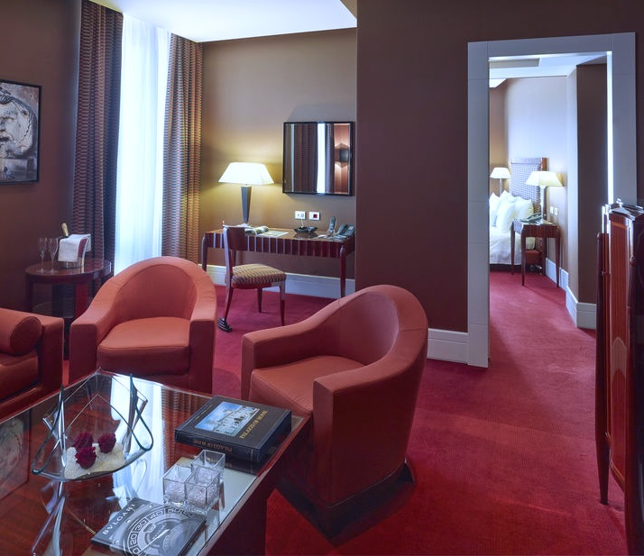
Hotels
(Highest Price)
This hotel is in Rome and is a five star hotel. It is $424 a night so for 18 nights it is $7,632. The Grand Hotel Via Veneto has a 4.4 out of five service satisfaction.

Slide 8
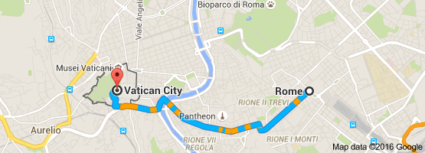
Driving
Because there was no direct flight to Holy See or Vatican City we flew to Rome. If you fly to Rome you can take a cab to drive there because it is only 20 minutes. The cost to take the cab is 30 euros or 34.16 U.S dollars.

