Slide 1
Come to My Mkutano
Lily Babbitt

Slide 2
Invites
Maximum amount of people-10 (people on high honor role in the sixth grade) Lia Kopsaftis, and Kaylee Elliott
Starts at 5:00pm
Takes place at my house
Wear Kenyan inspired outfits
Food will be provided
All decorations will be Kenyan styled

Slide 3
Menu
Beverages
Bottled water
Chai
Appetizers
Sukuma Wiki
Masala Chips
Entrees
Kenyan Stew
Wali wa Nazi
Desserts
Mandazi

Slide 4
Shopping List
The following slides will be about my shopping list that I need to make all of my dishes.

Slide 5
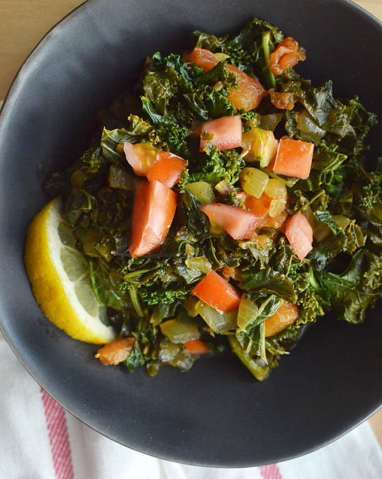
Sukuma Wiki
Kale
Tomatoes
Onion
Peanut Oil
Cumin
Coriander
Turmeric
Kosher Salt
Ground Black Pepper
Lemon Juice

Slide 6
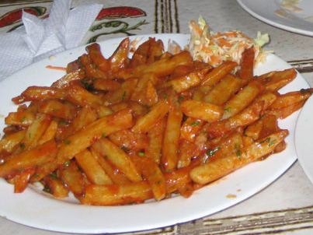
Masala Chips
Potatoes
Oil
Butter/Margarine
Spanish Paprika
Cayenne Pepper/Chili Powder
Garlic Paste
Tomato Paste
Tomato Sauce
Turmeric
Garam Masala
Coriander
Salt
Lemon

Slide 7
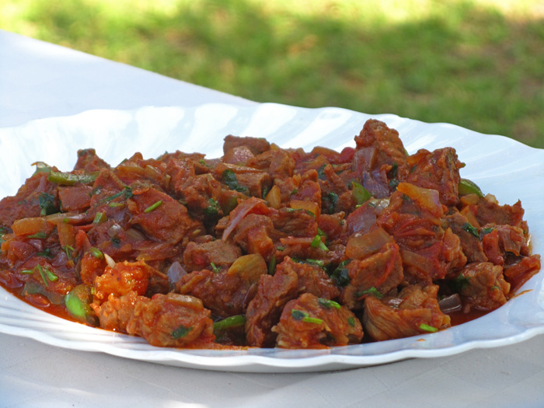
Kenyan Stew
Beef Cubed
Olive Oil
Onion
Curry Powder Mix
Diced/Crushed Tomatoes
Cilantro
Salt and Pepper

Slide 8
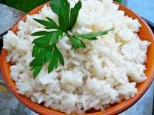
Wali wa Nazi
Rice
Coconut Milk
Salt

Slide 9
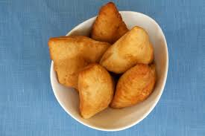
Mandazi
Water
Baking Powder
All Purpose Flour
Sugar
Cardamom
Butter
Milk
Egg
Salt
Oil

Slide 10
These ingredients I will get at Giant Food Mart

